Slide 1
Behavior Data Analysis

Slide 2
Session Plots for Baseline Animals for Alcohol
Checks for Vulnerable and Resilient

Slide 3
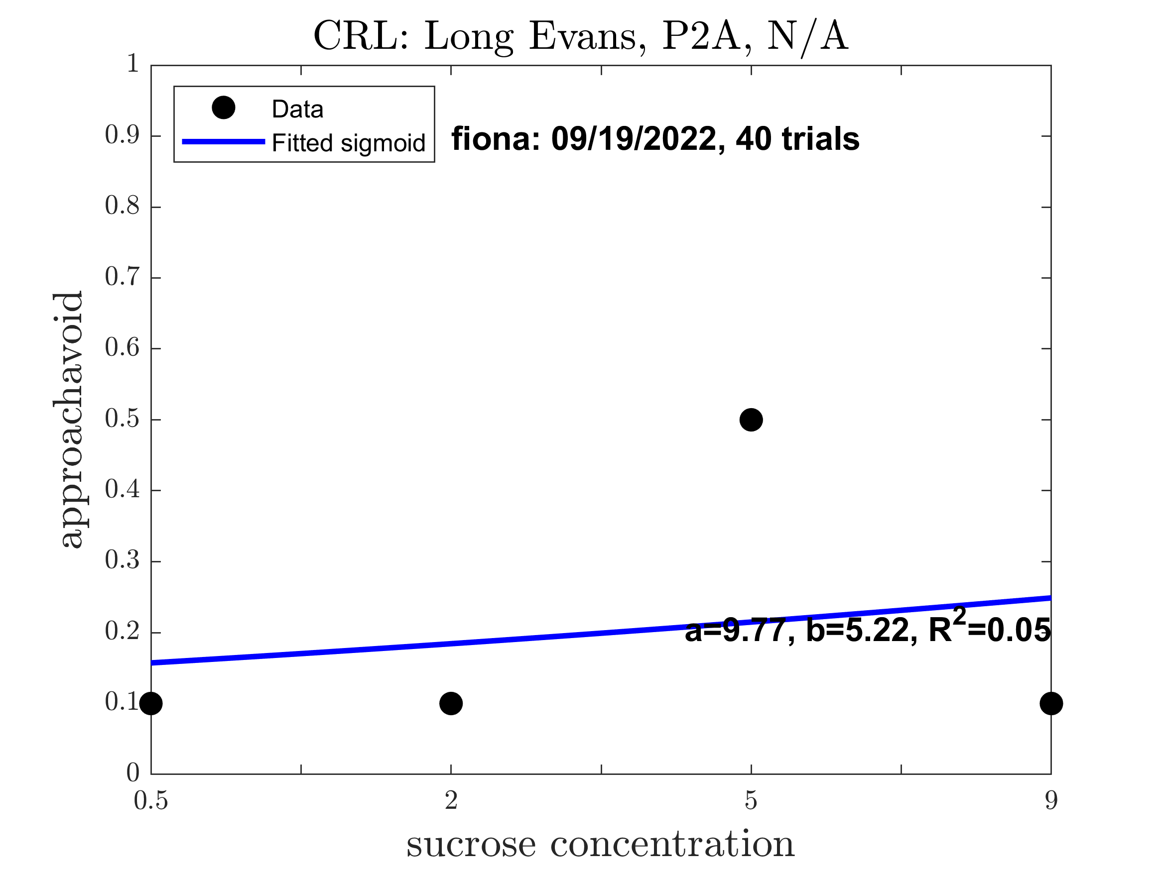
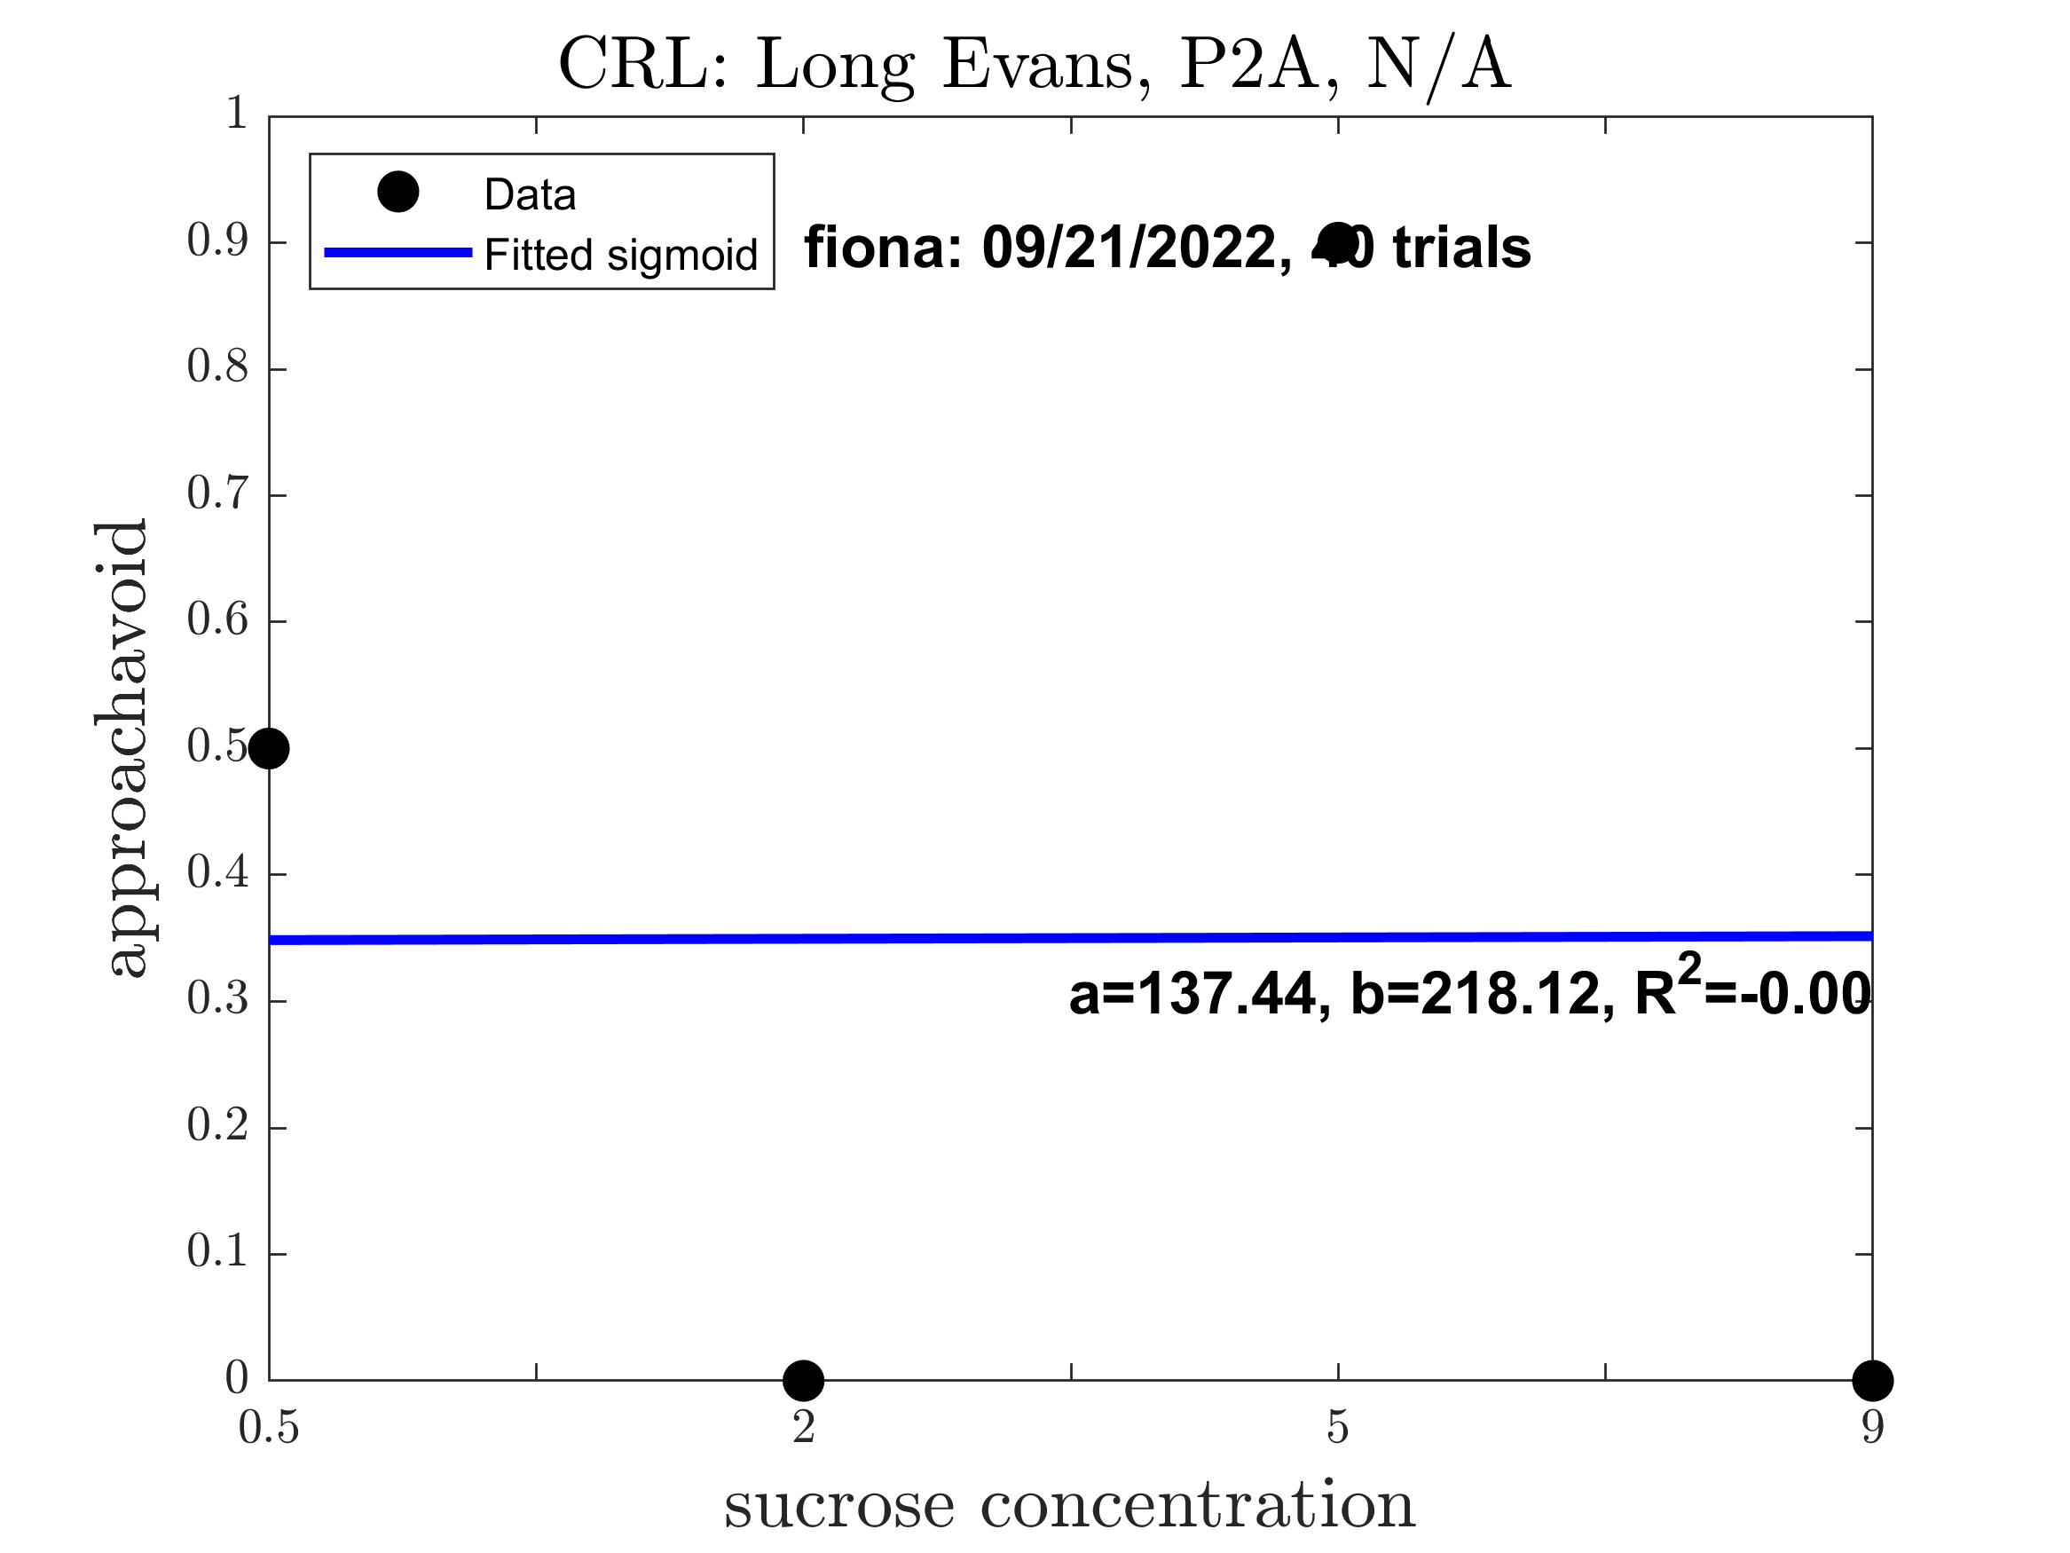
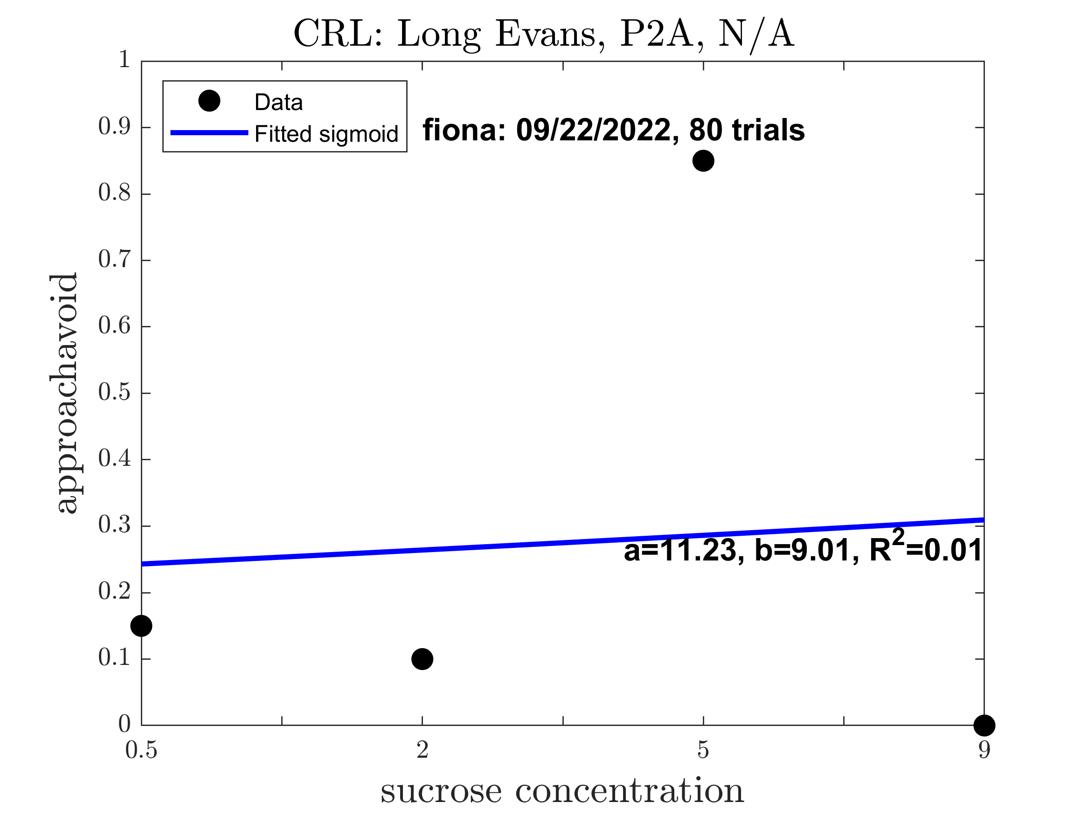
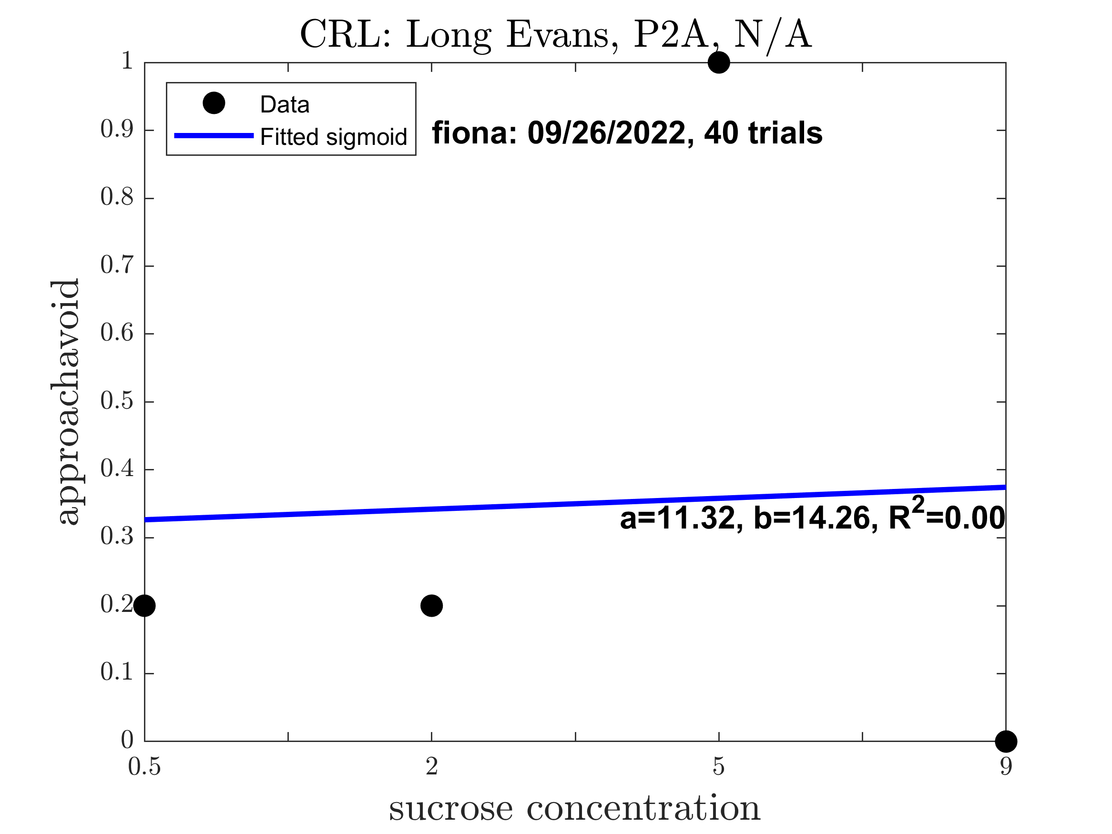
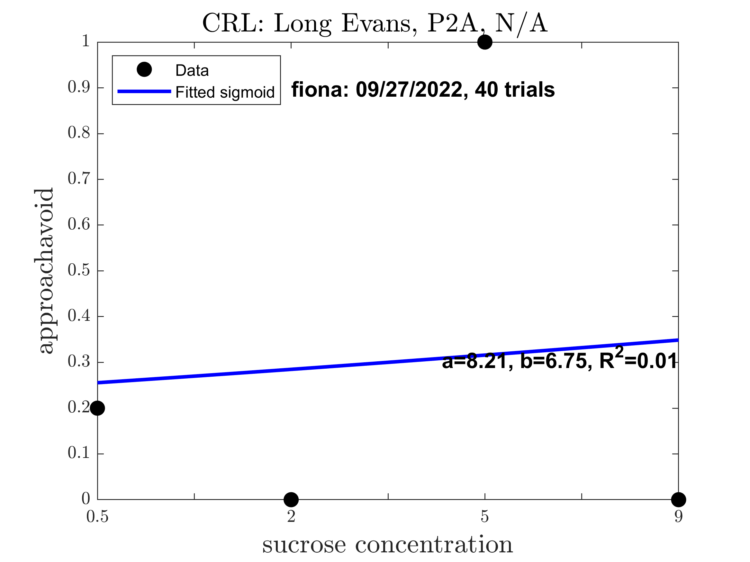
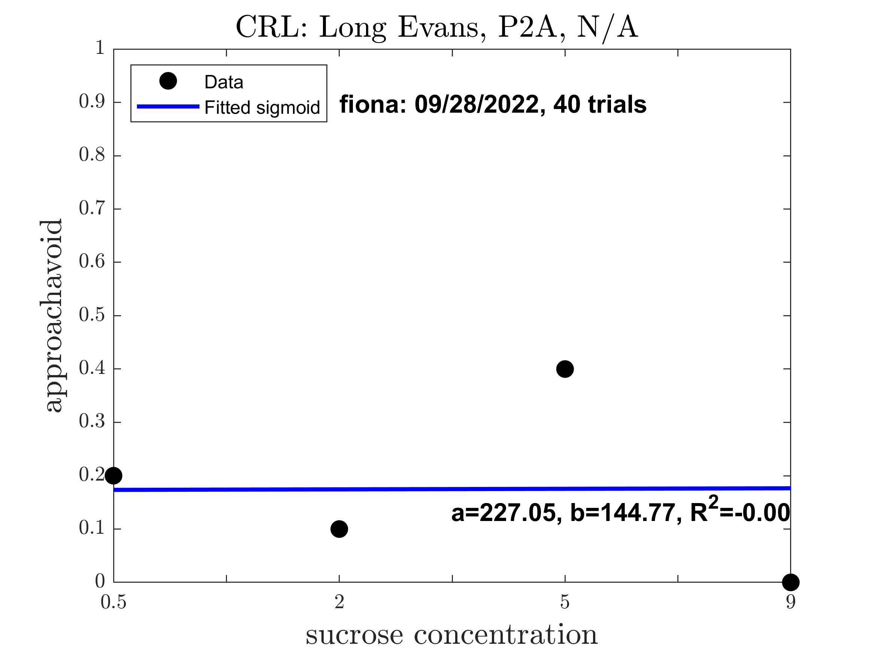
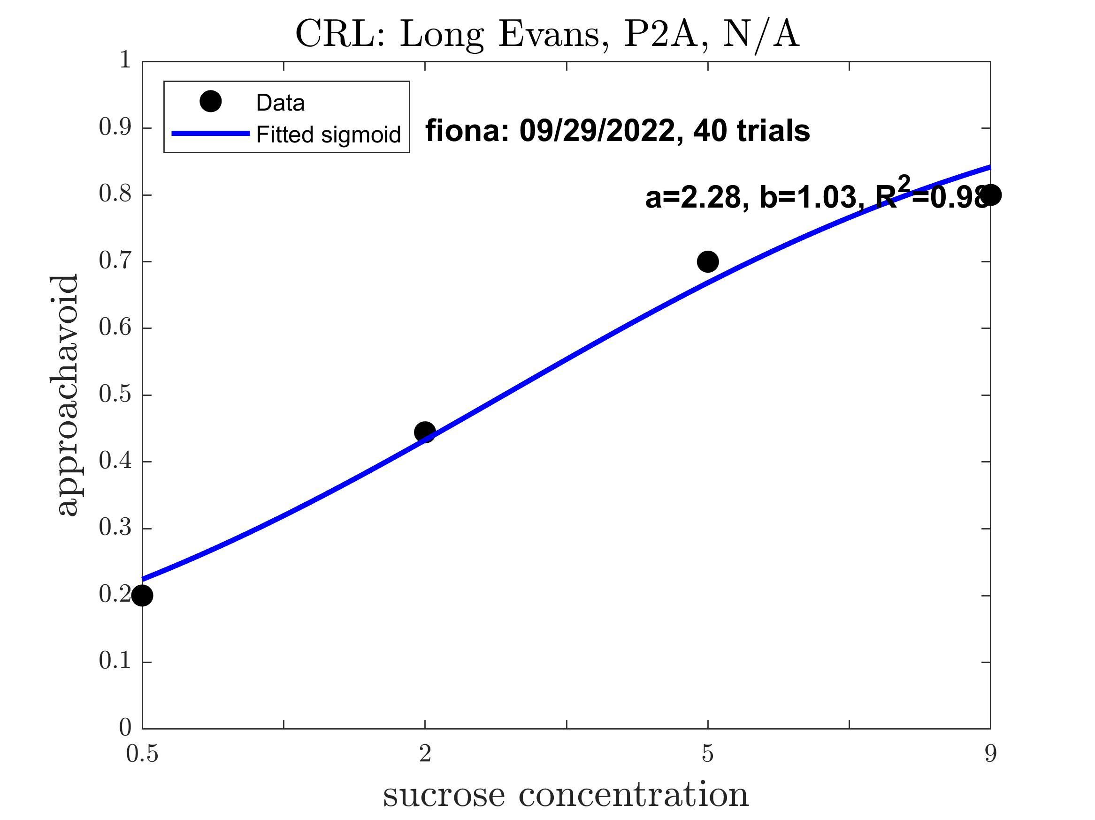
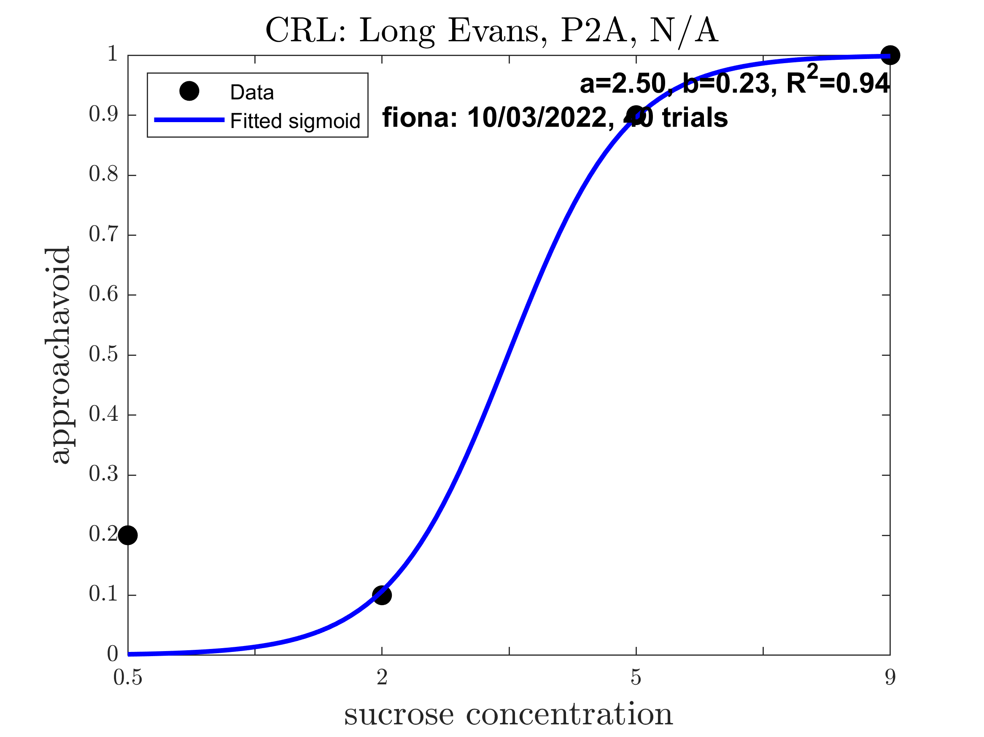
Fiona: Pre alcohol (Good Sigmoid: 0.2500)

Slide 4
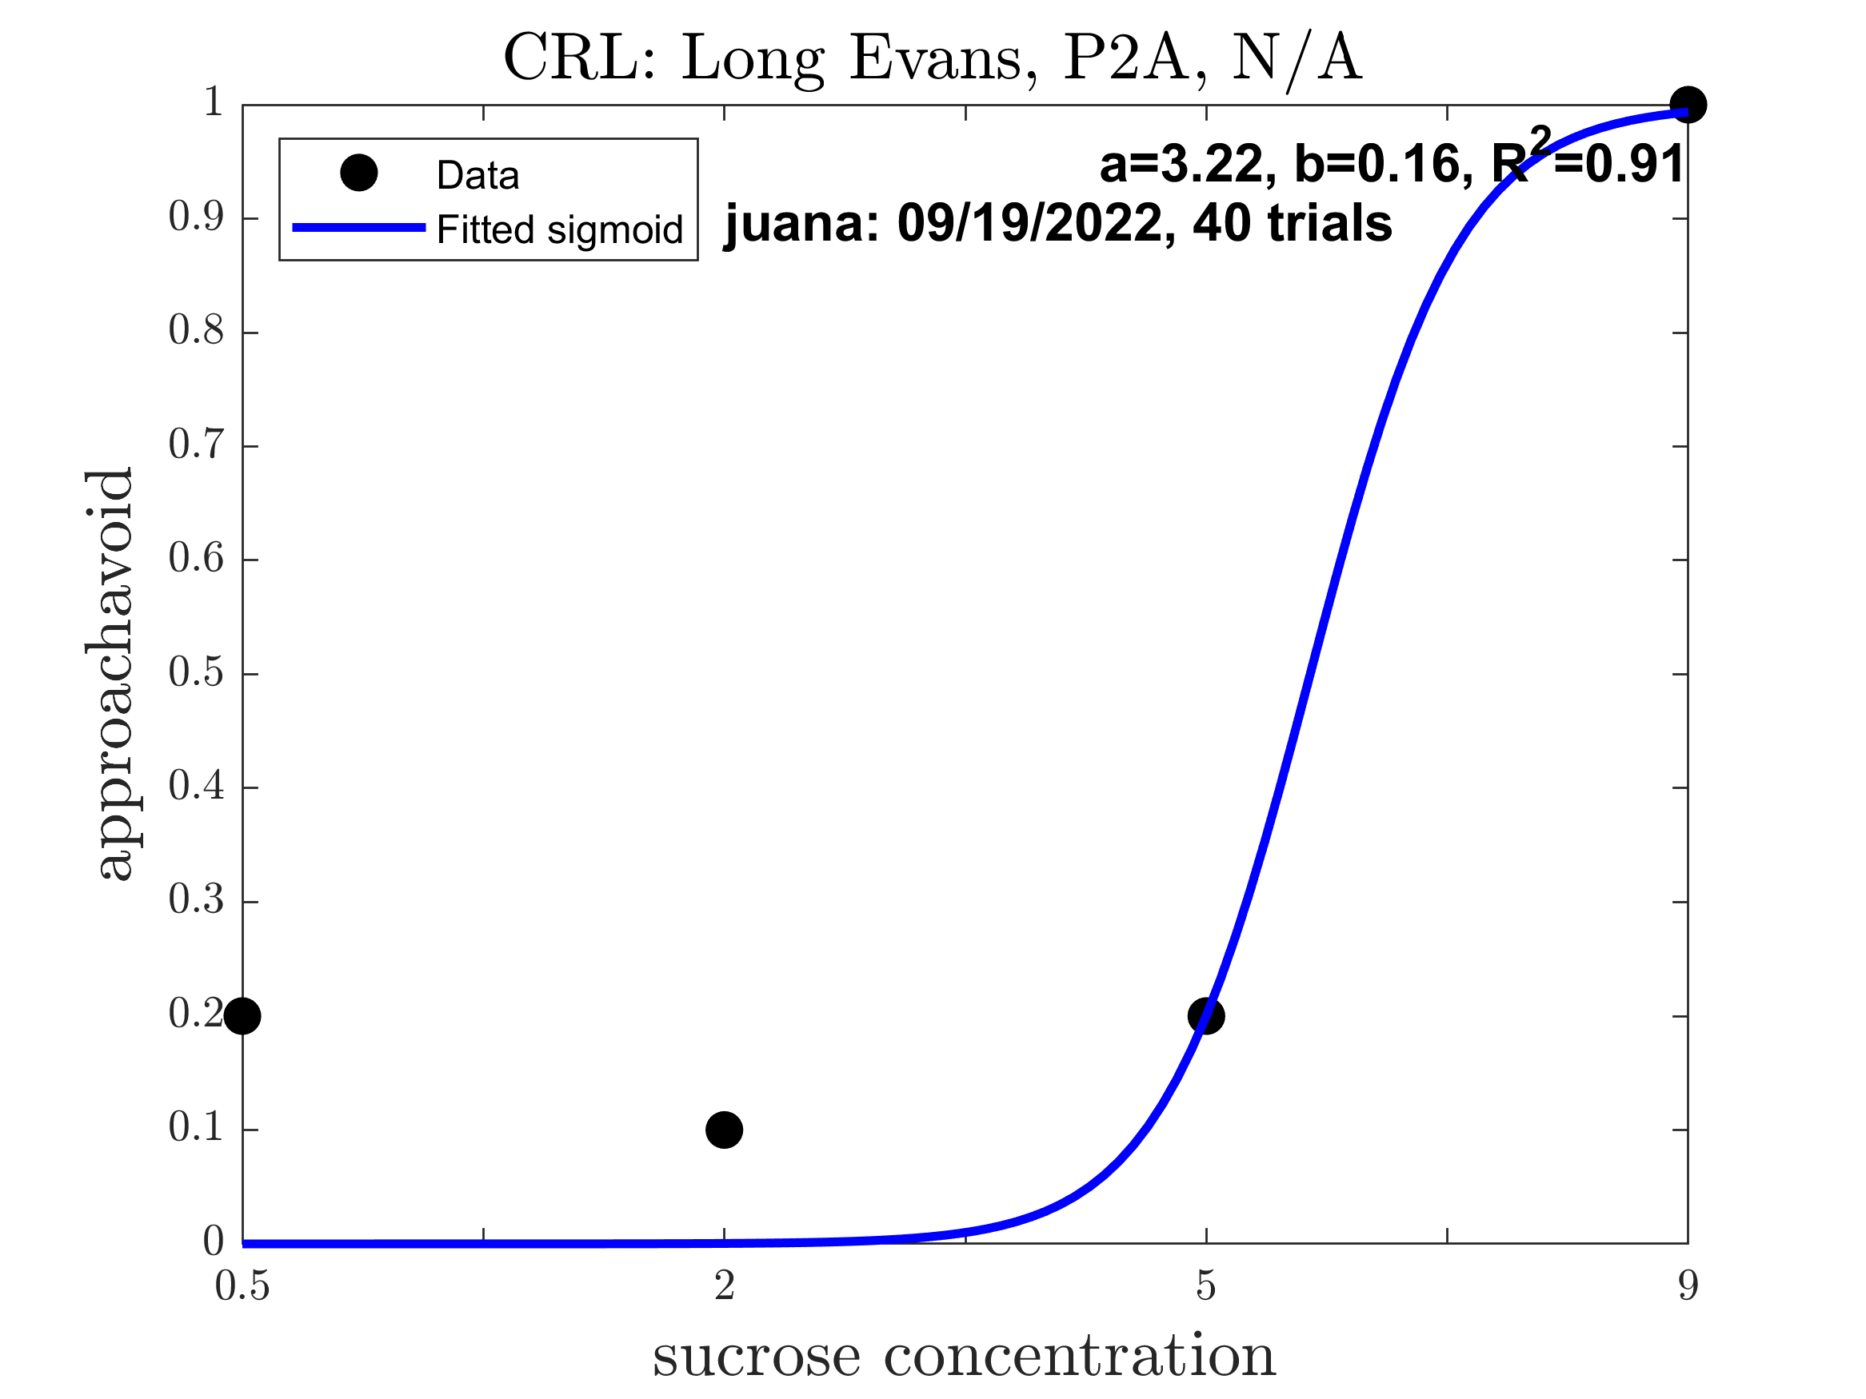
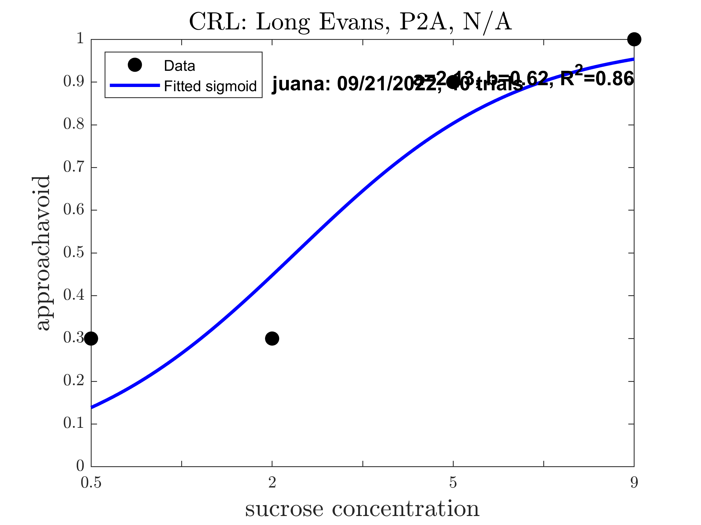
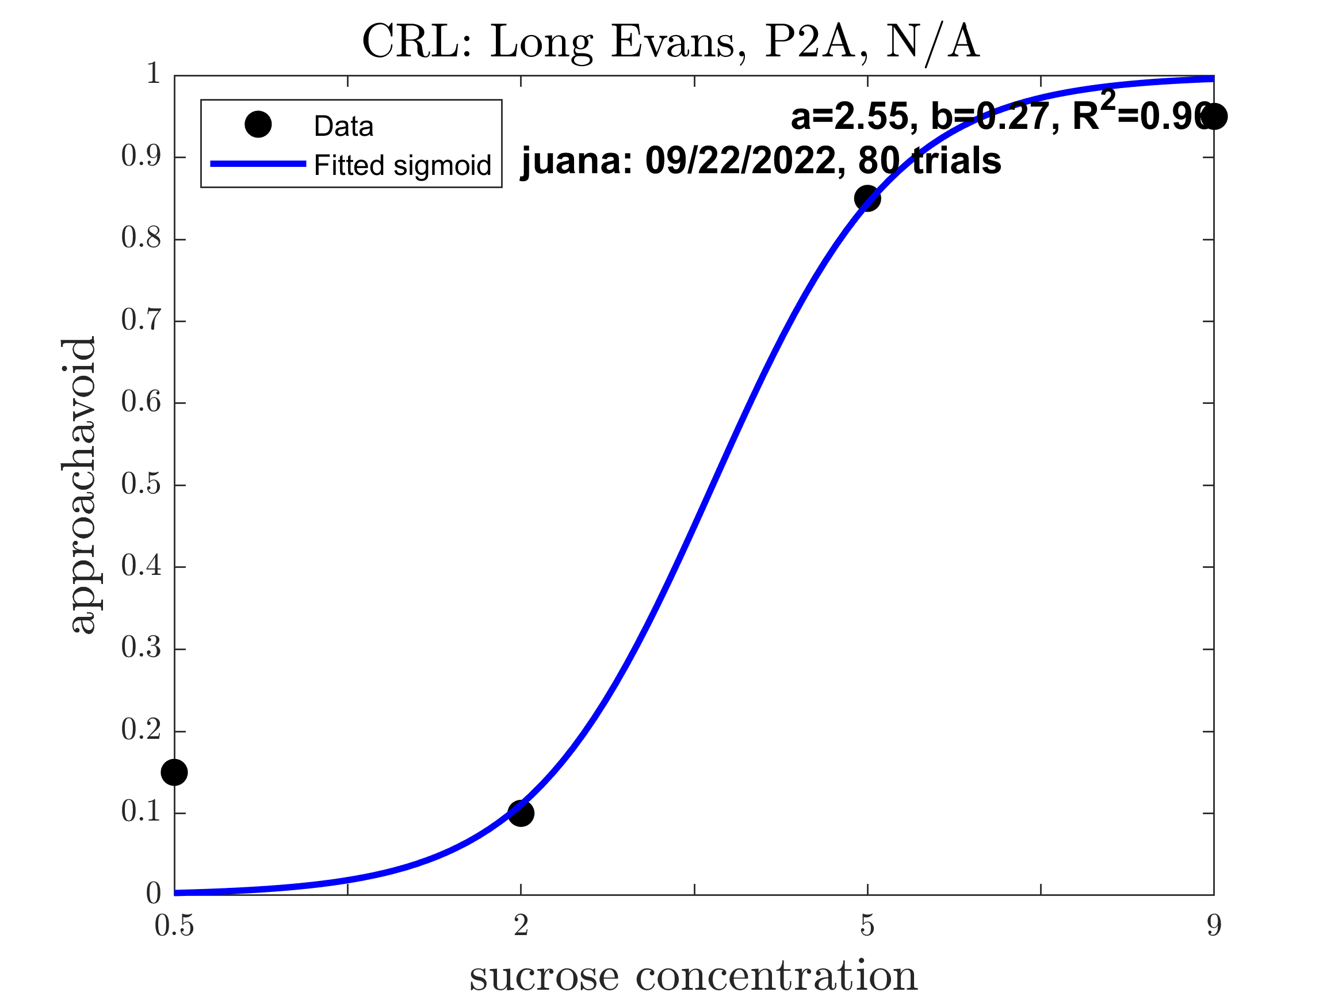
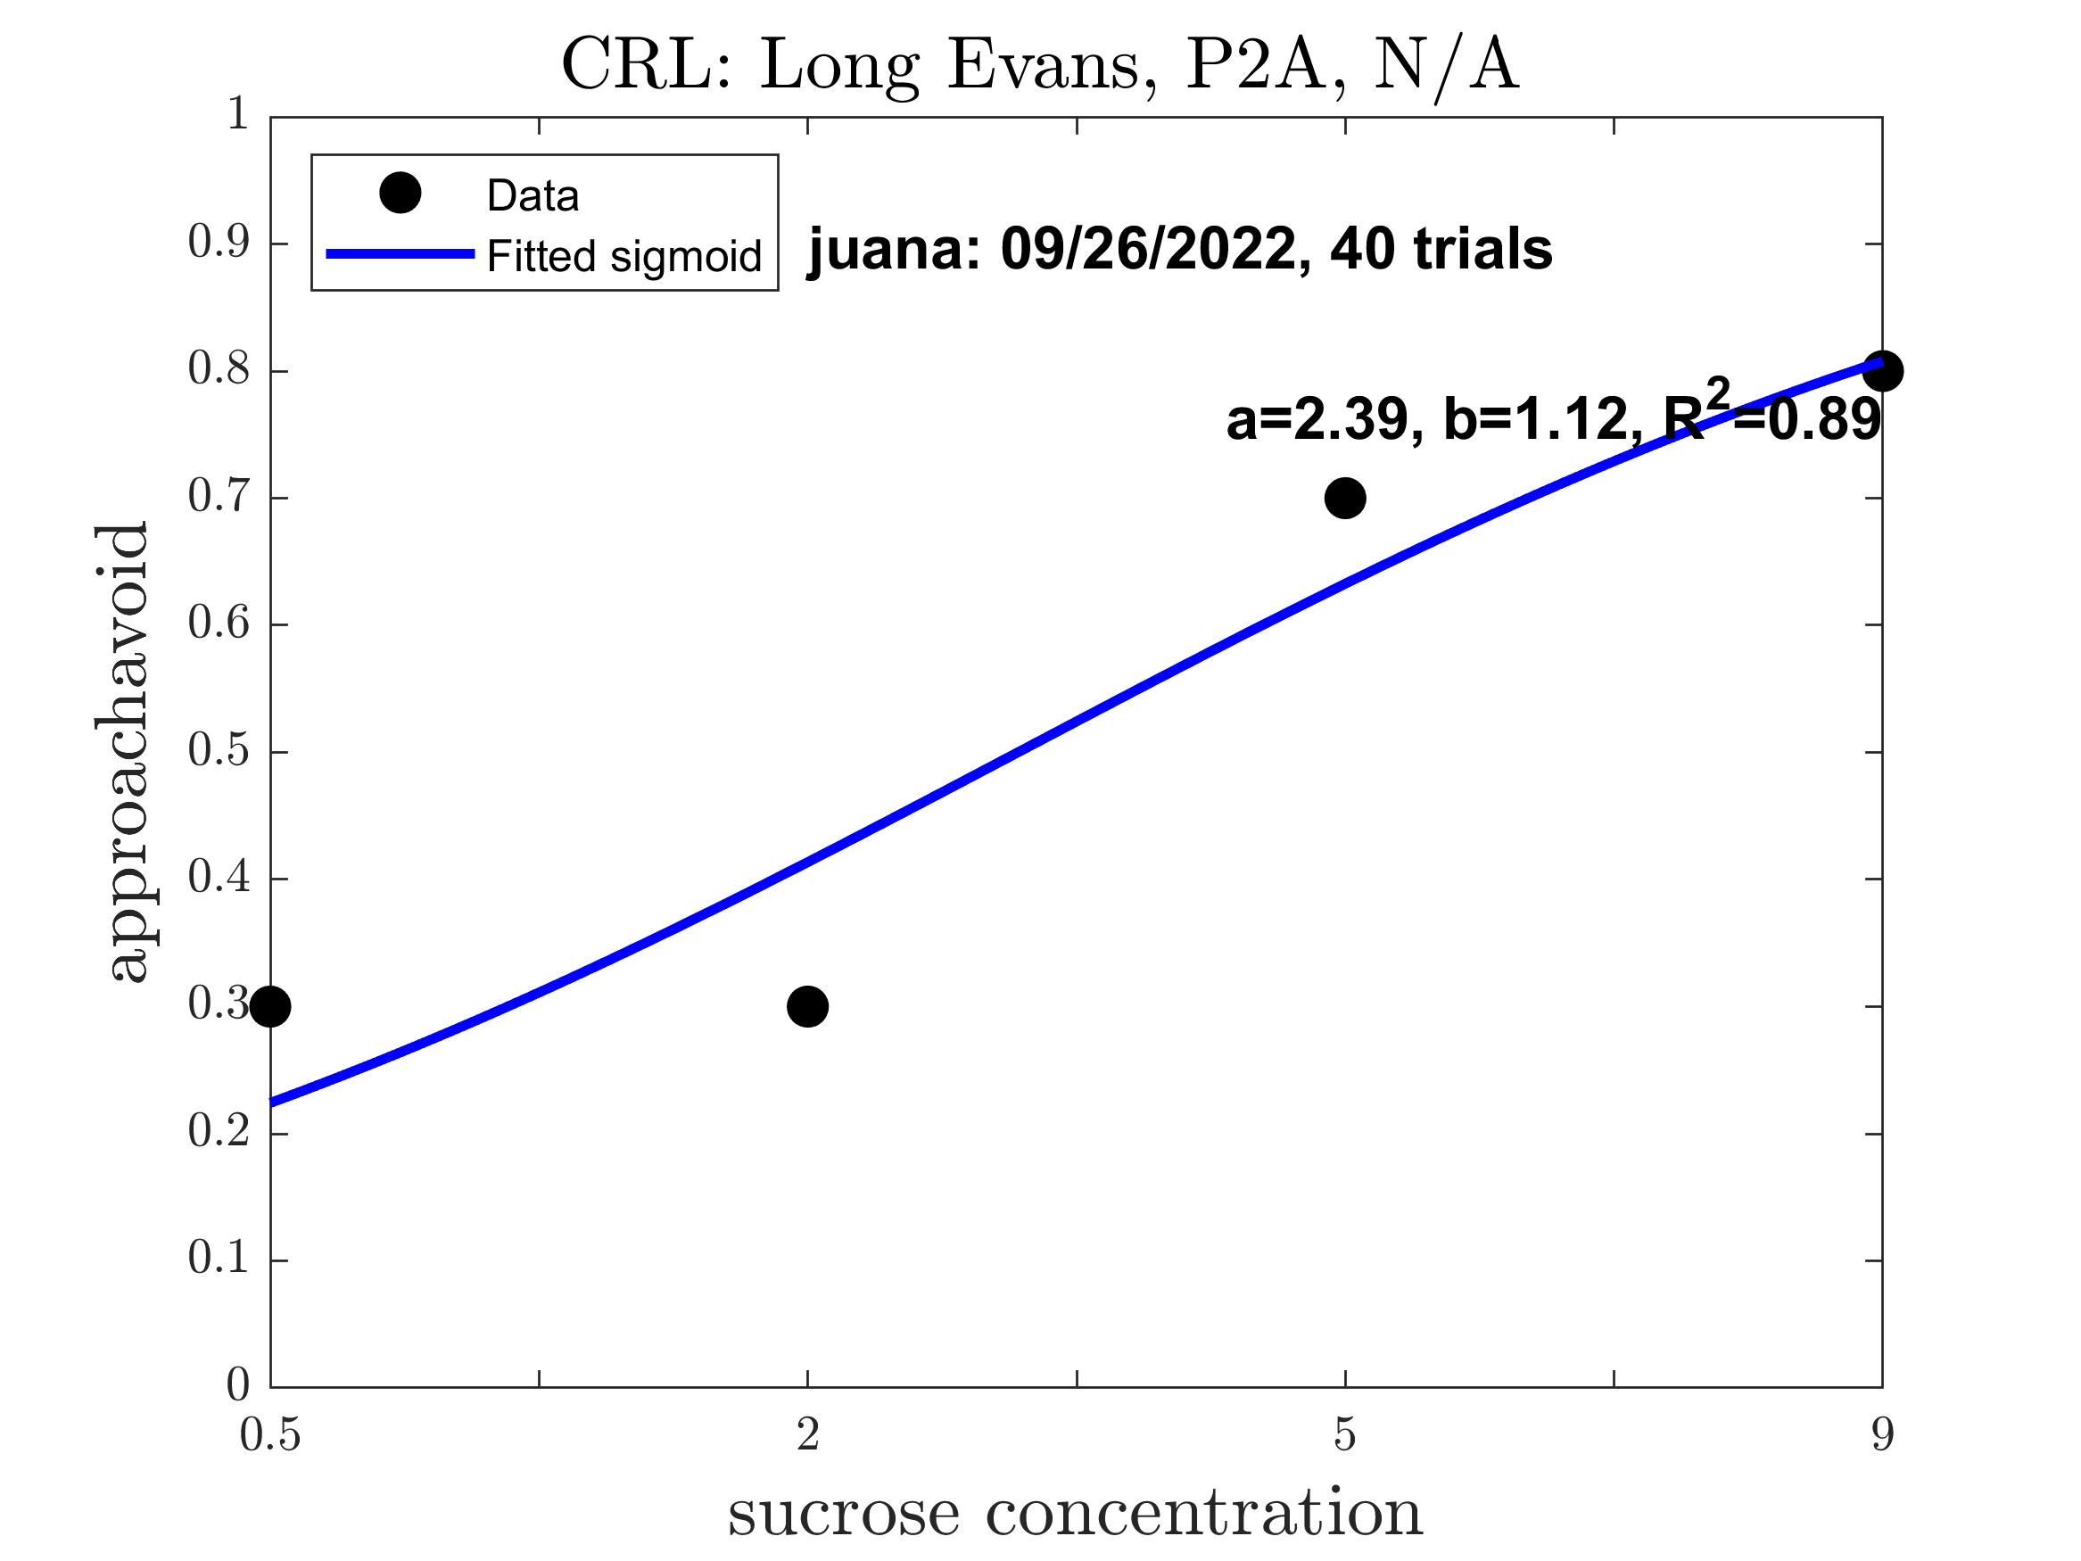
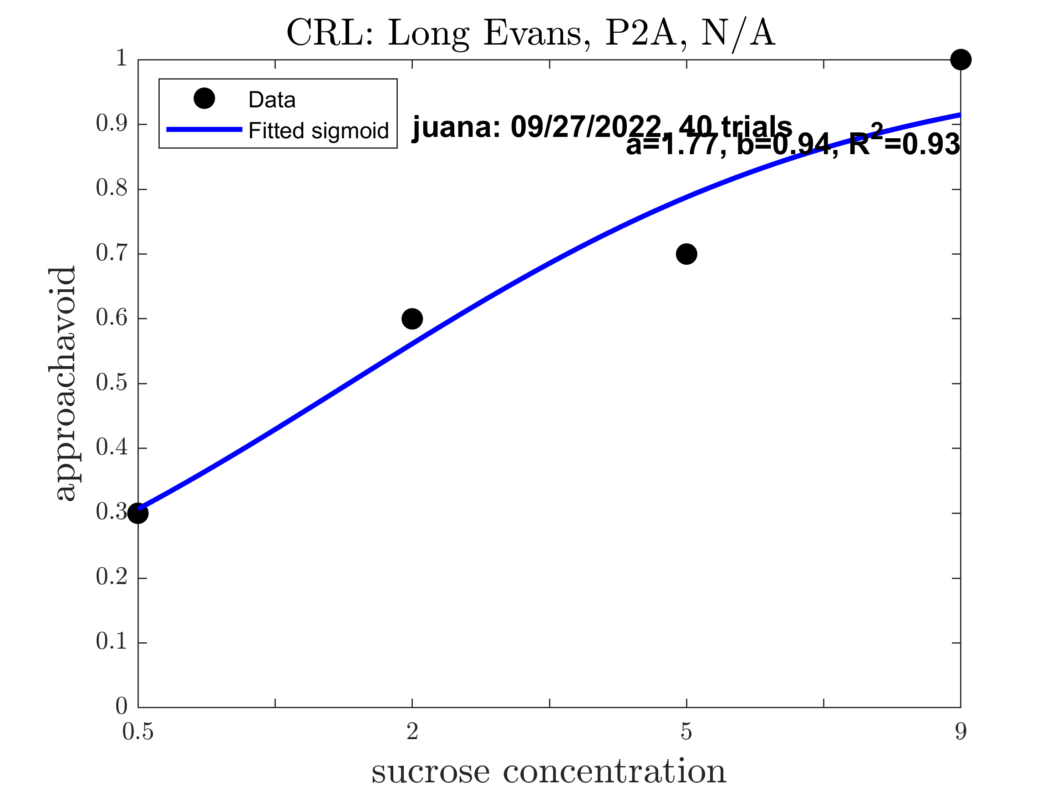
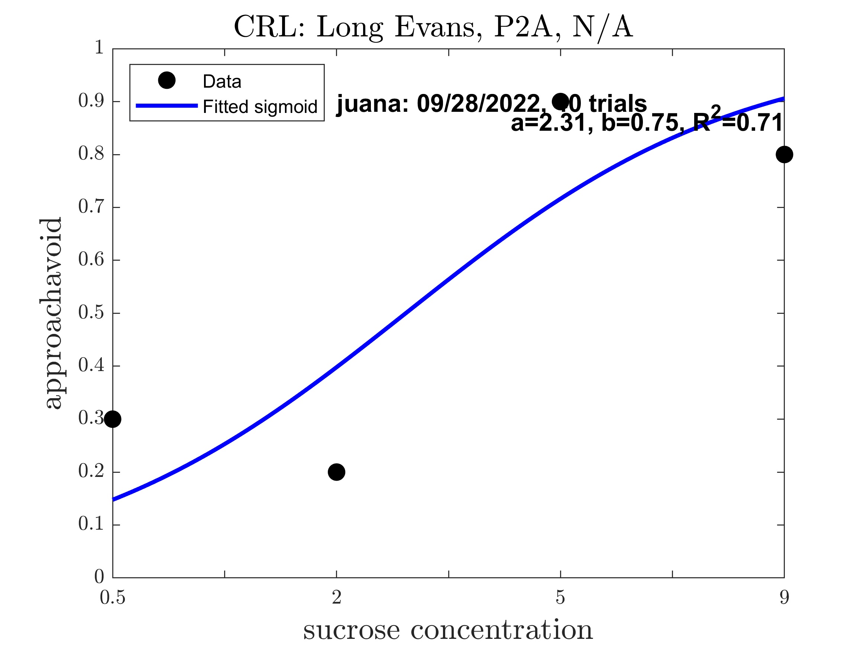
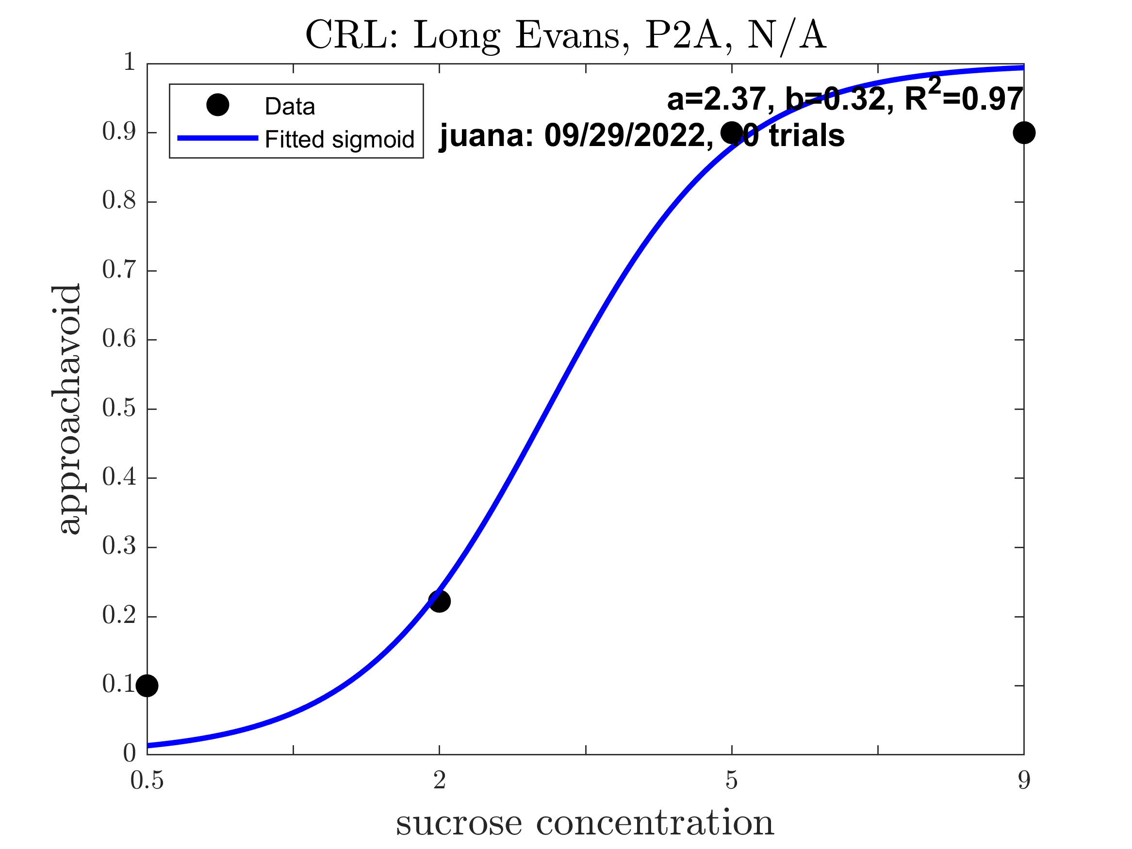
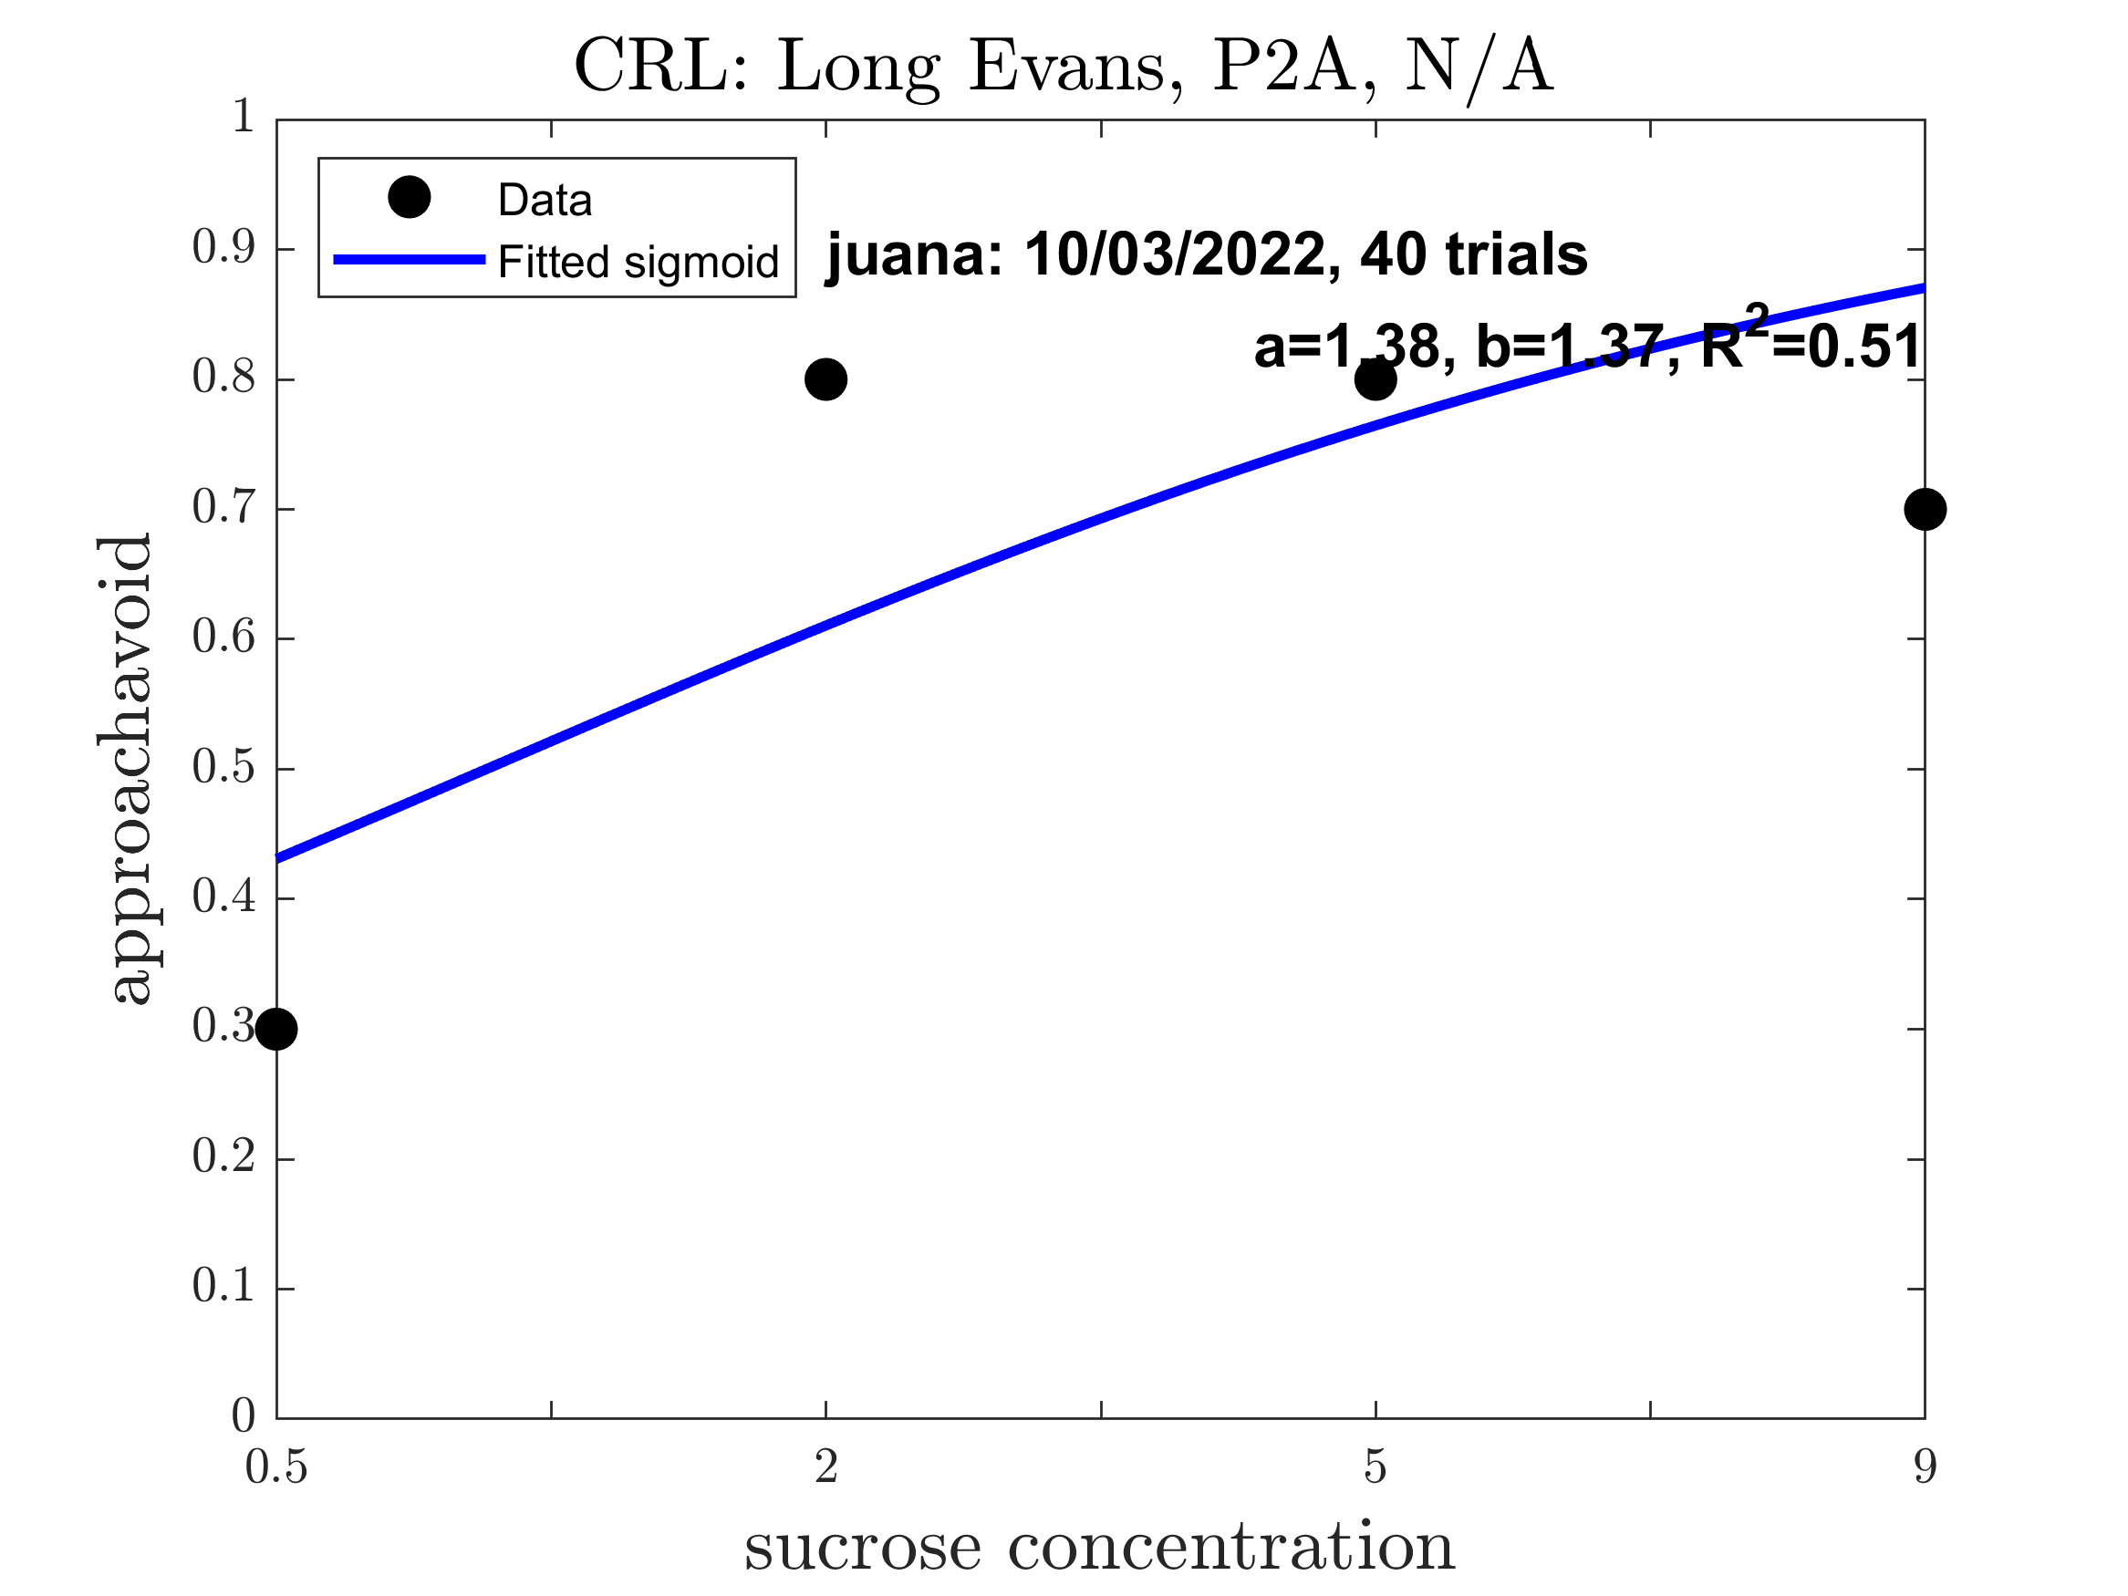
Juana: Pre alcohol (Good Sigmoid: 1.00)

Slide 5
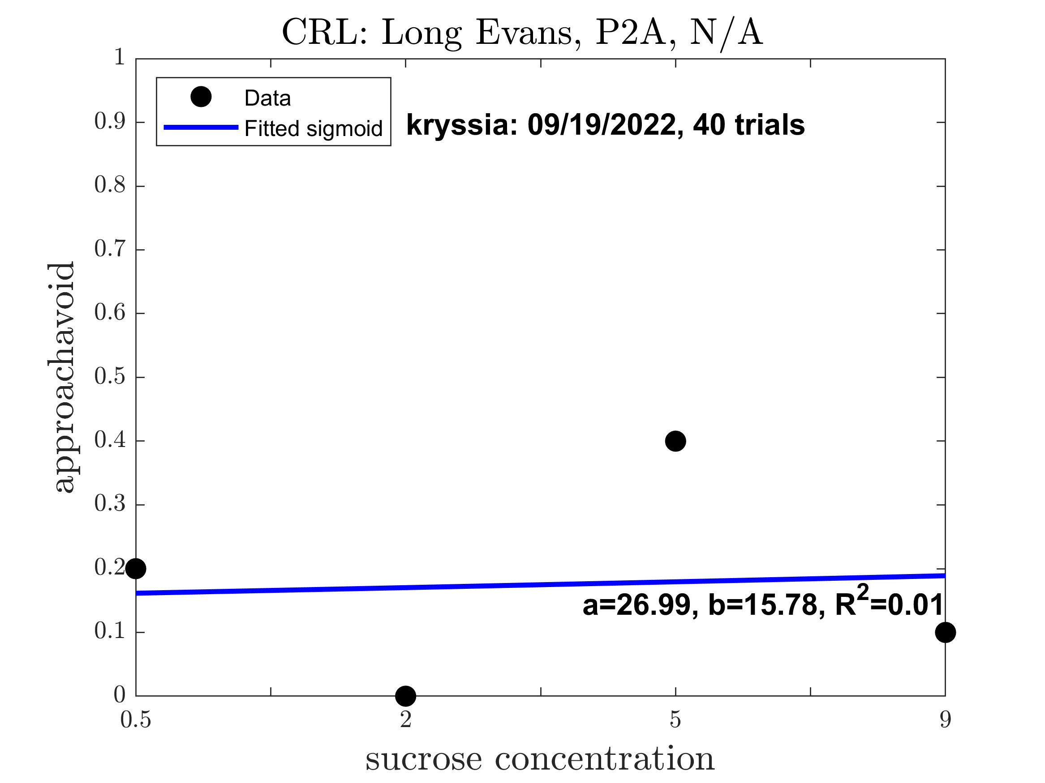
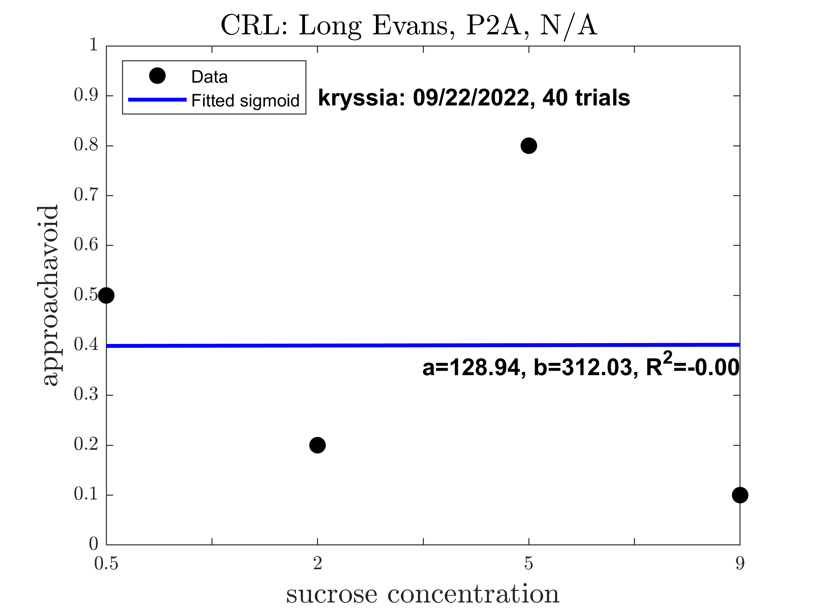
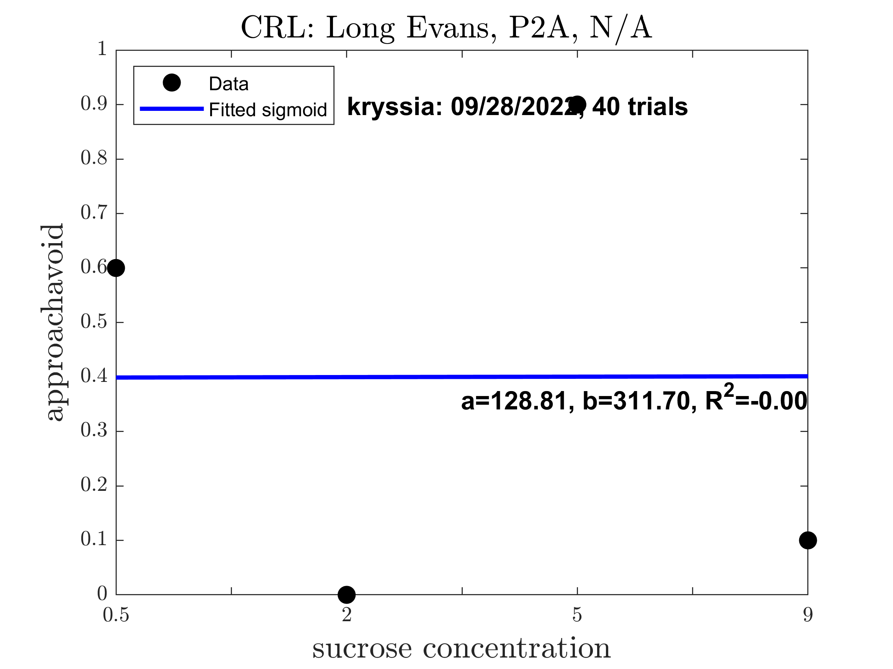
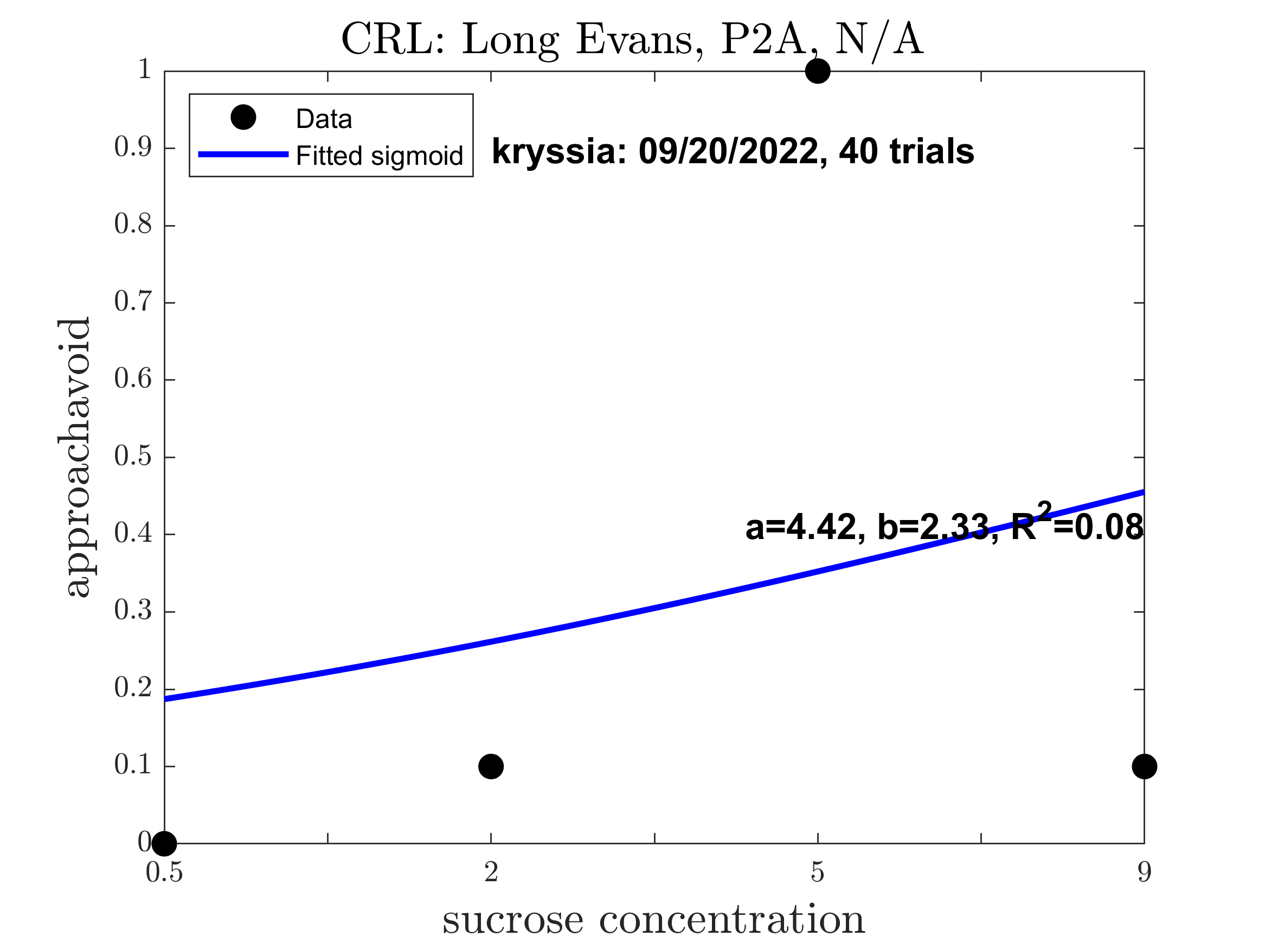
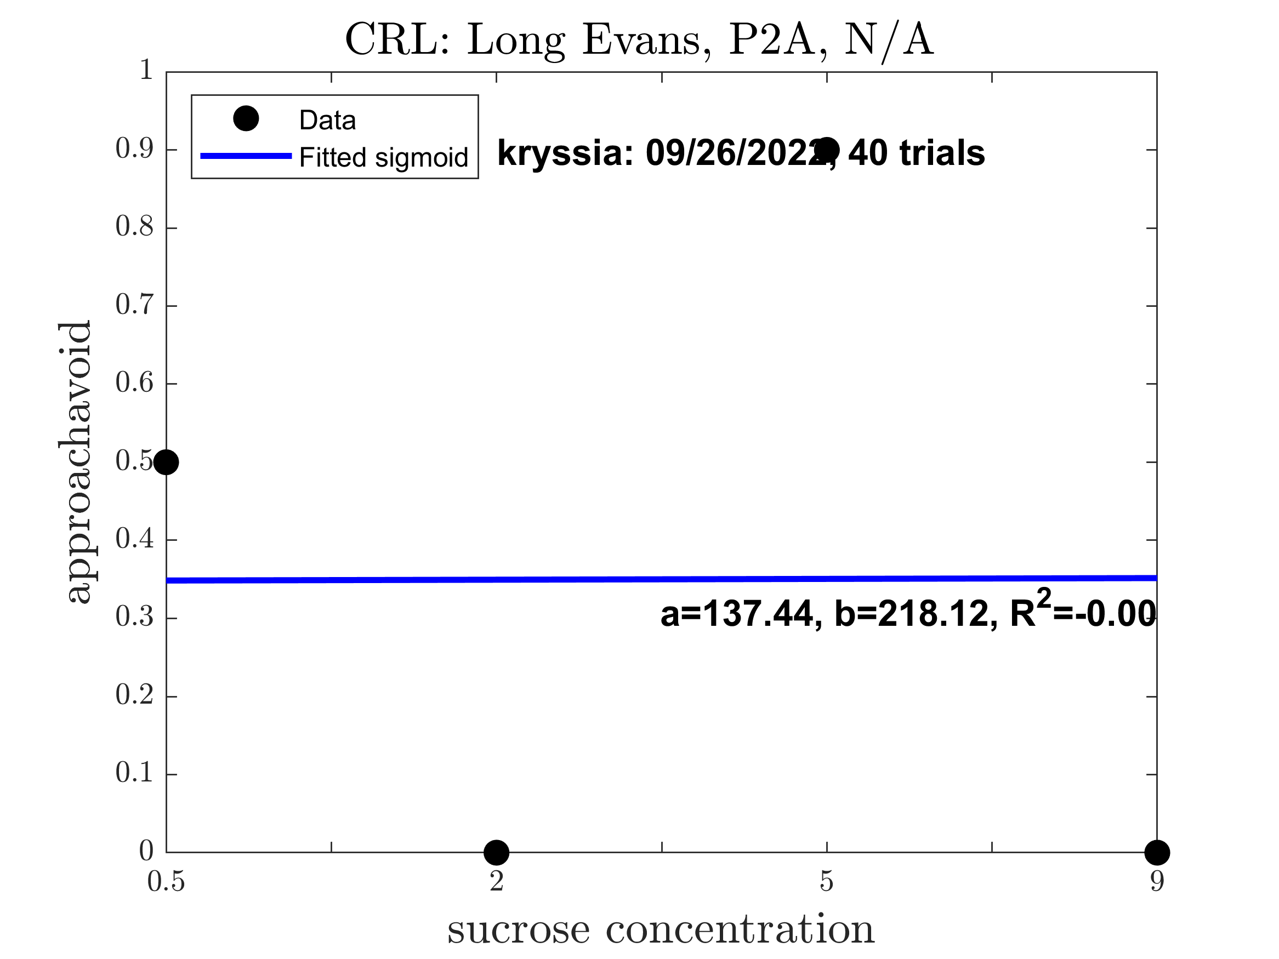
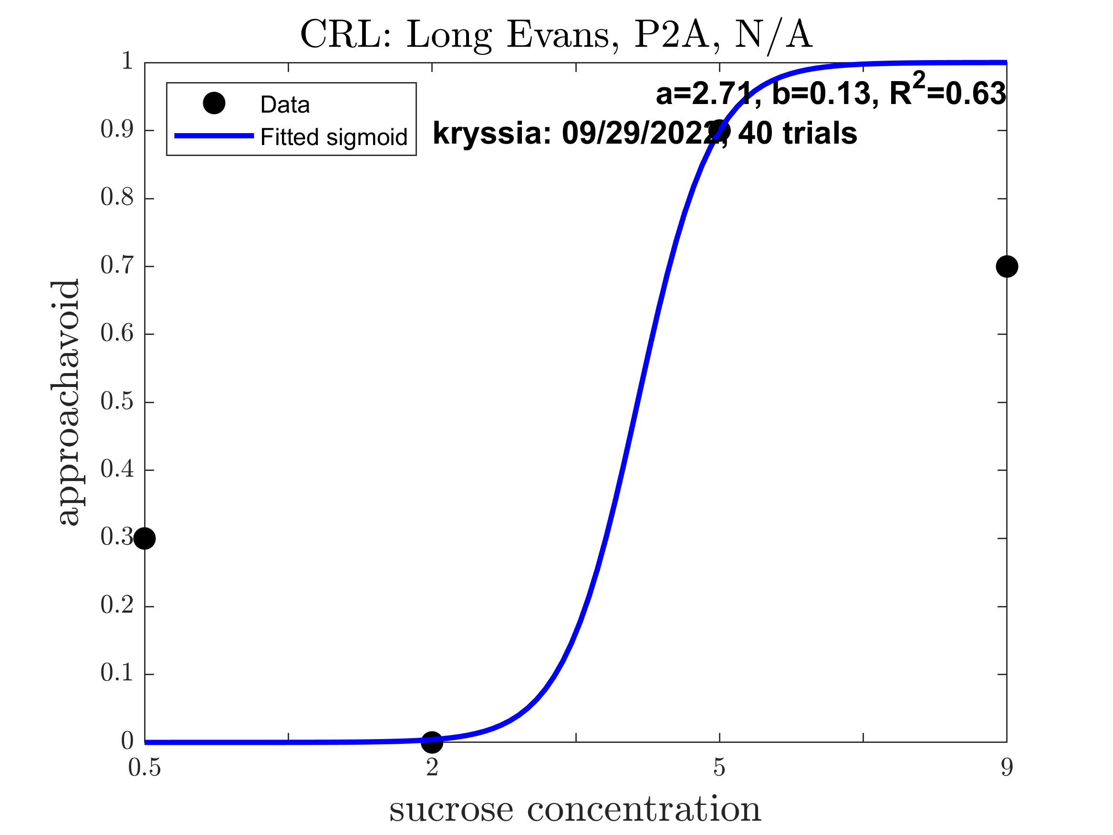
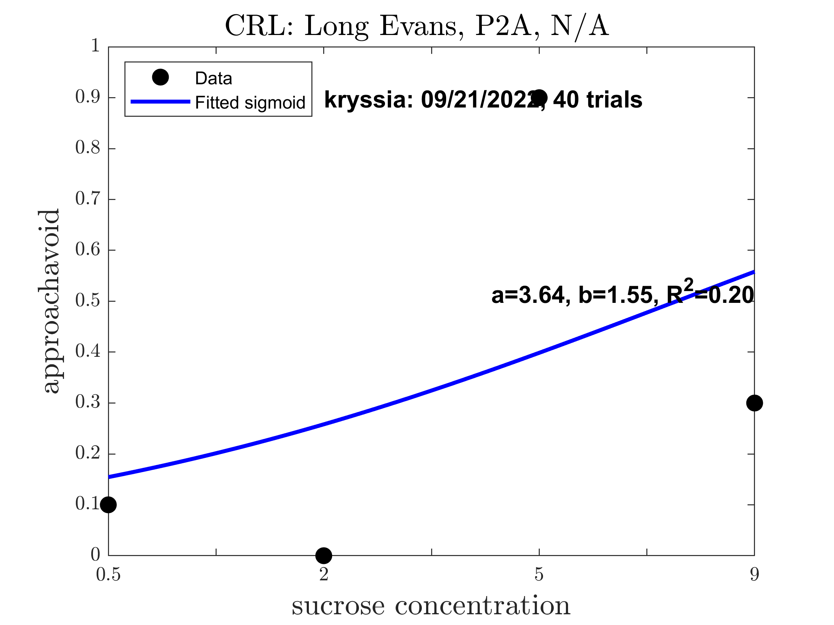

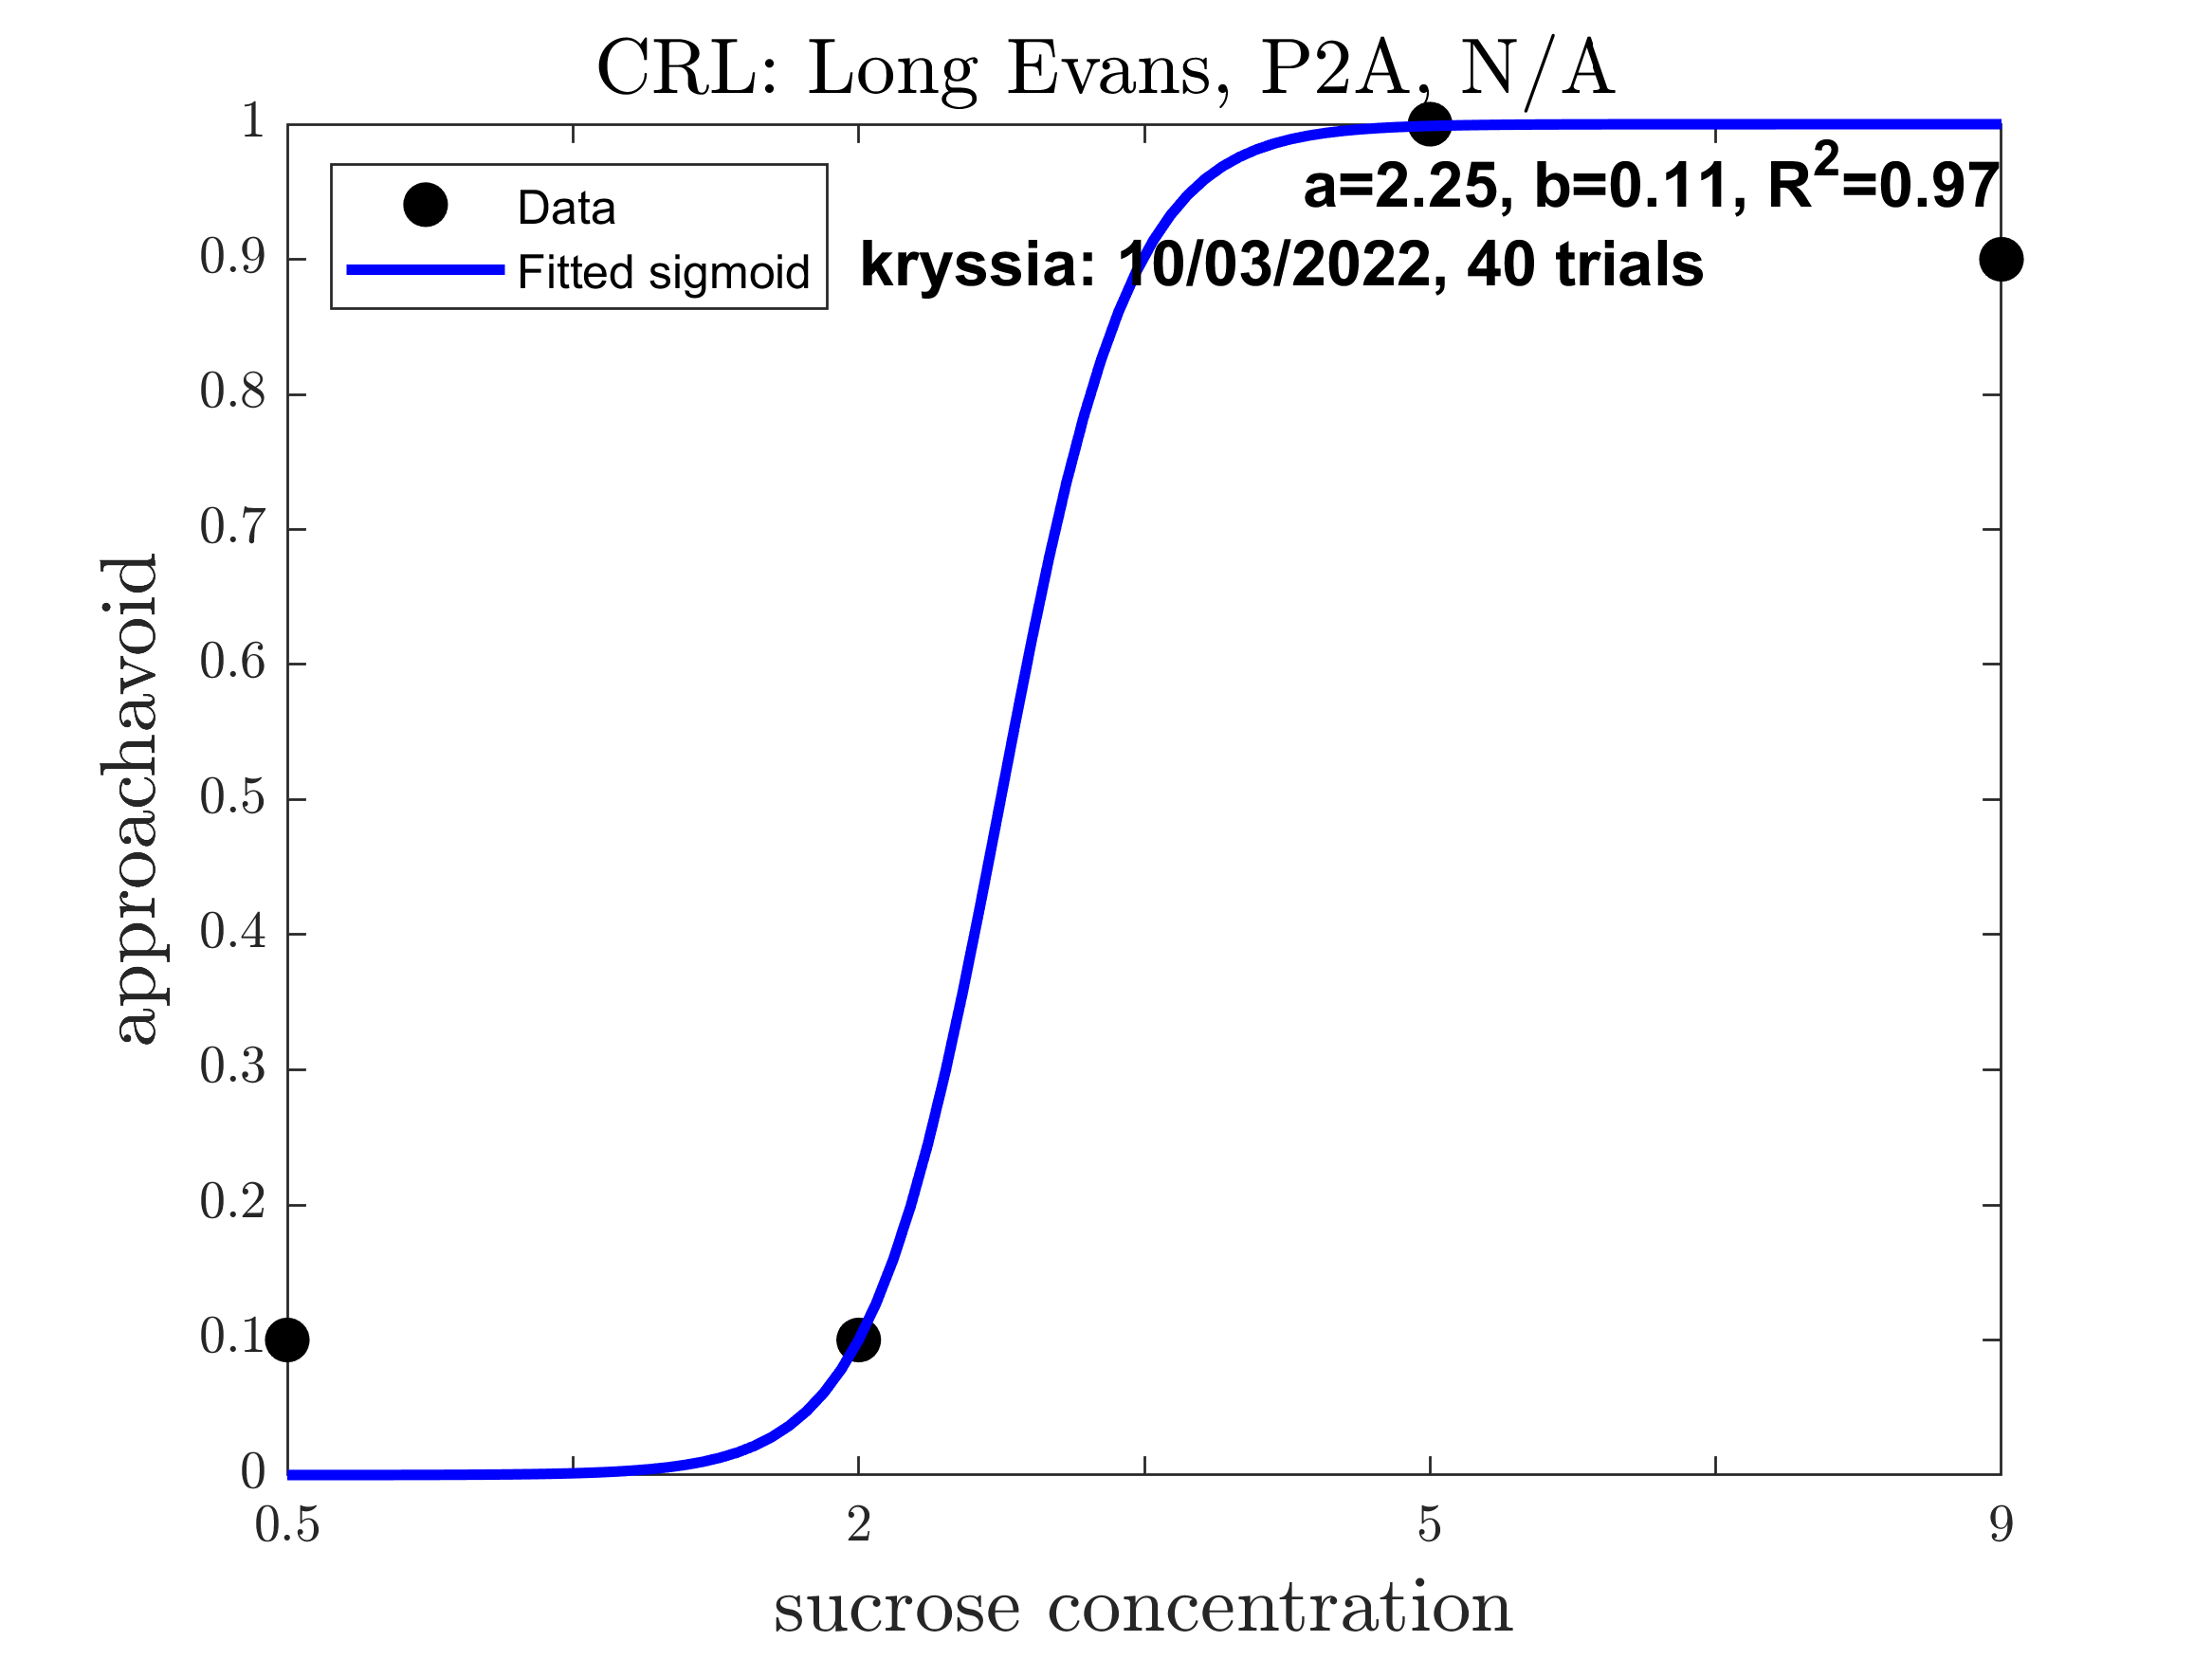
Kryssia: Pre alcohol (Good Sigmoid: 0.222)

Slide 6
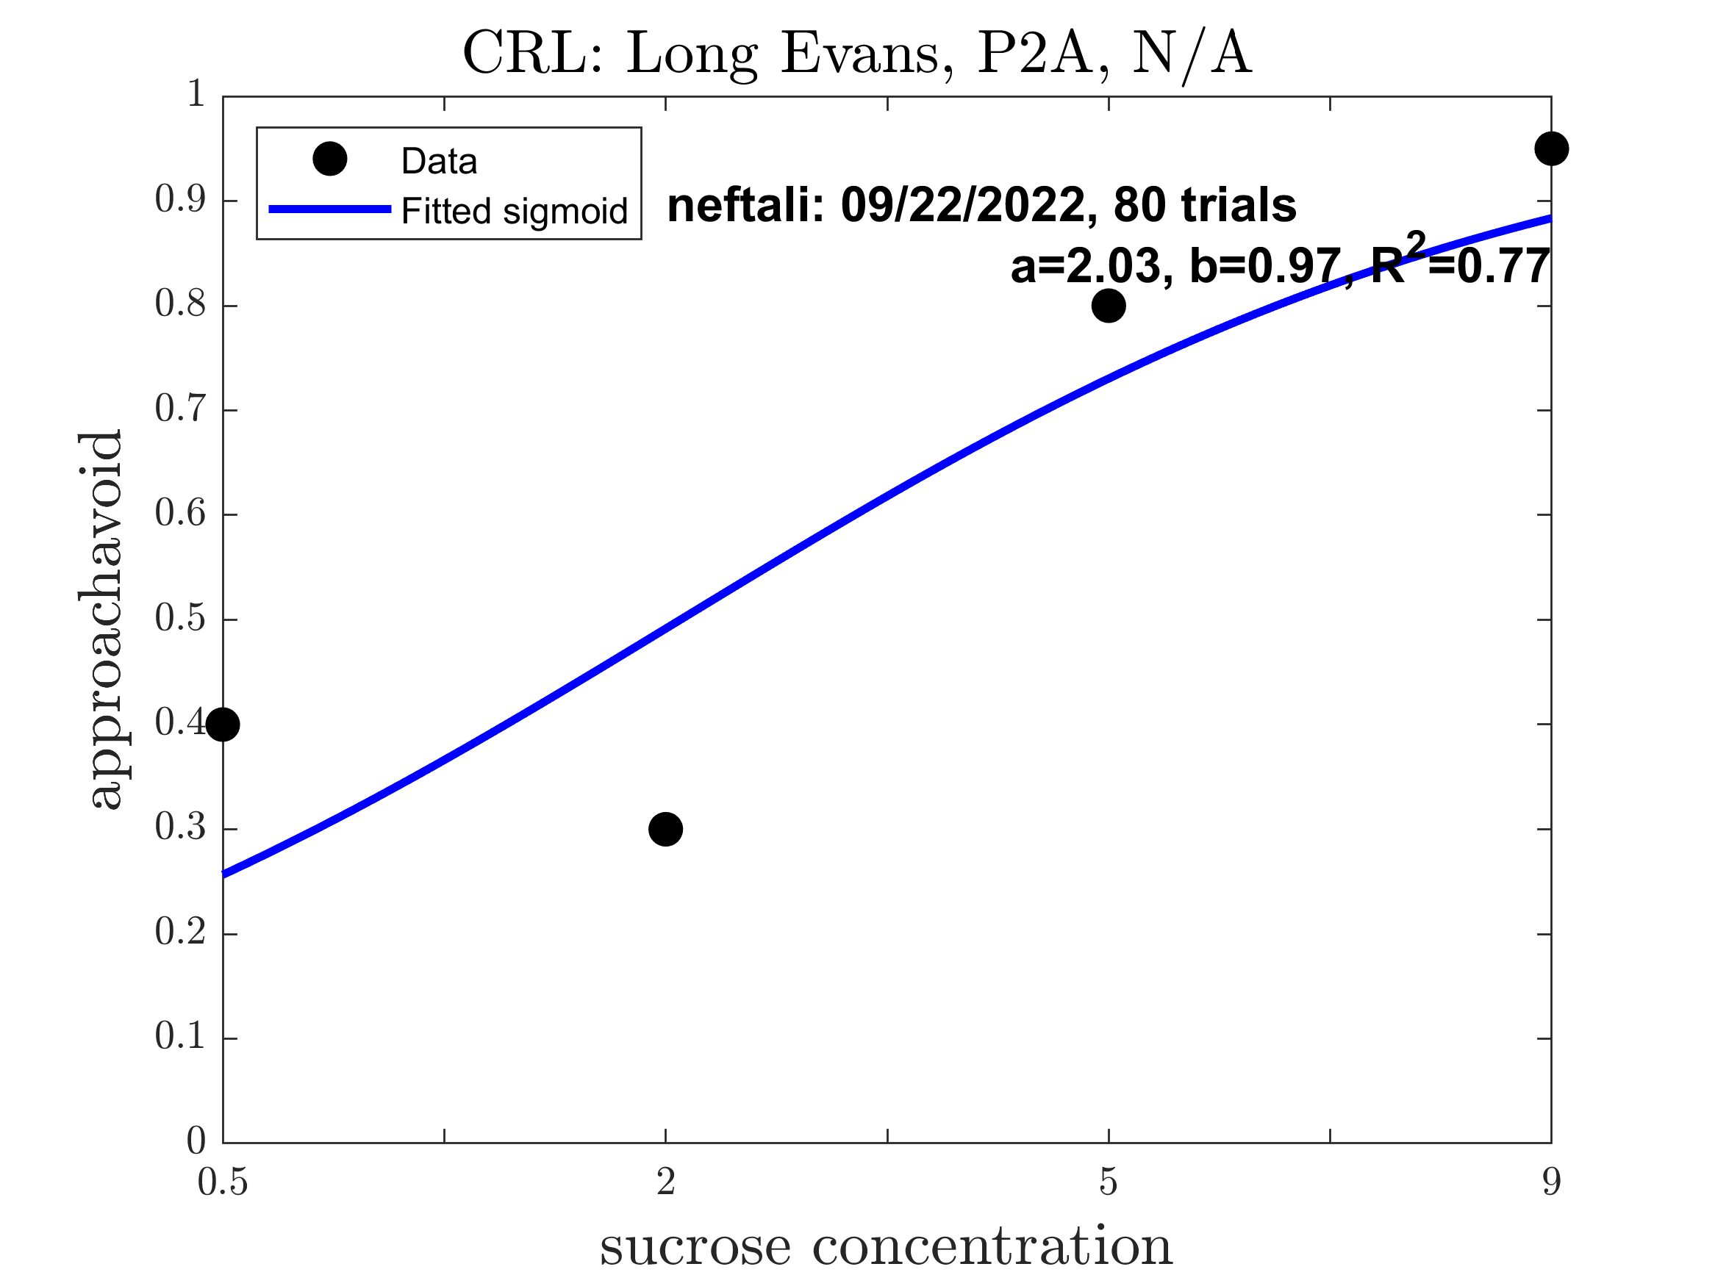
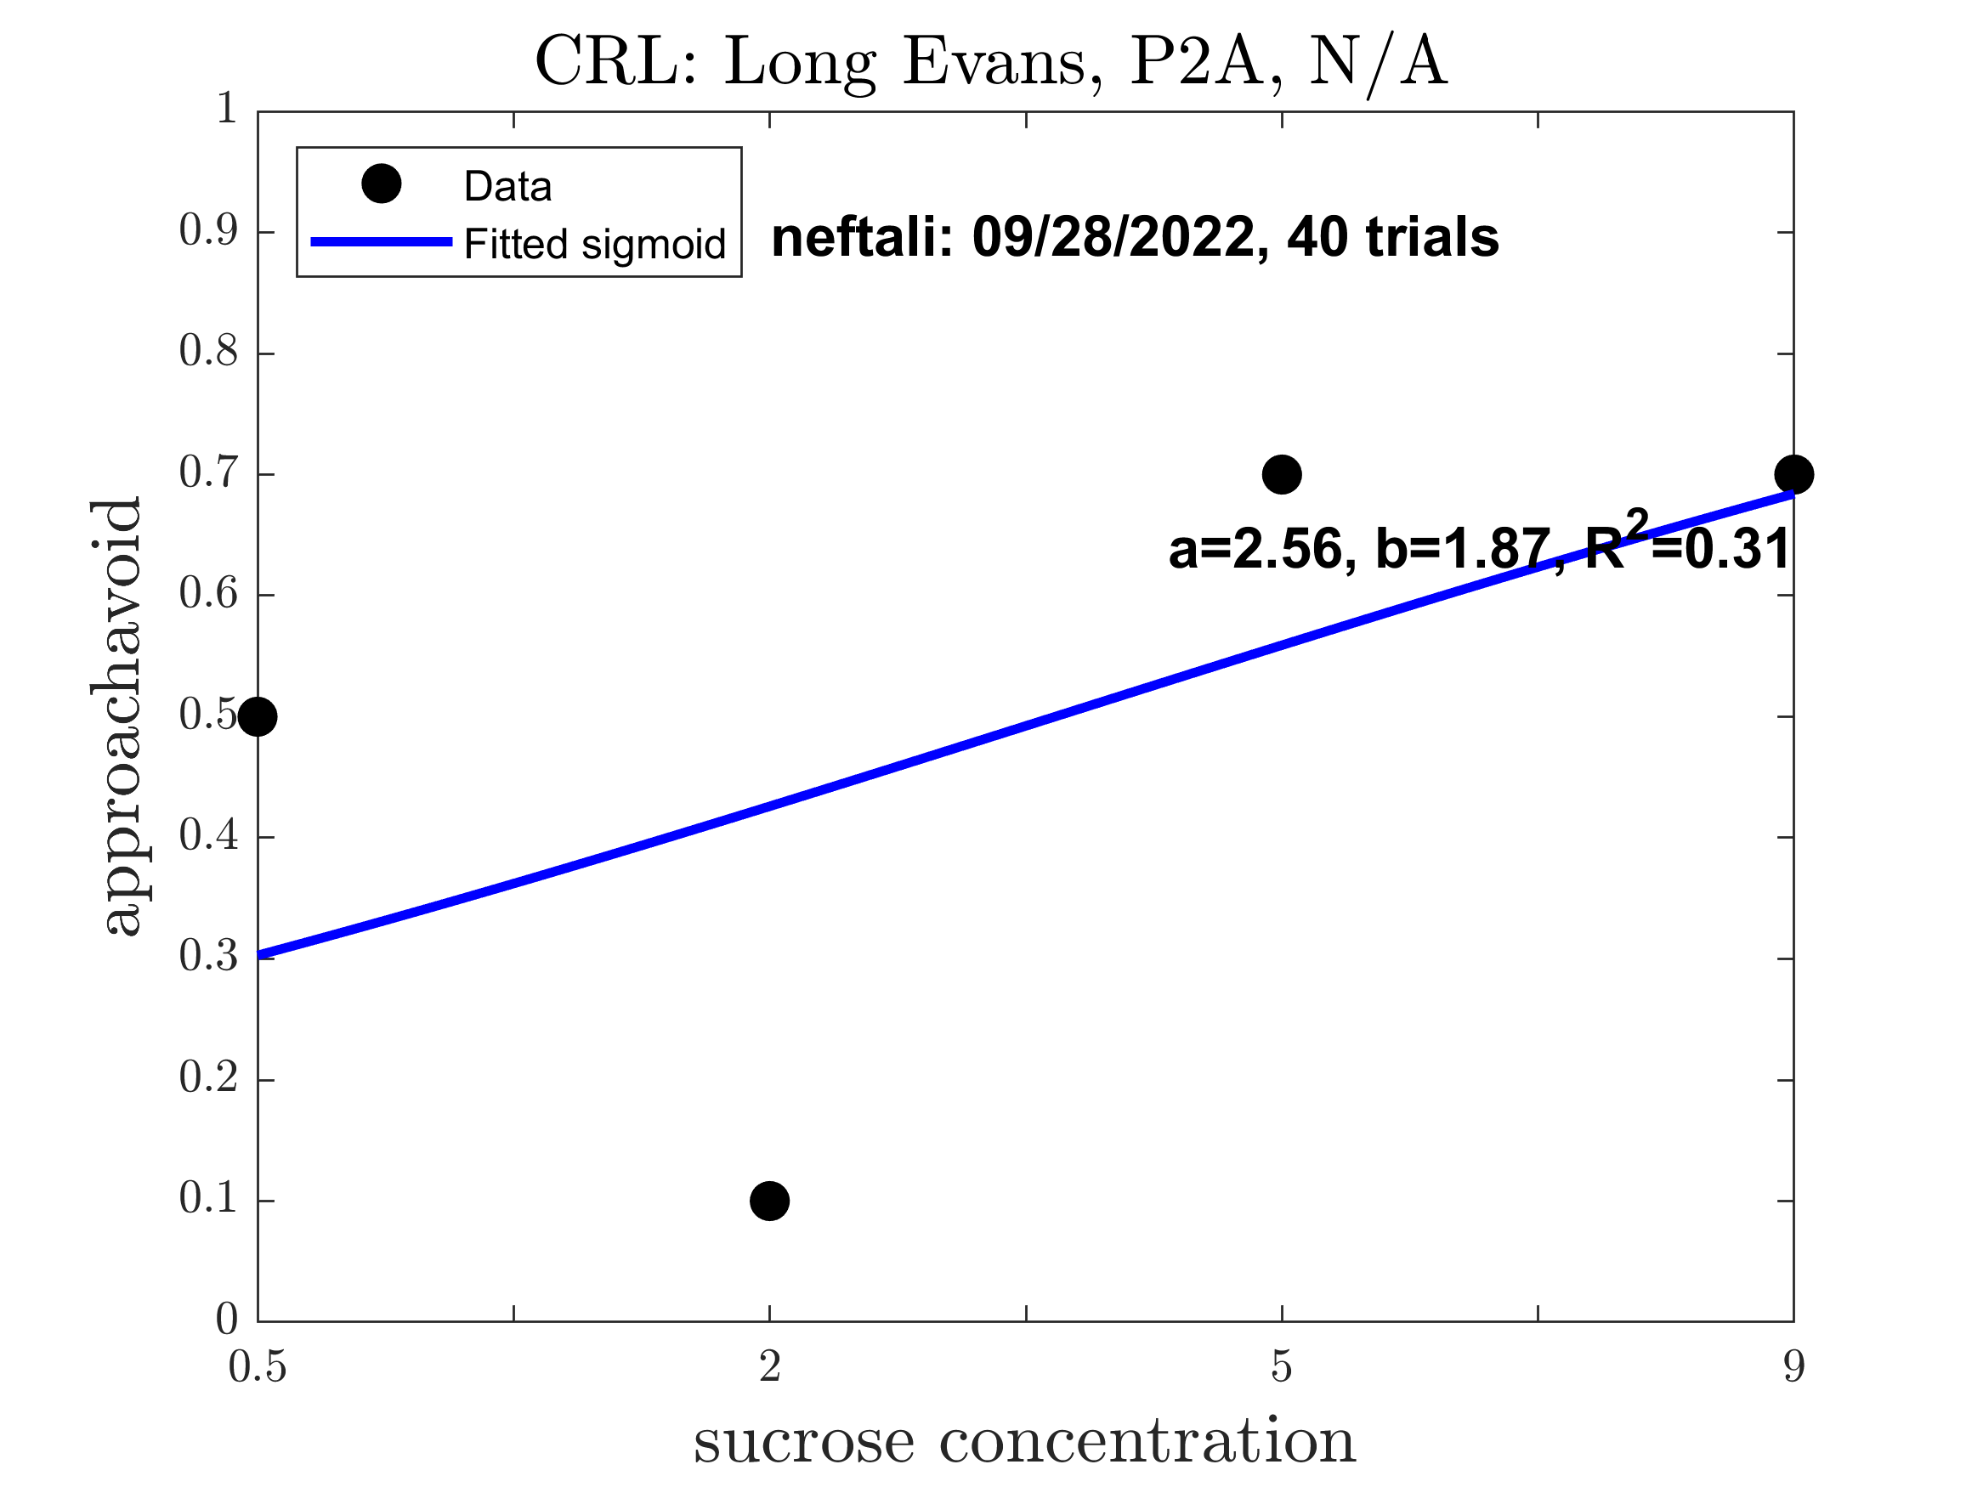
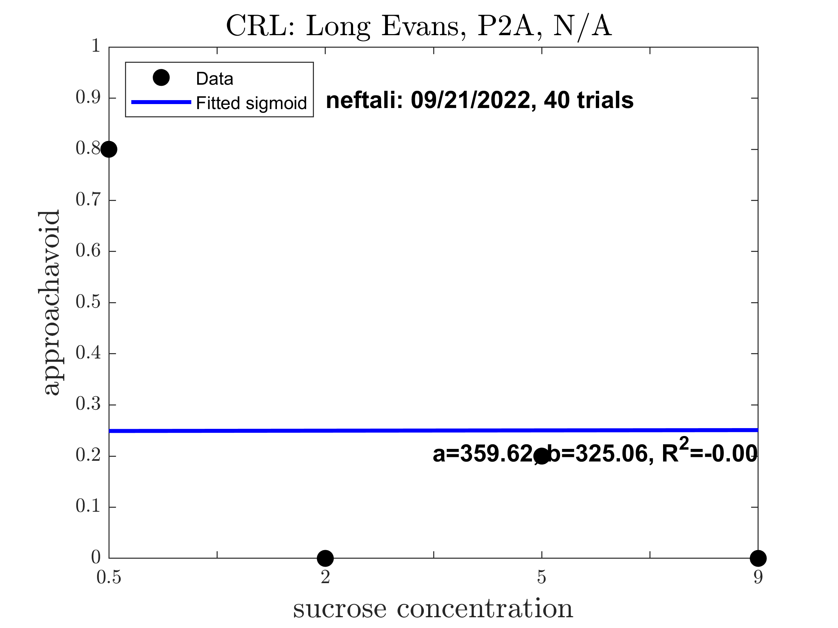
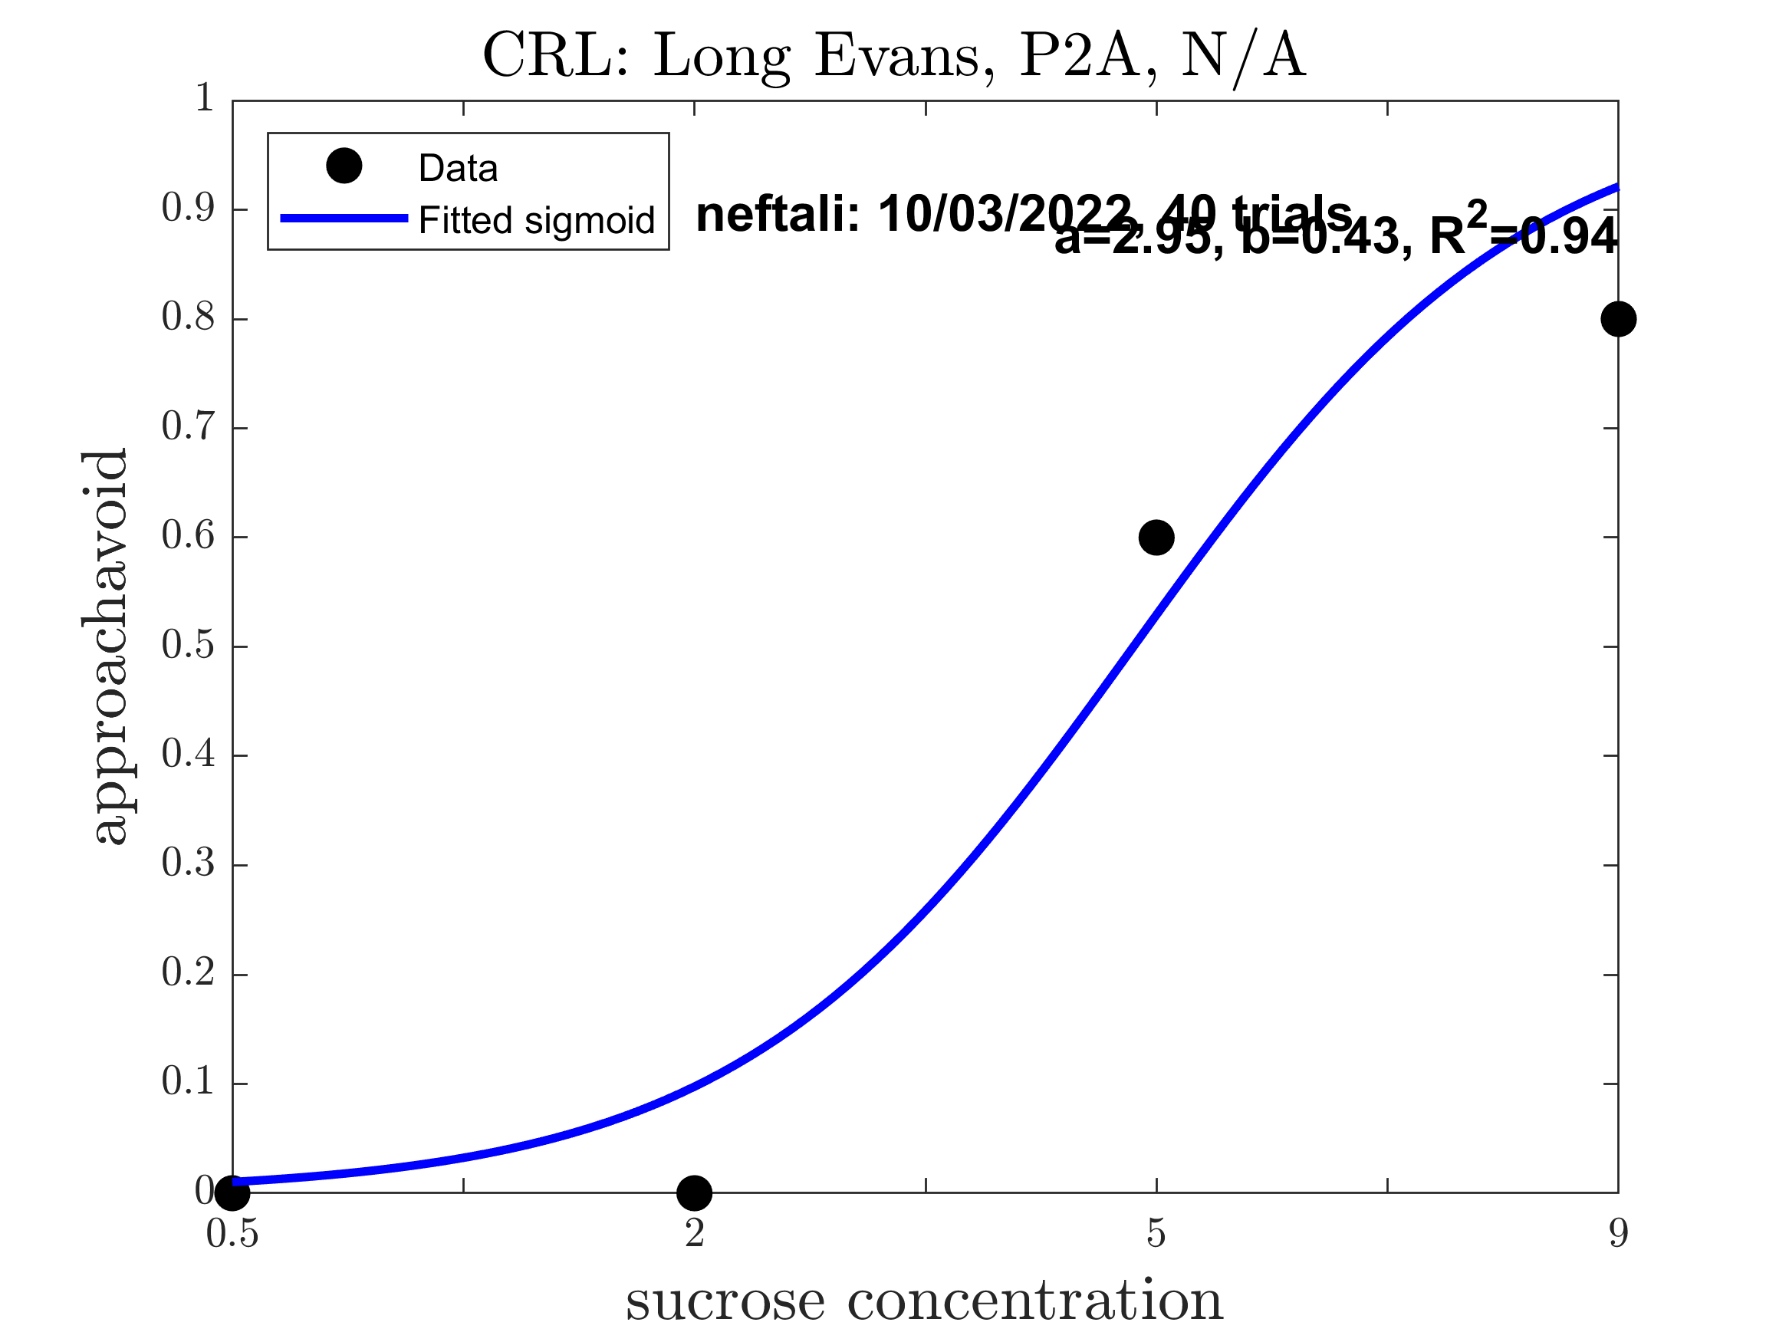
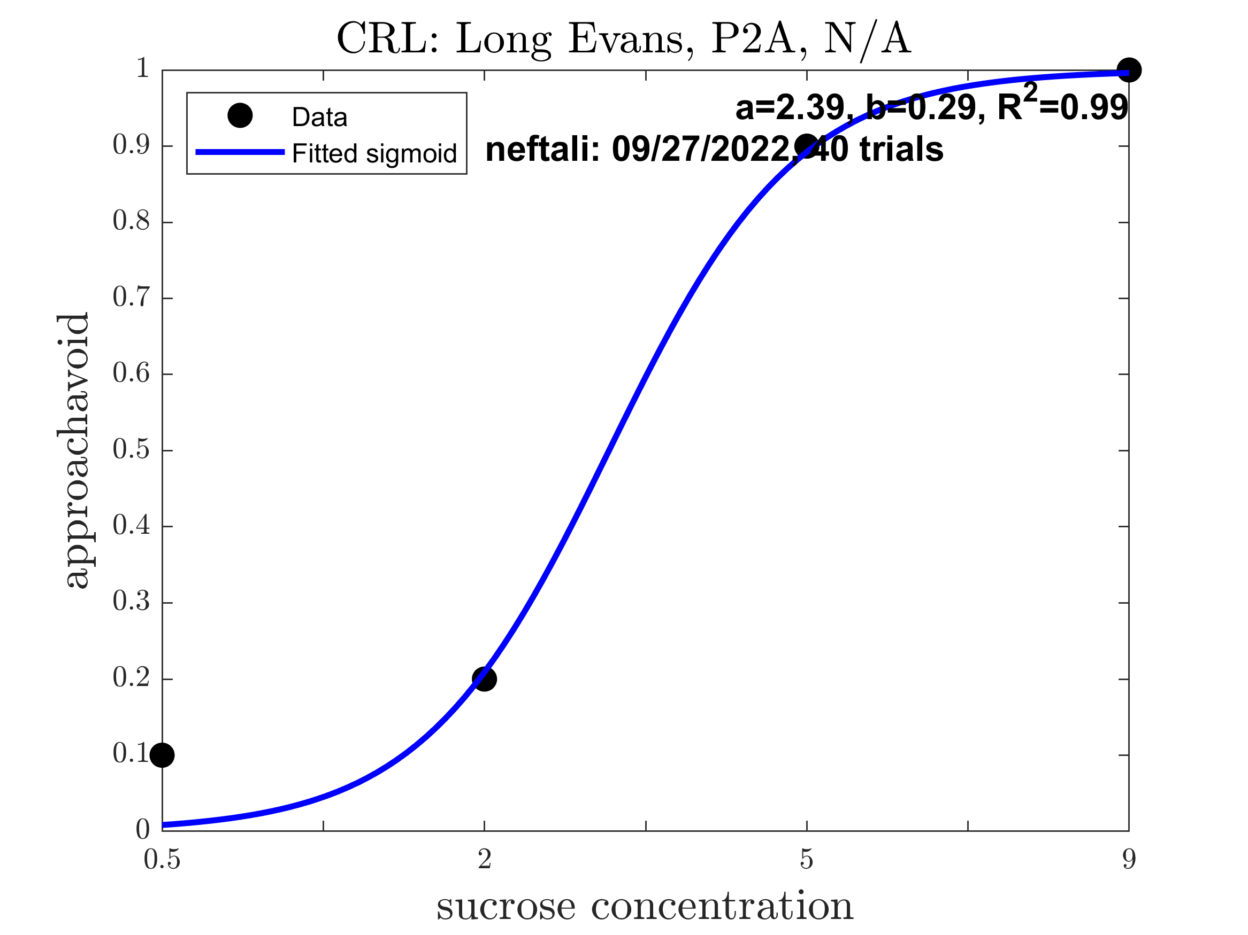
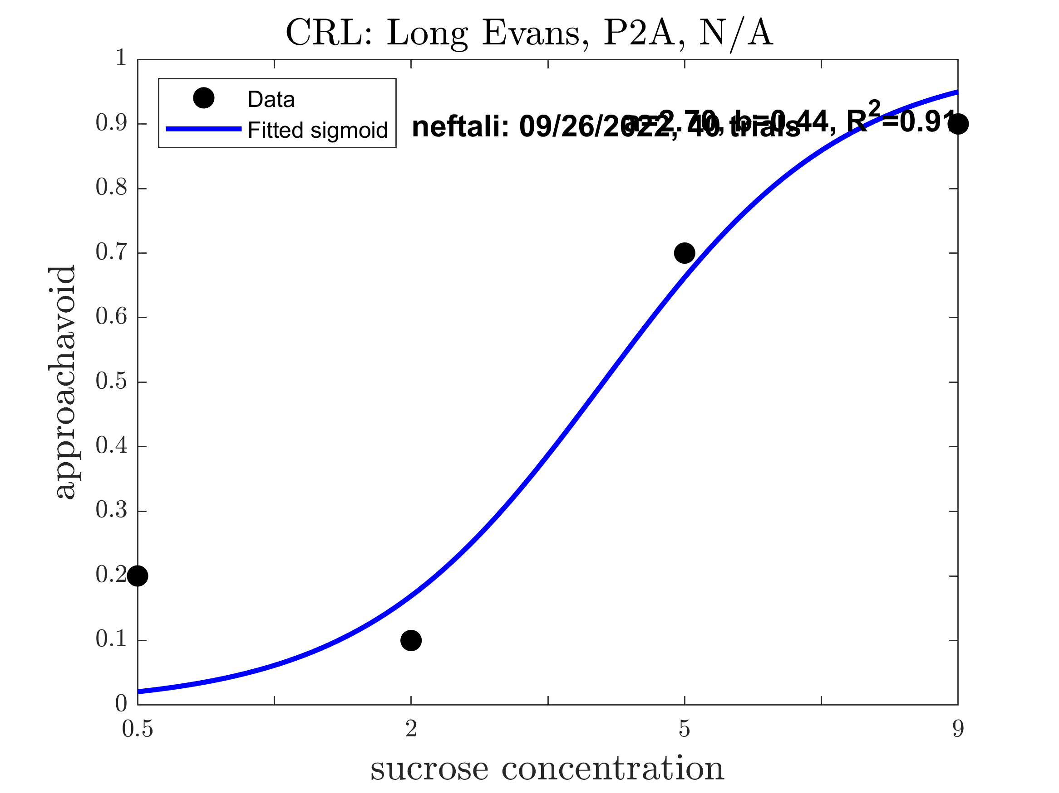
Neftali: Pre alcohol (Good Sigmoid: 0.6667)

Slide 7
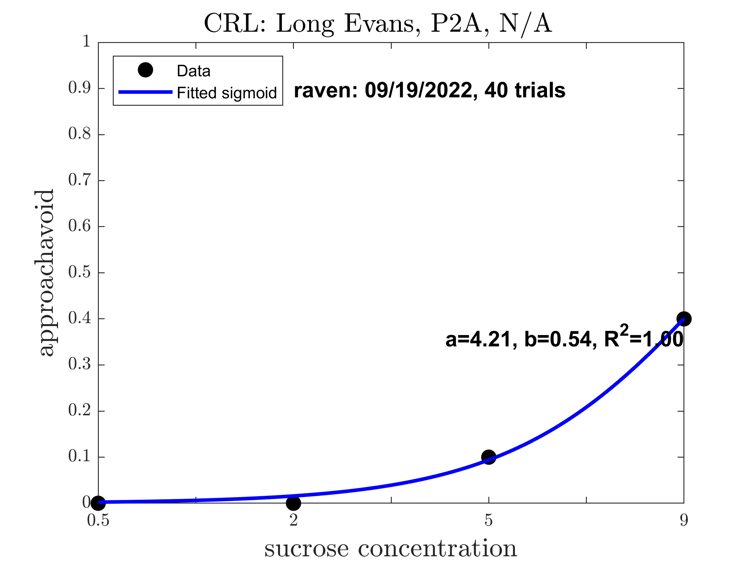
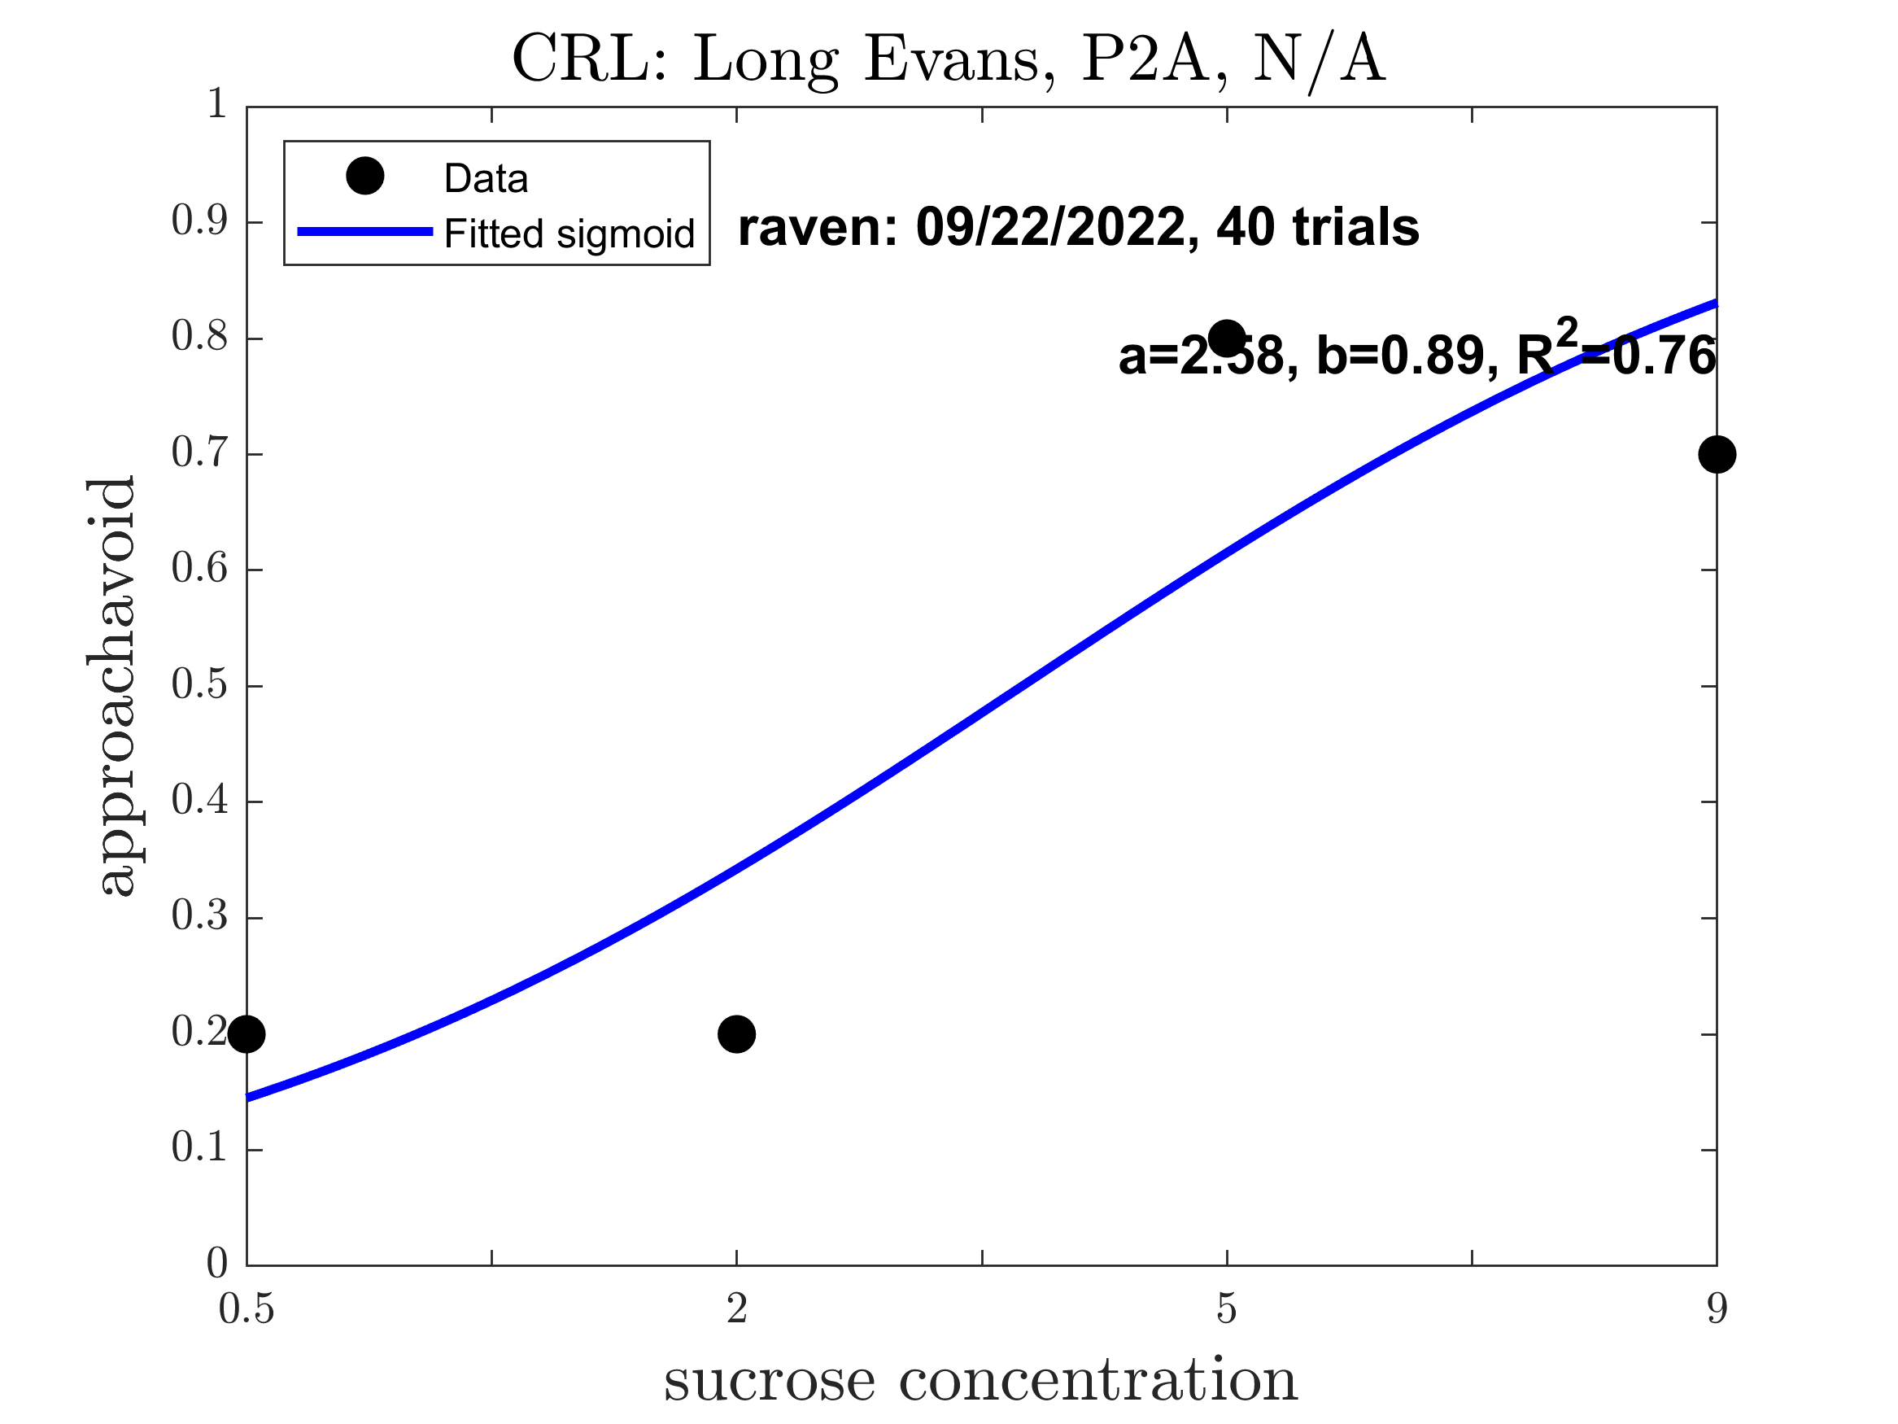
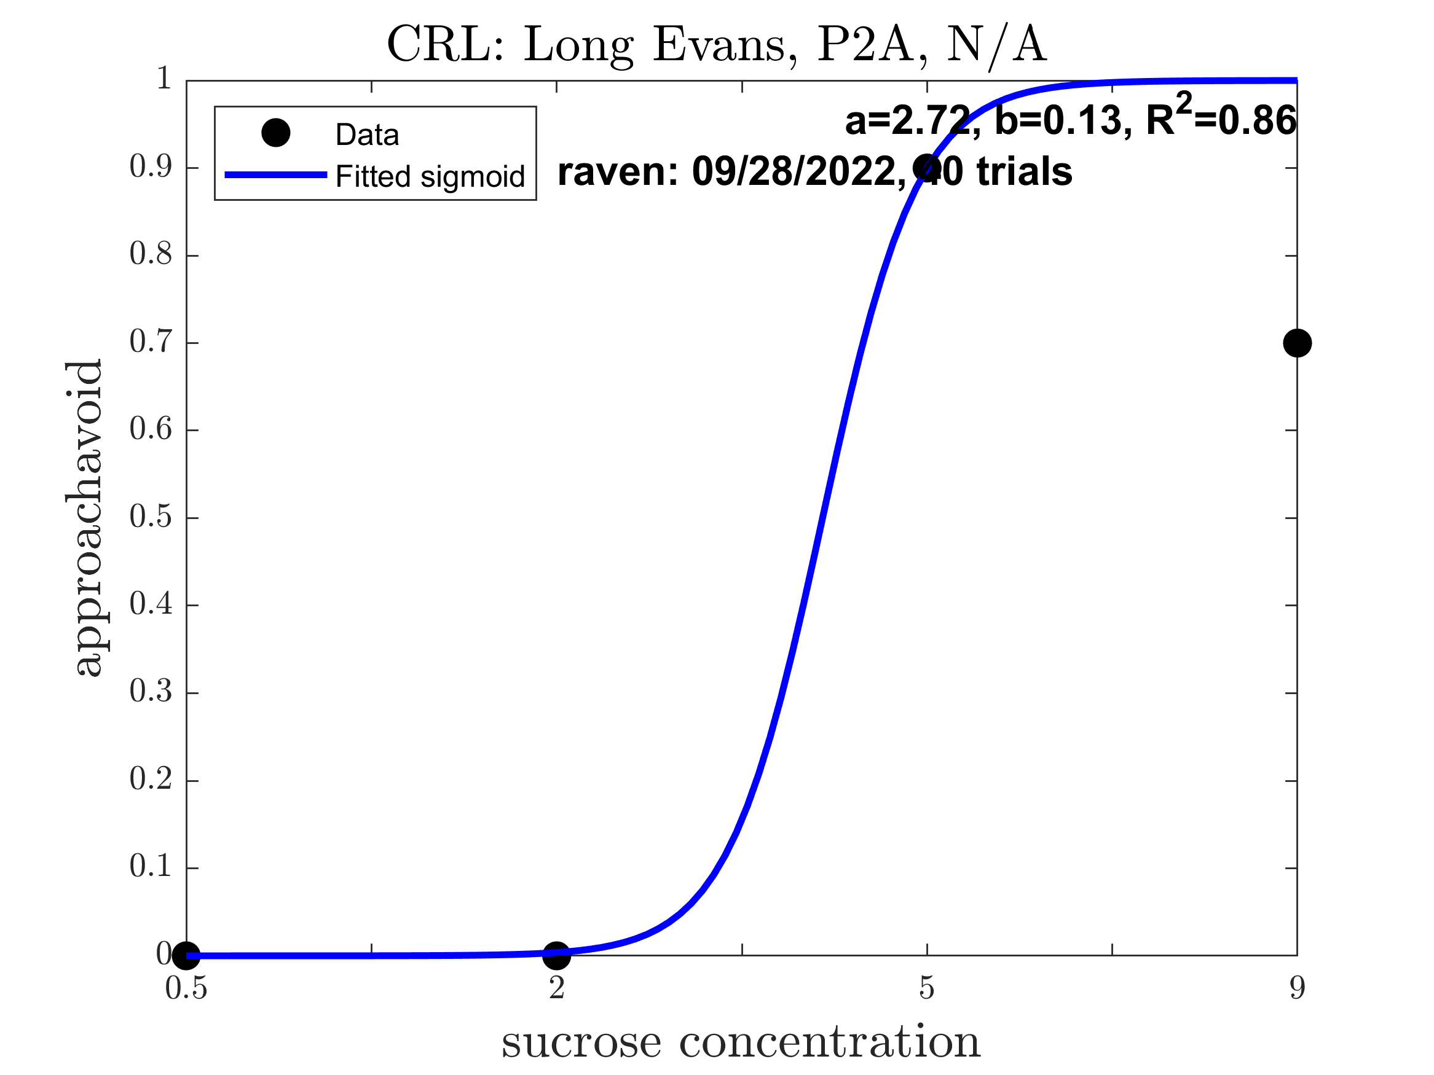

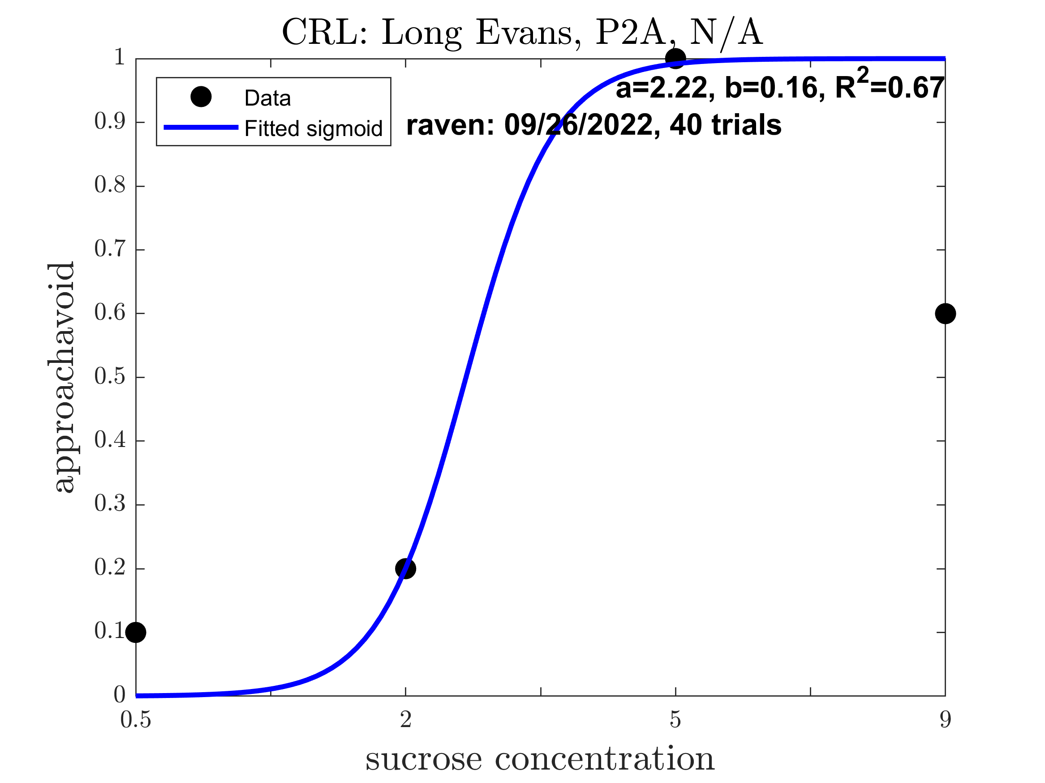
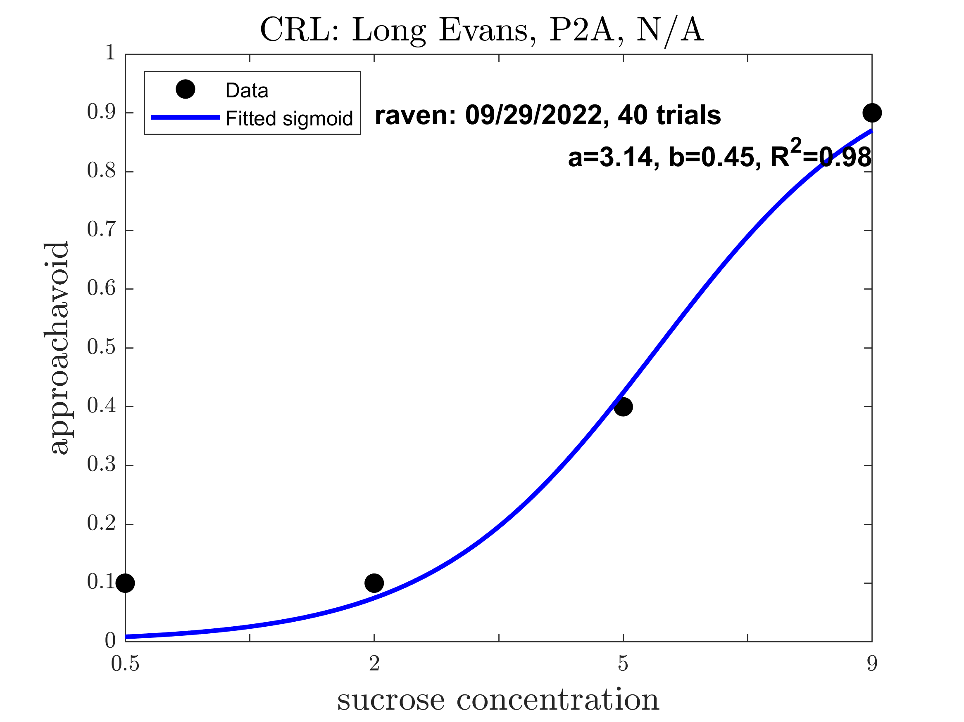
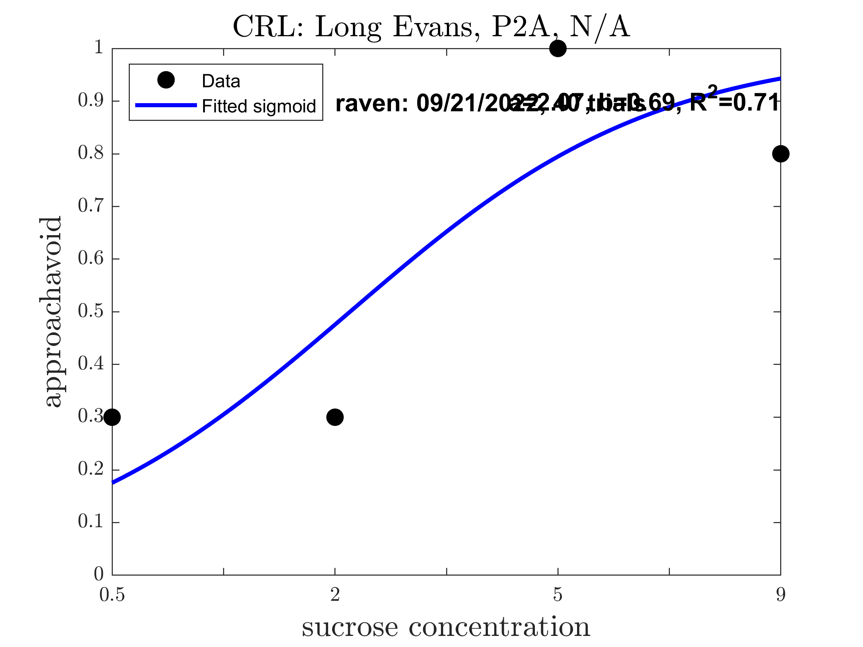
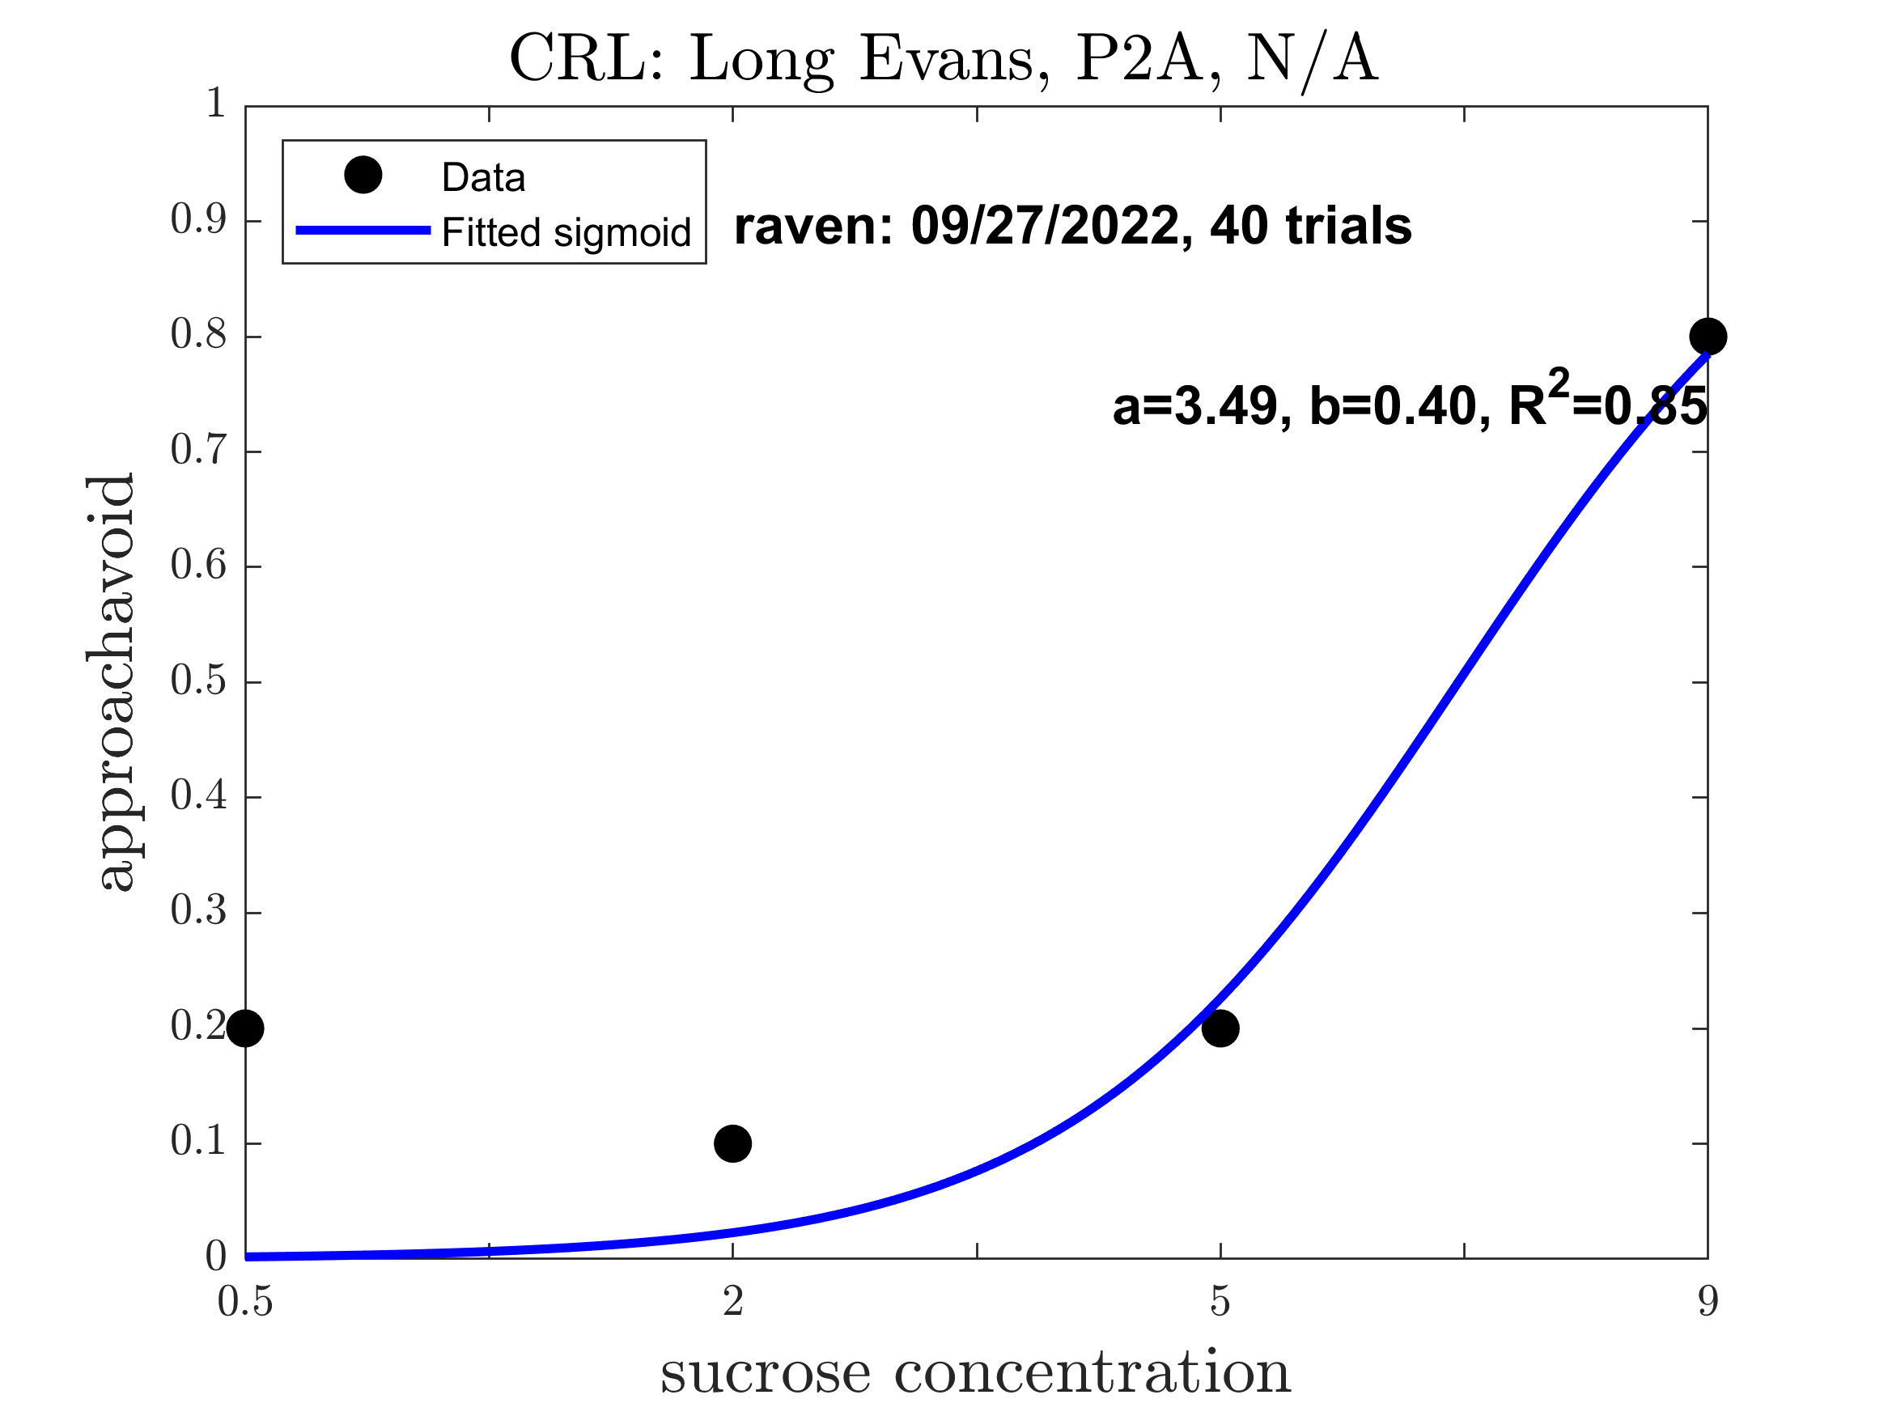
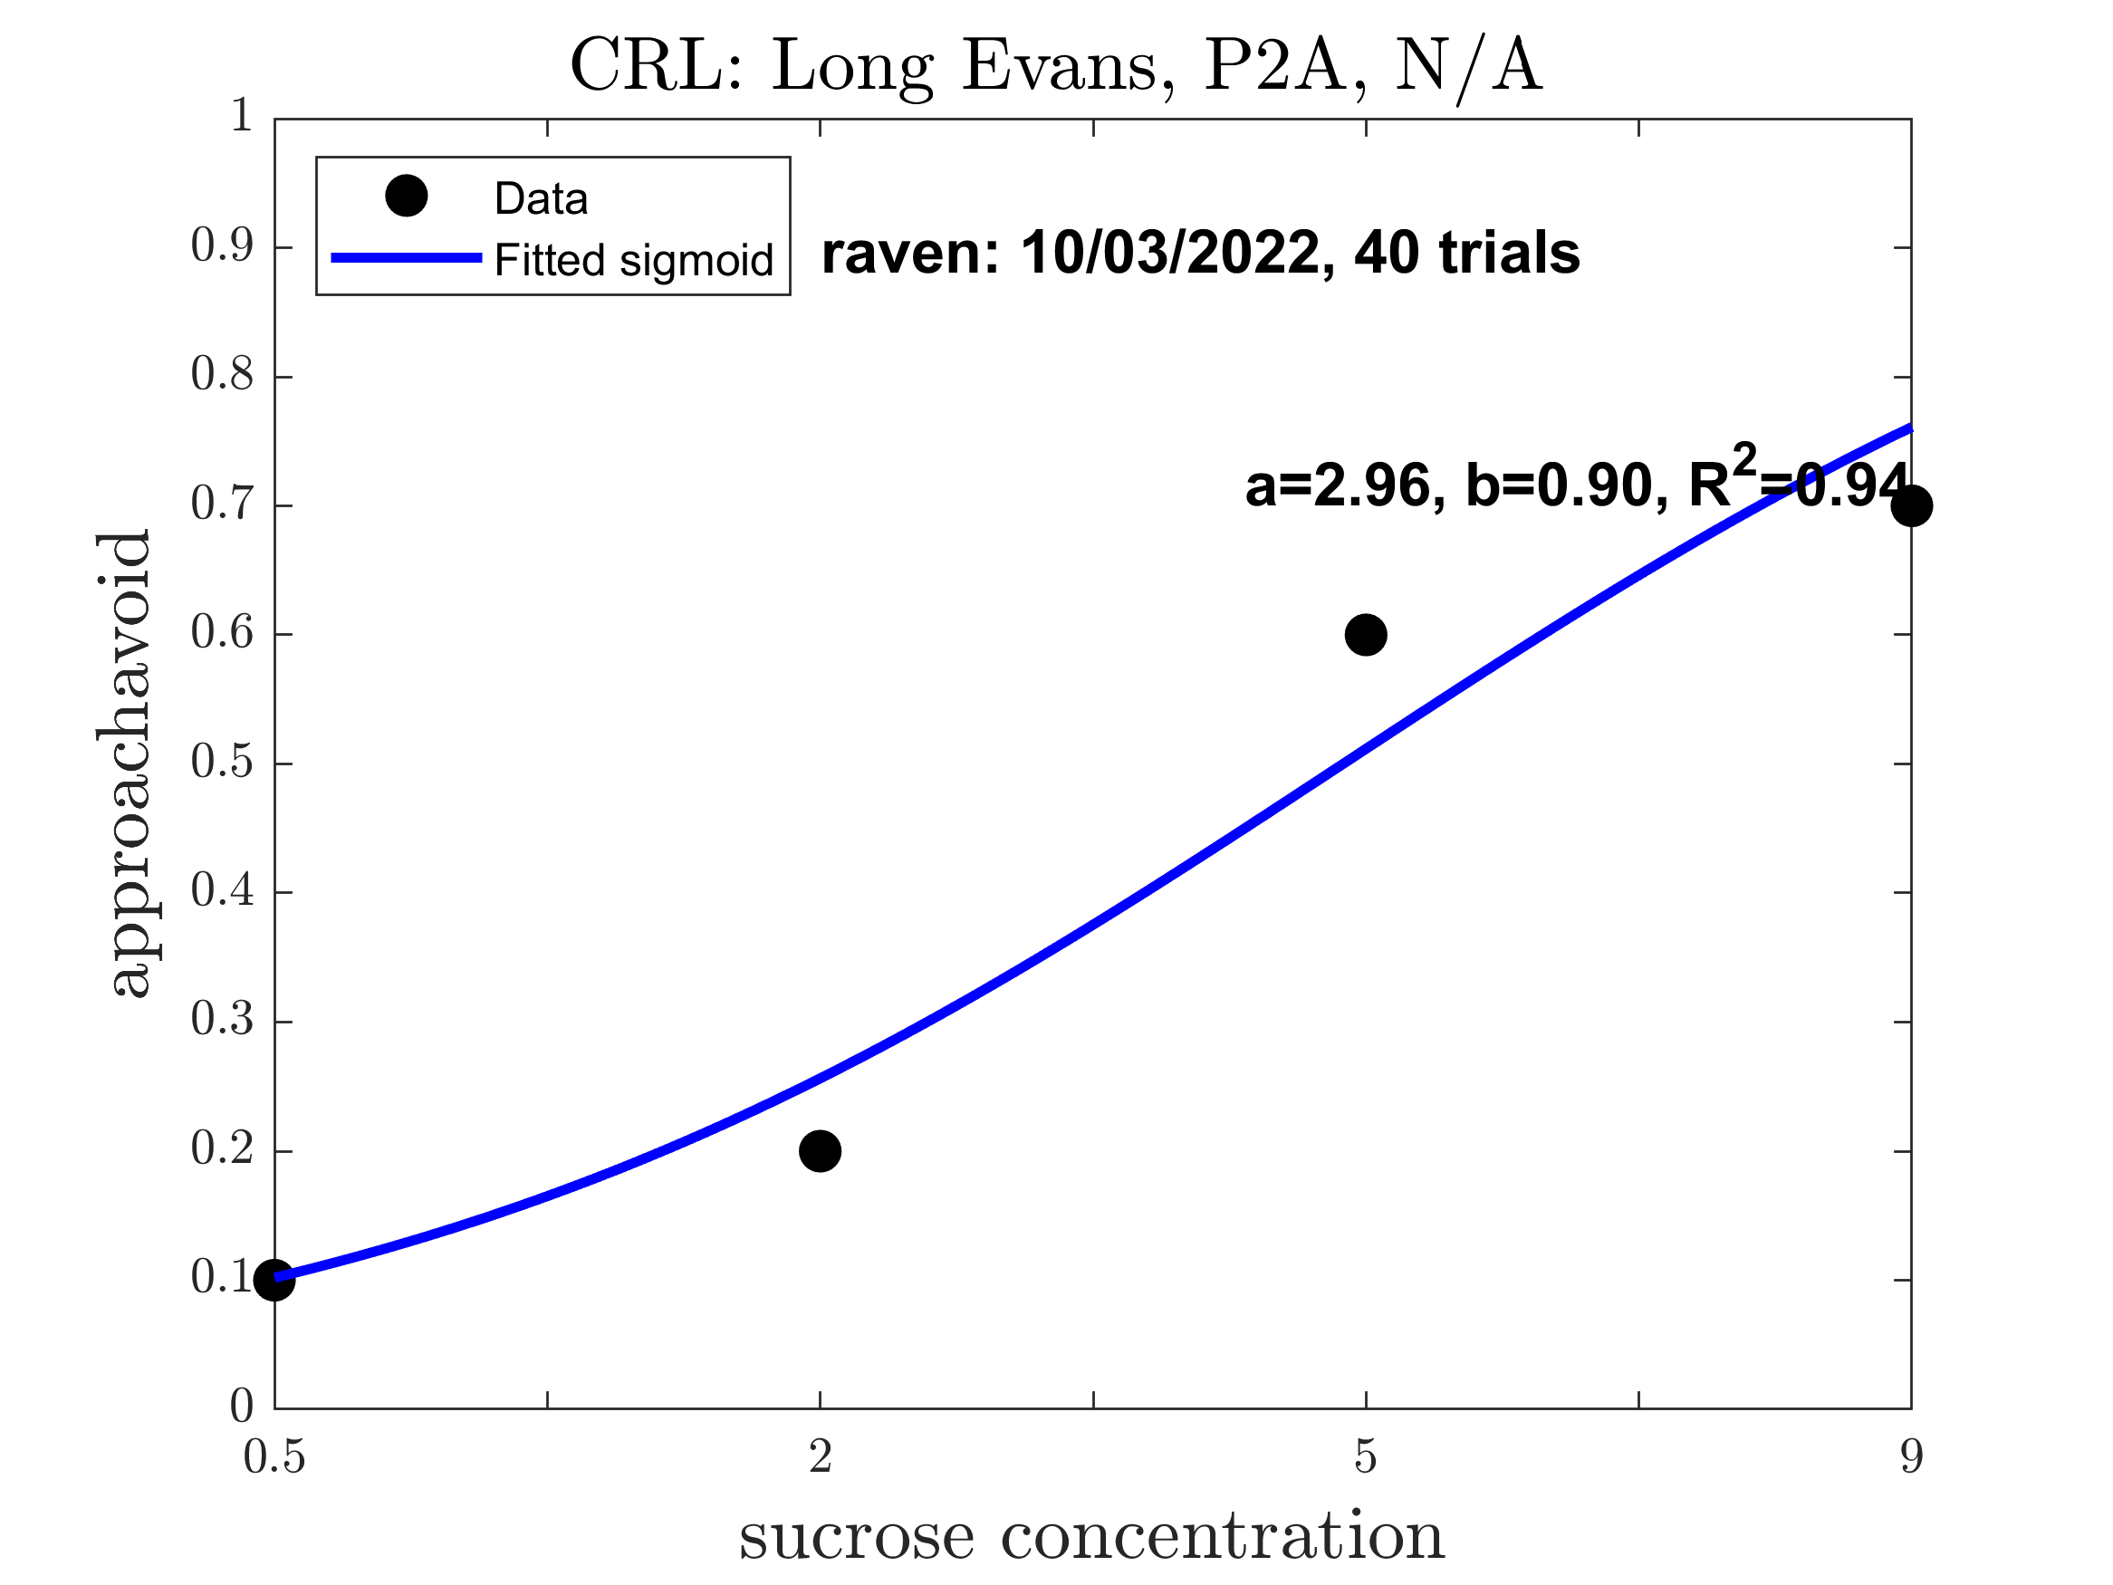
Raven: Pre alcohol (Good Sigmoid: 1.000)

Slide 8
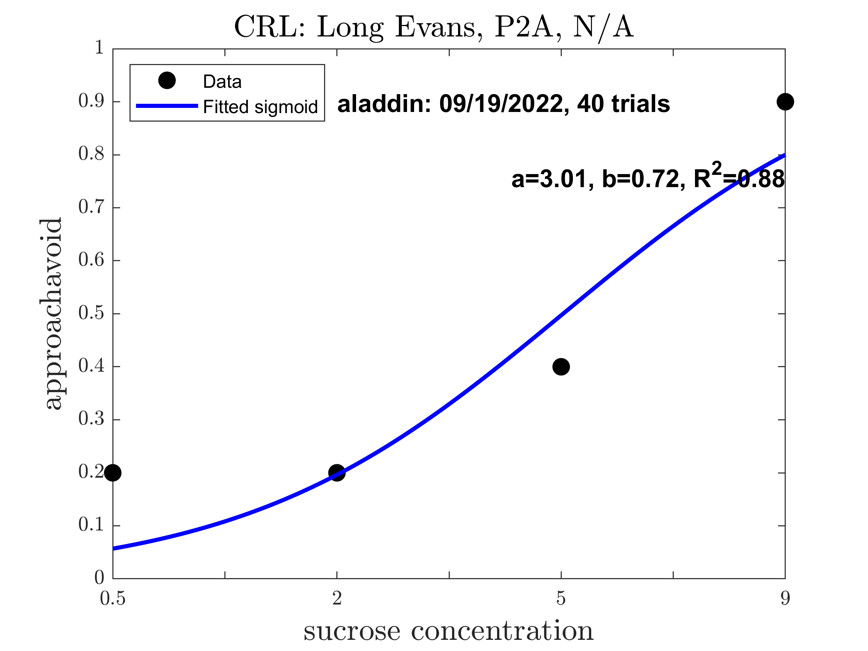
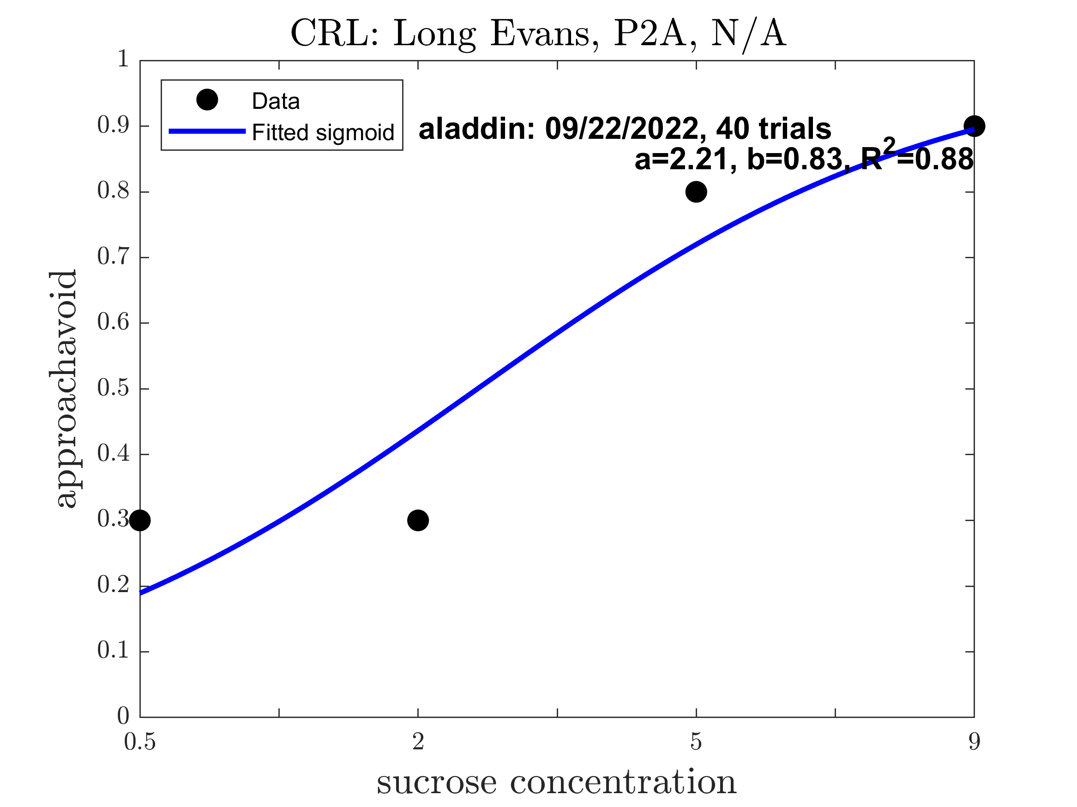
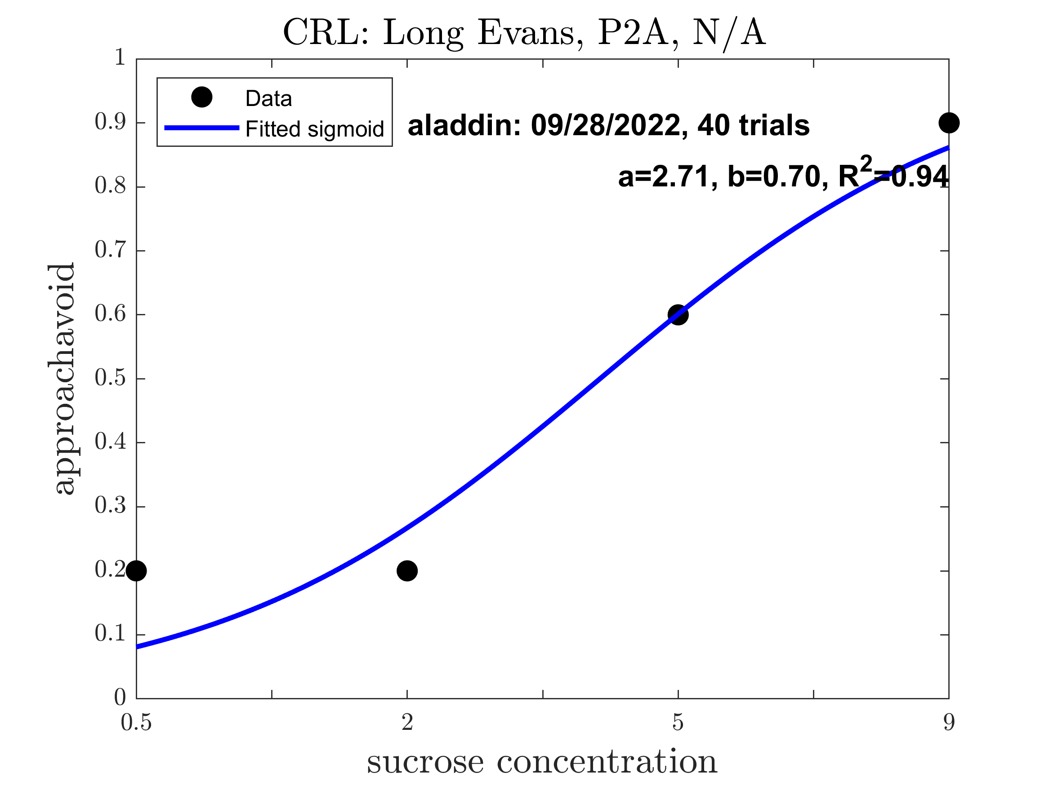
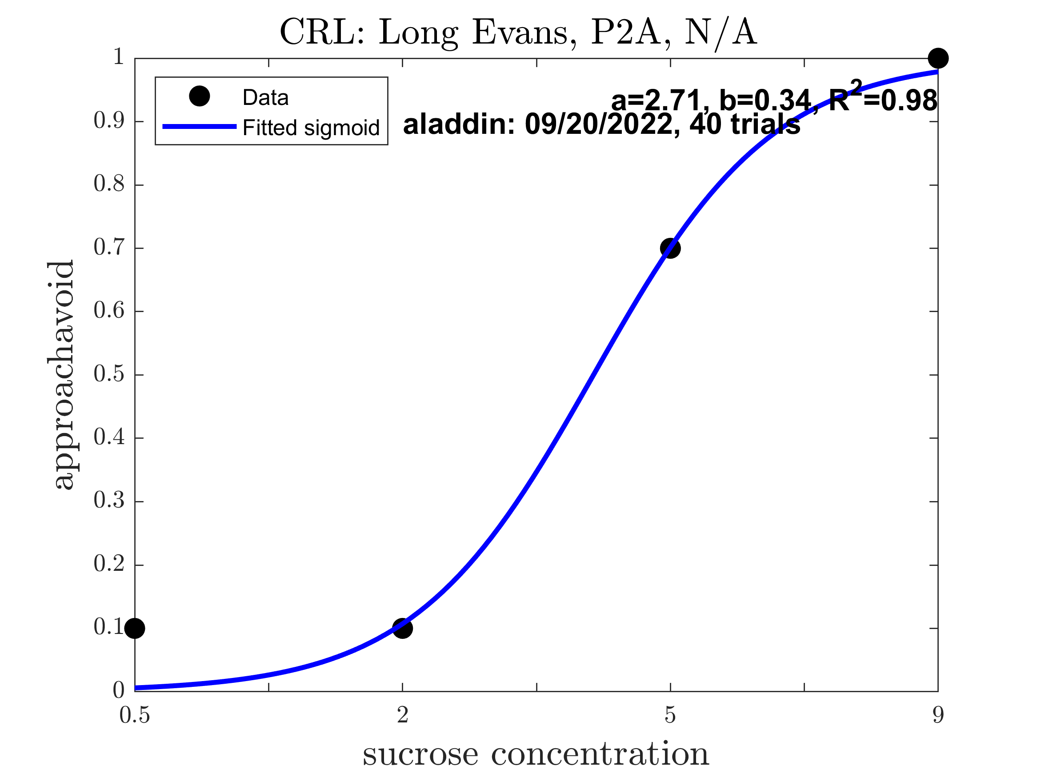
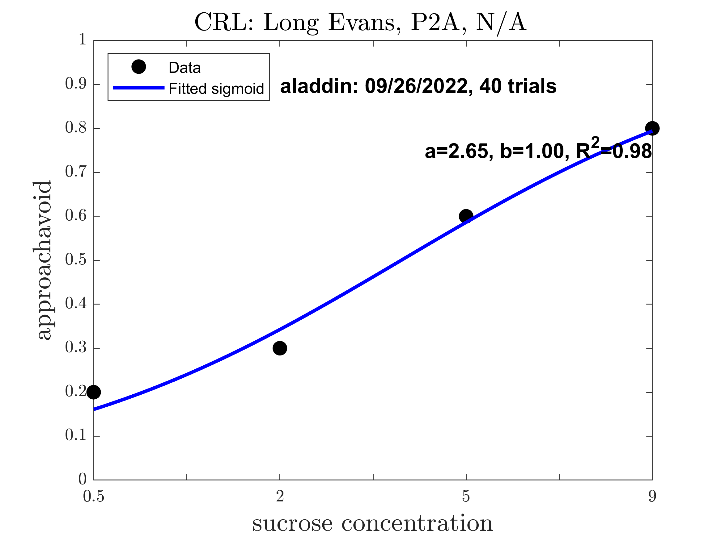

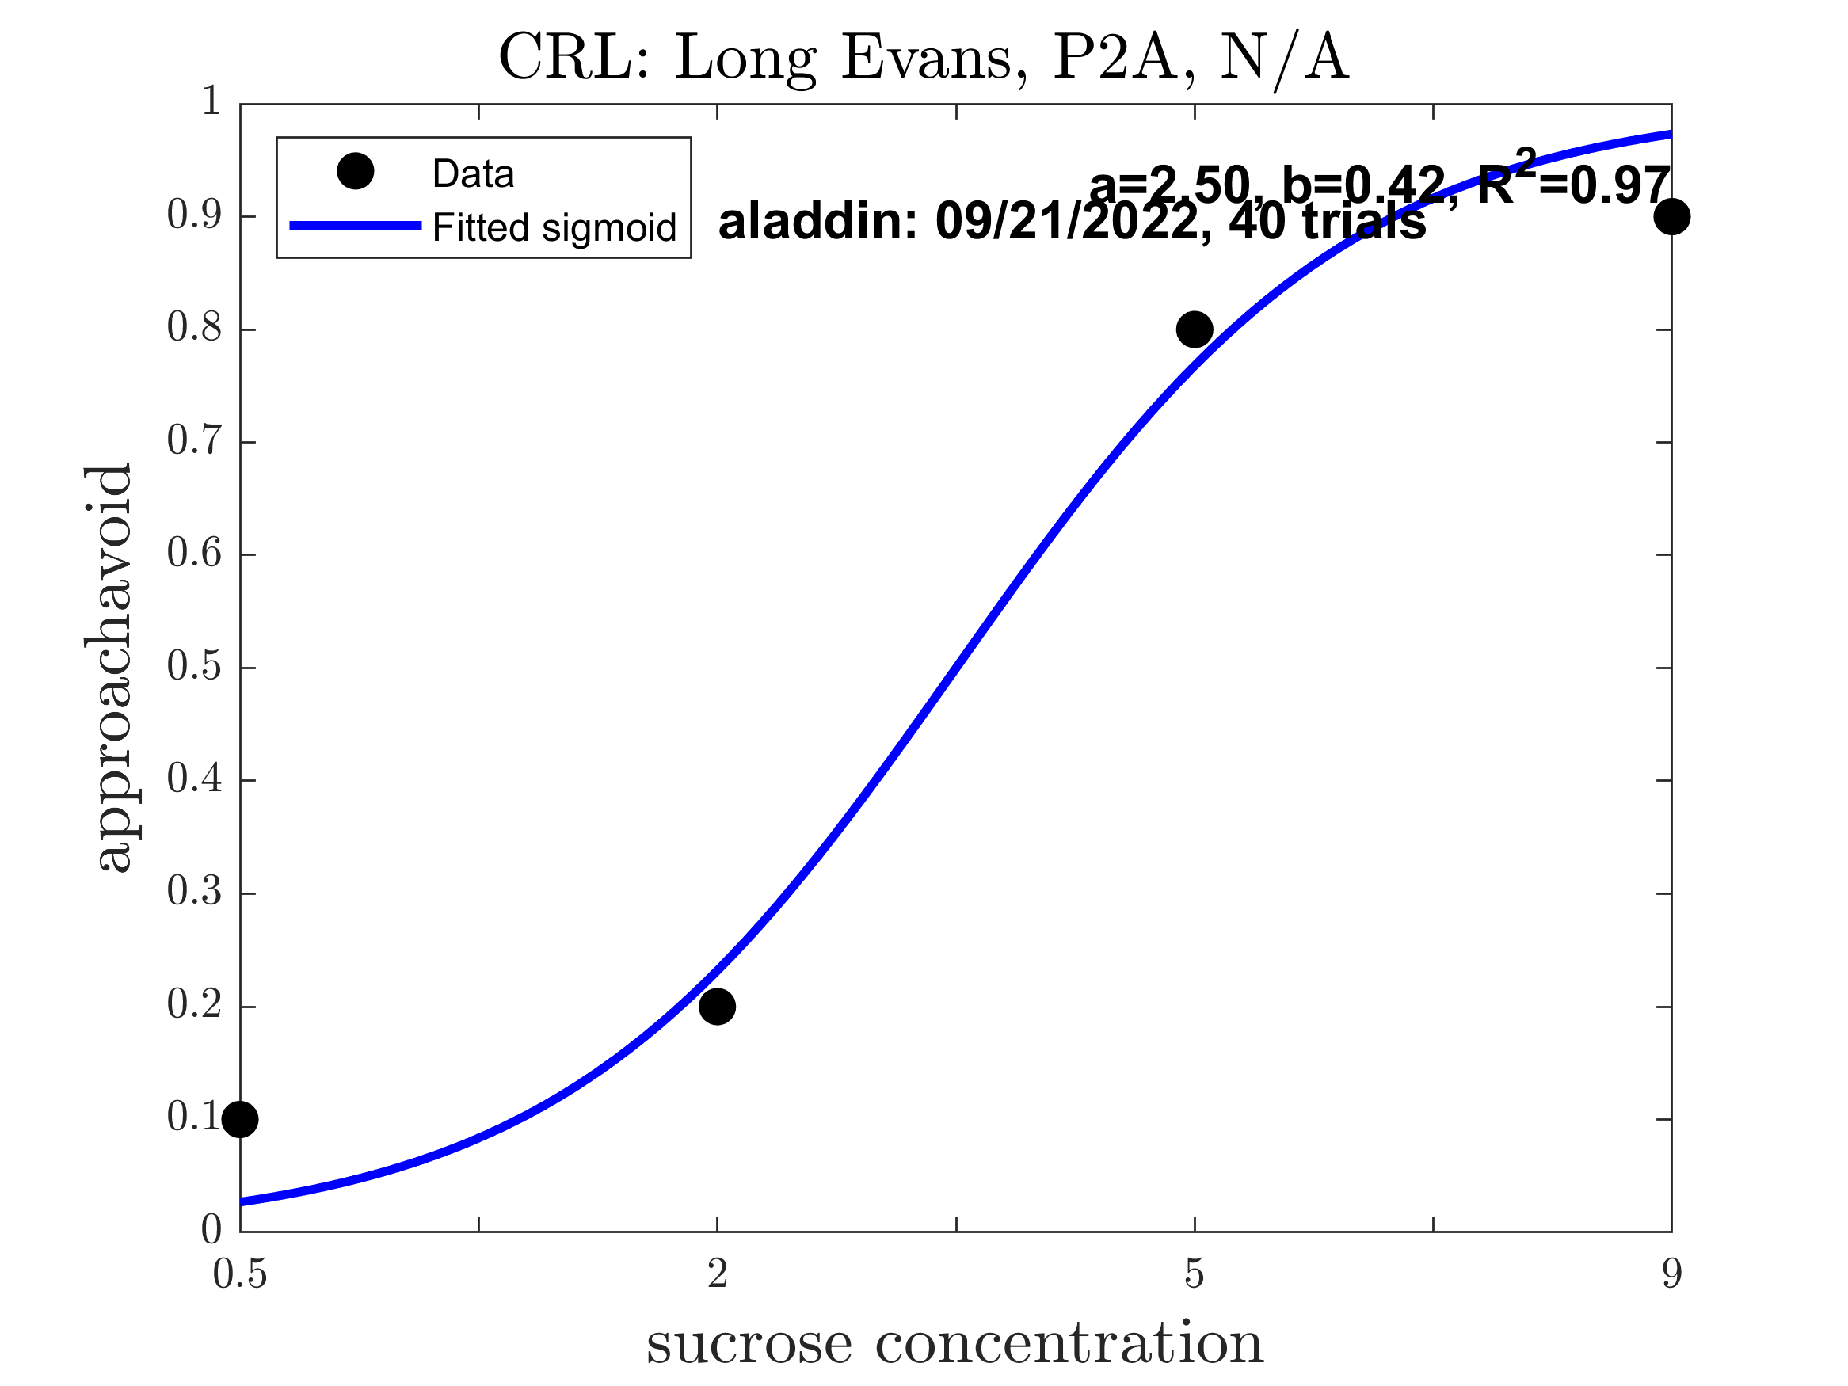
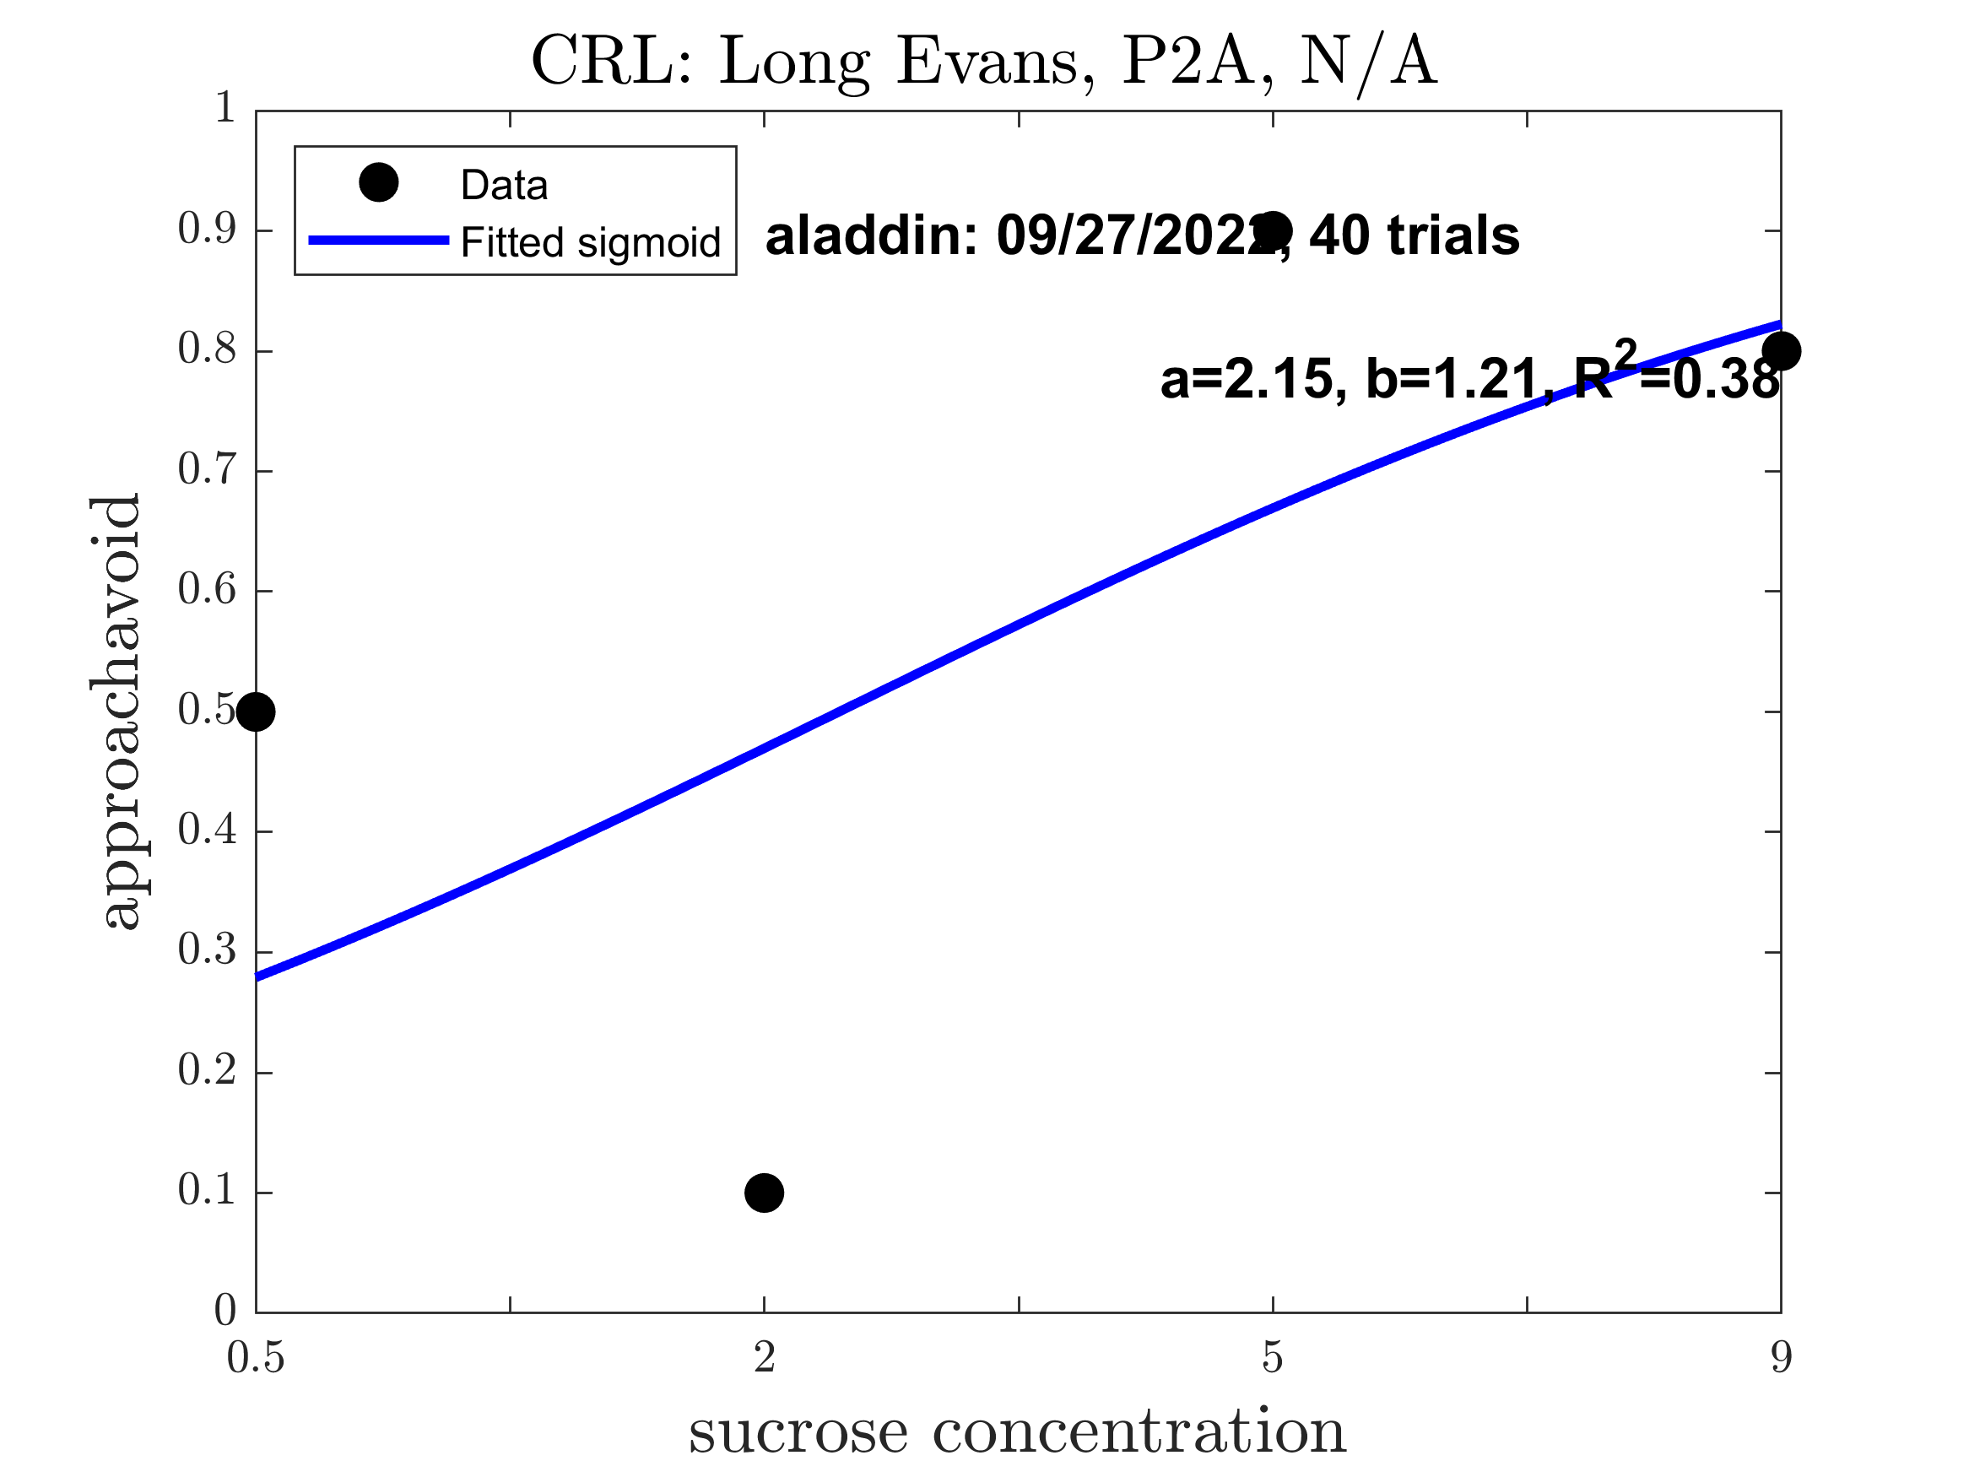
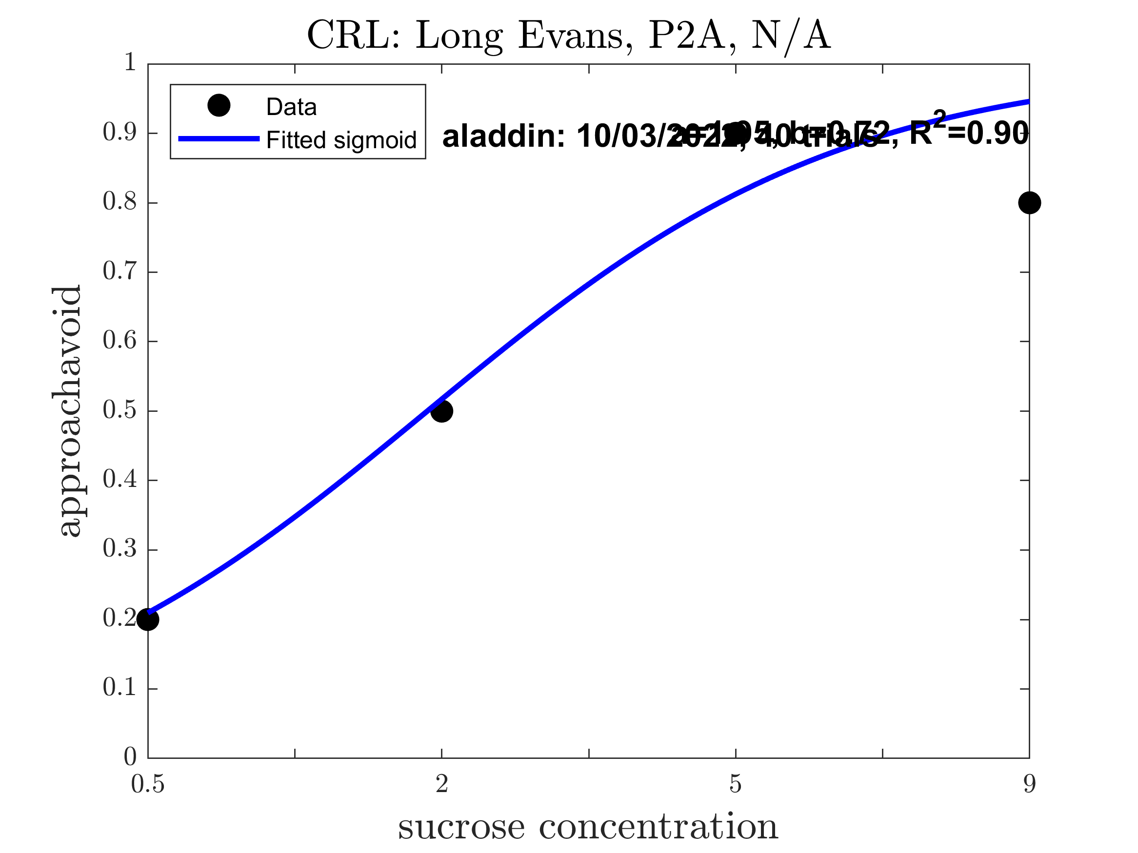
Aladdin: Pre alcohol (Good Sigmoid: 1.000)

Slide 9
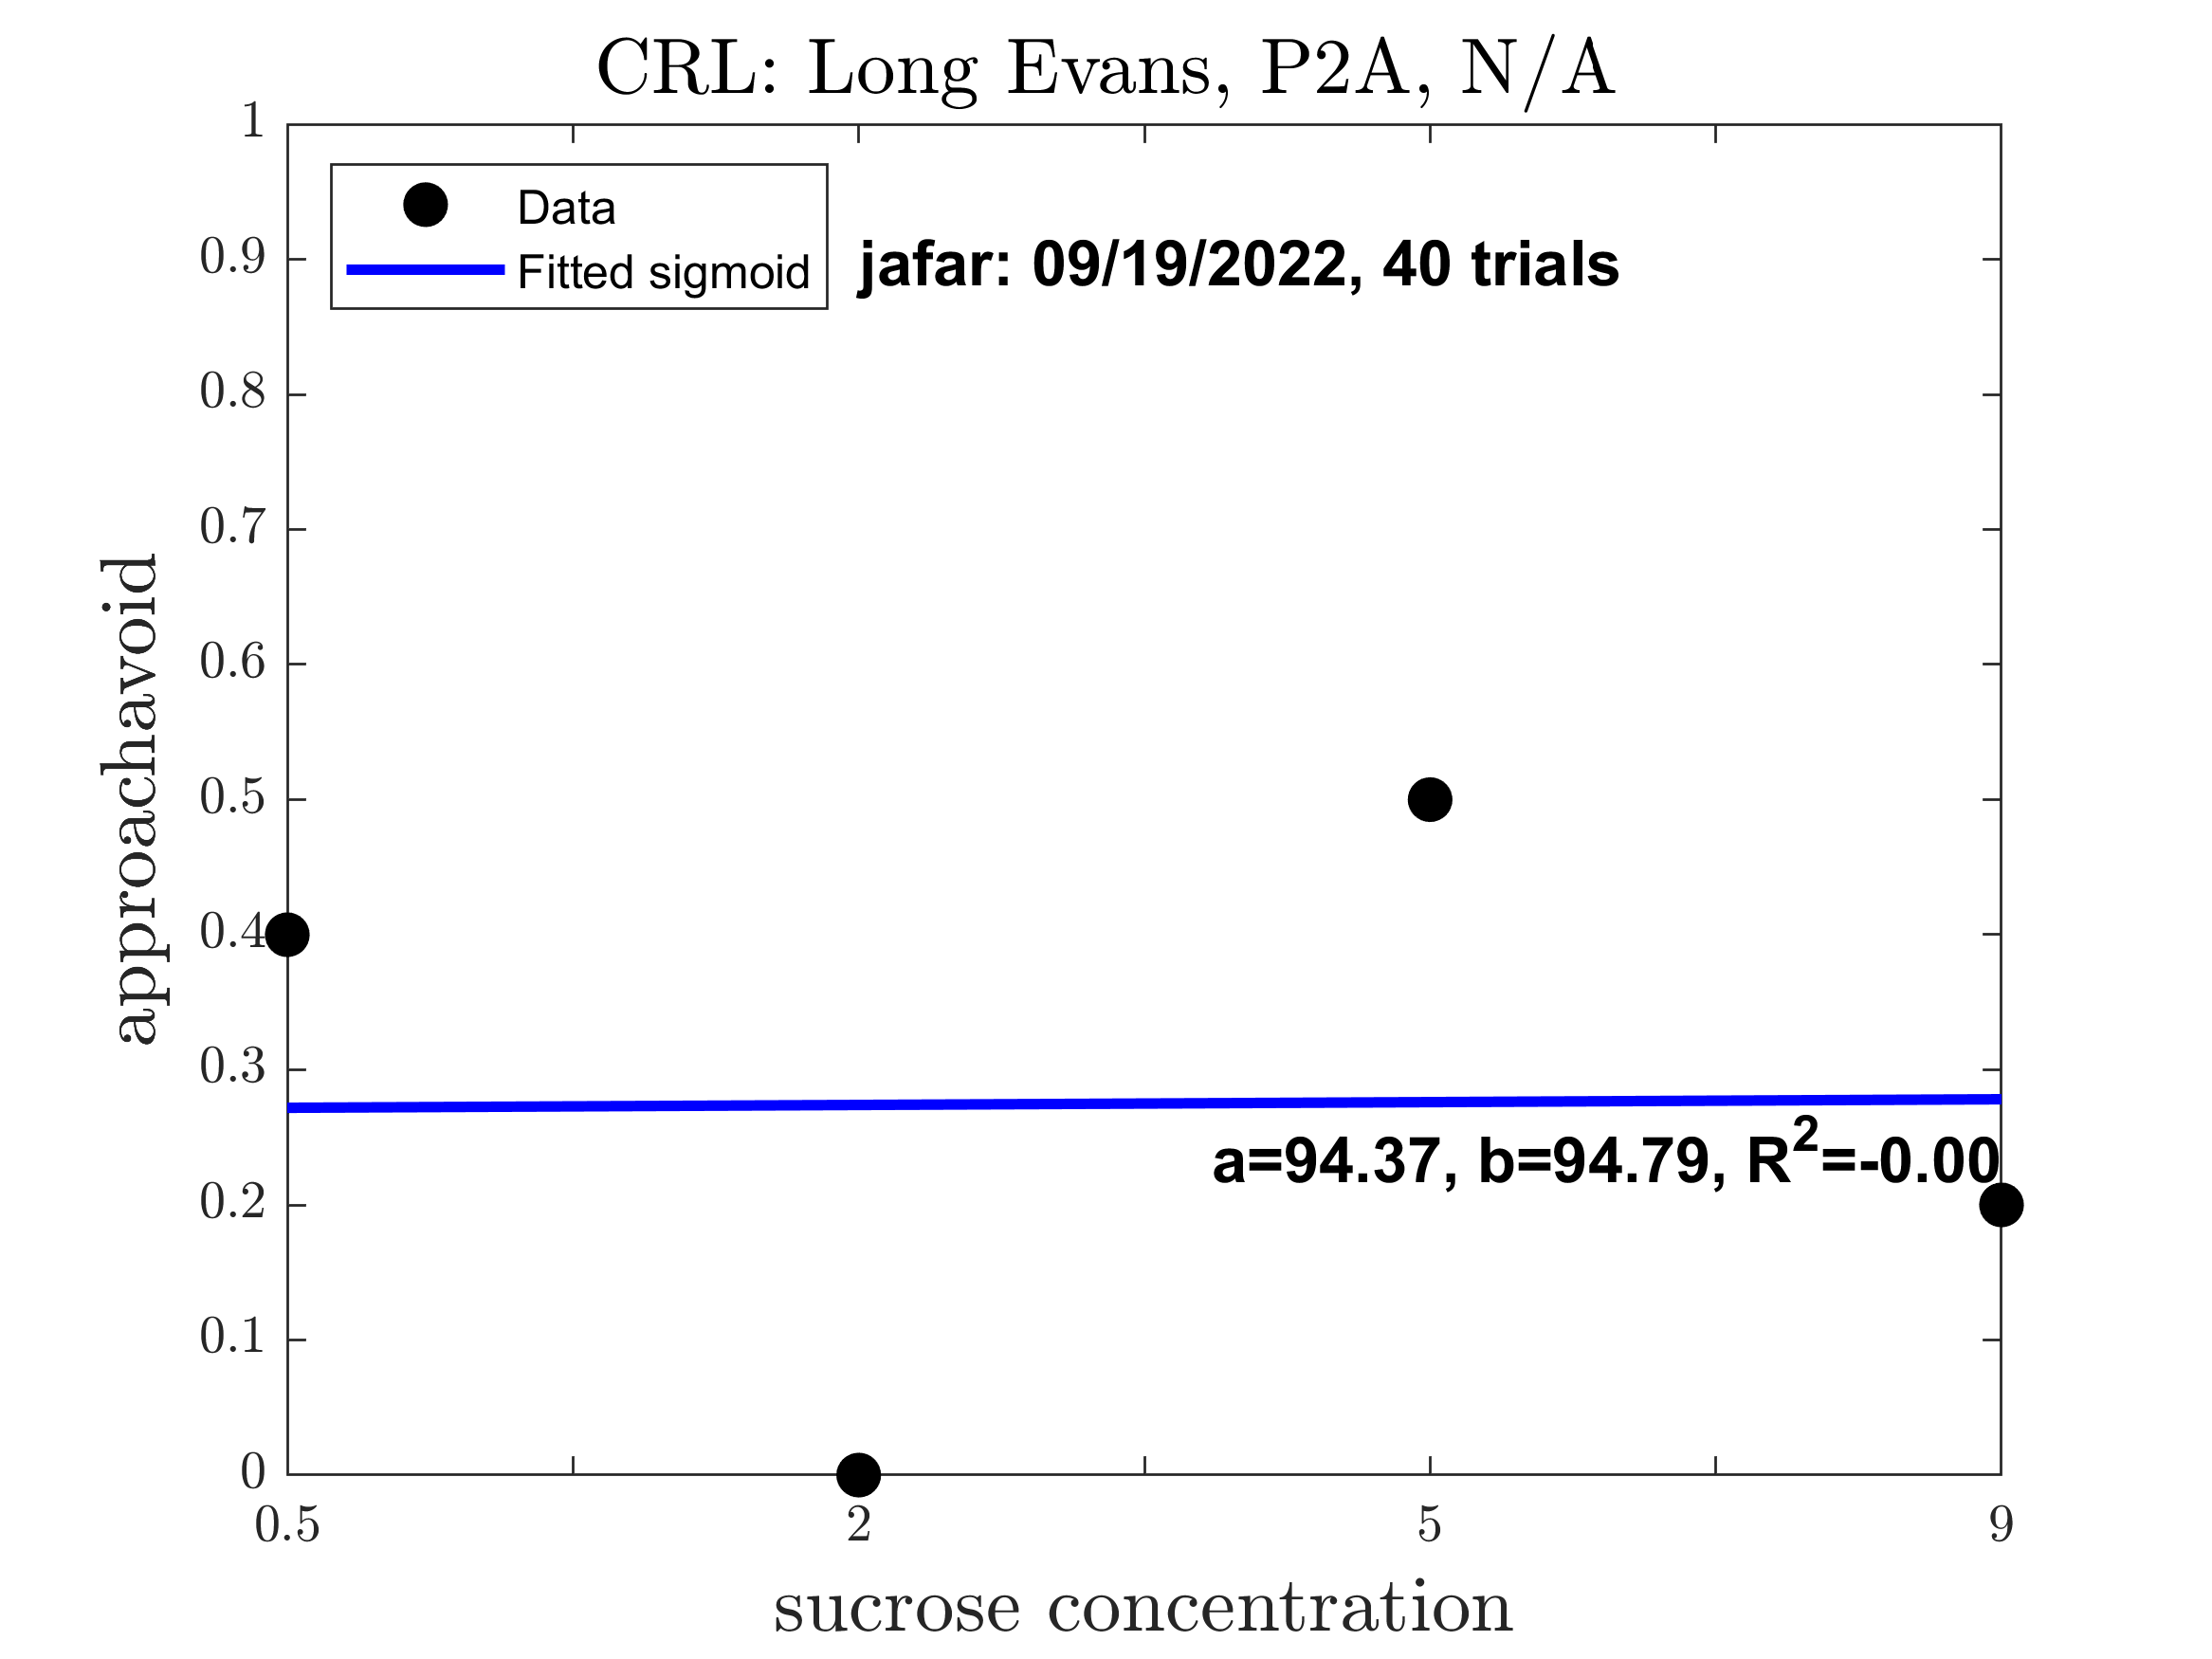
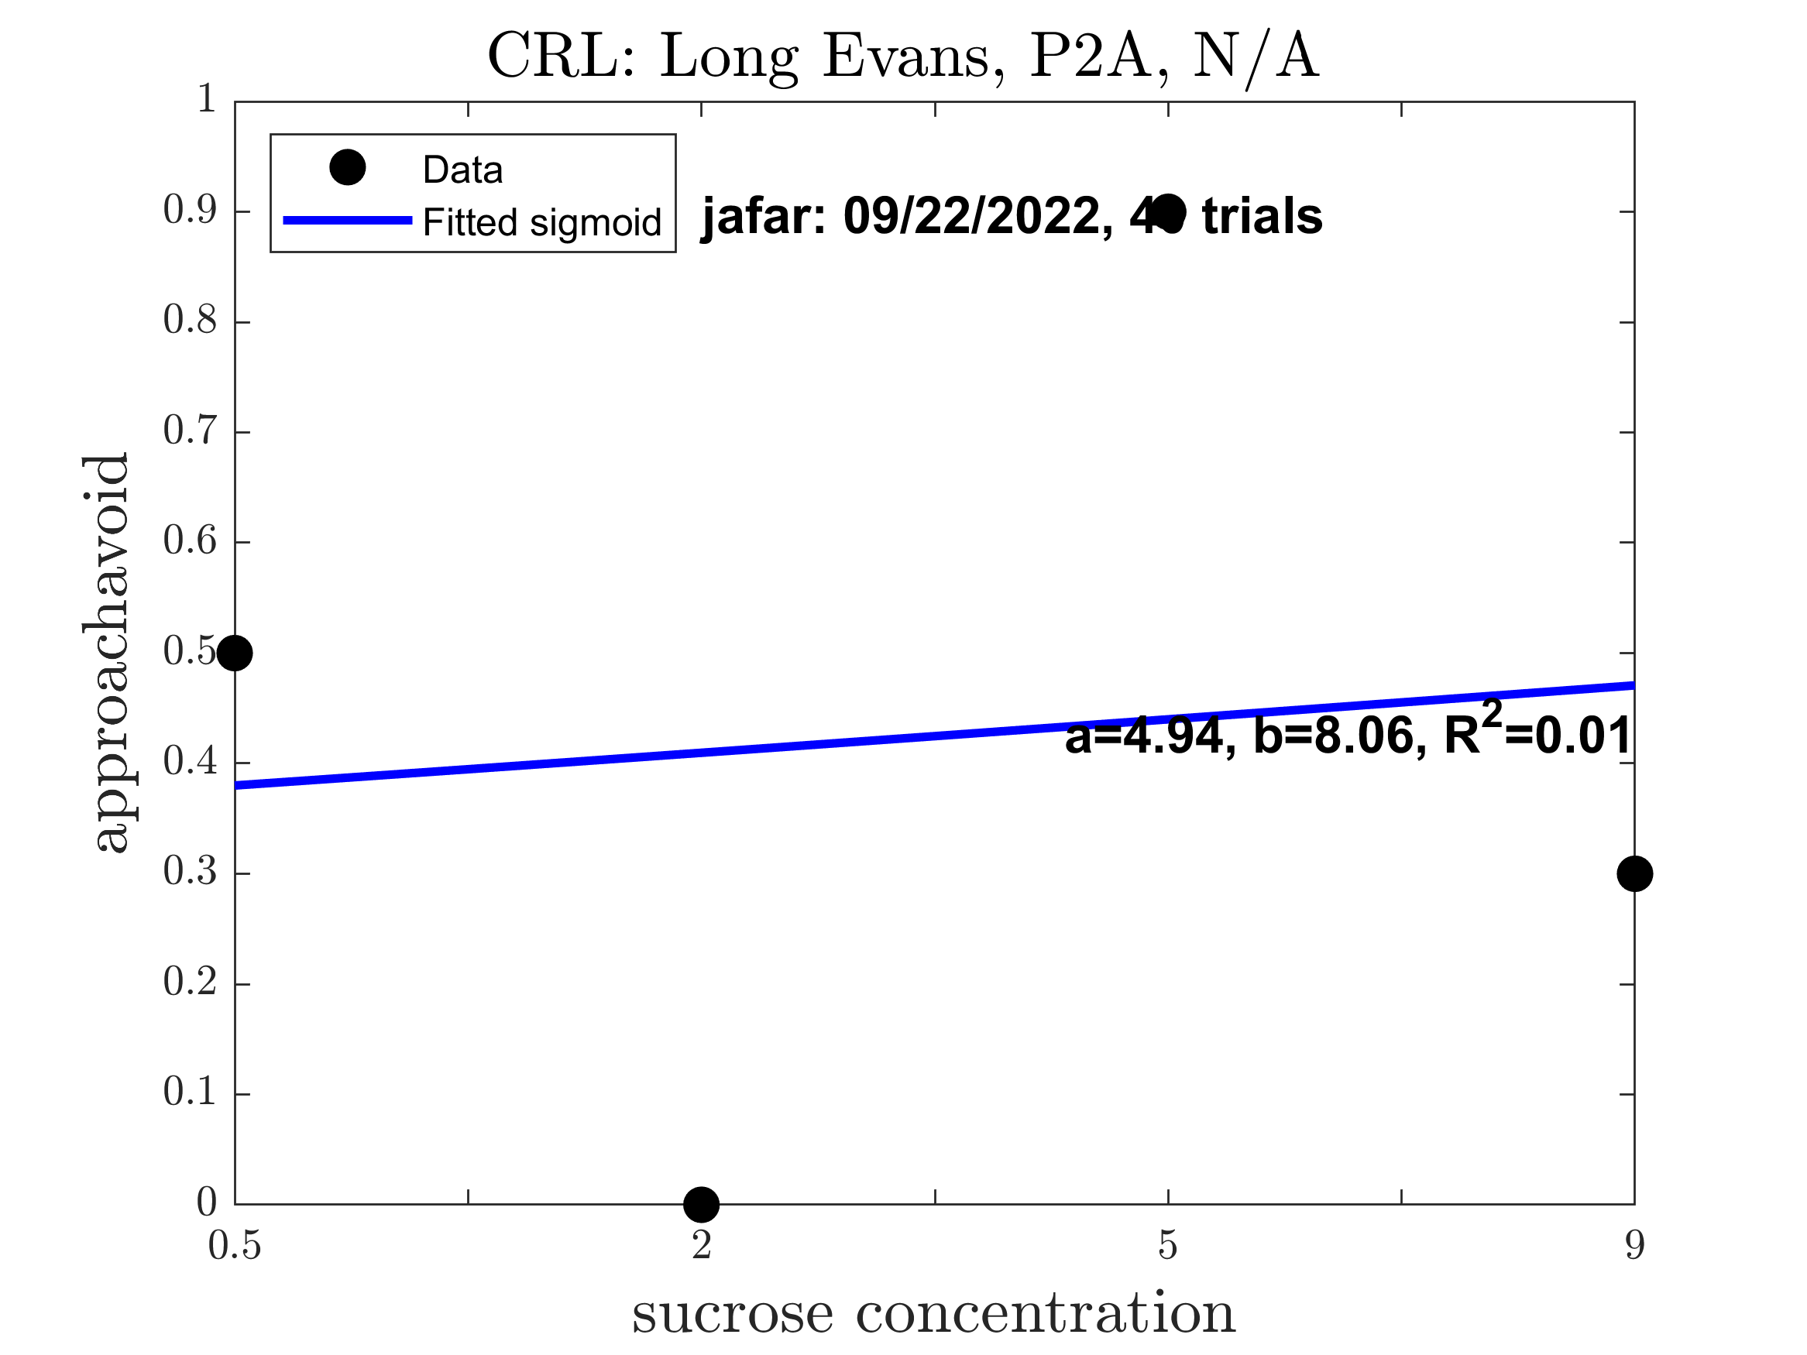
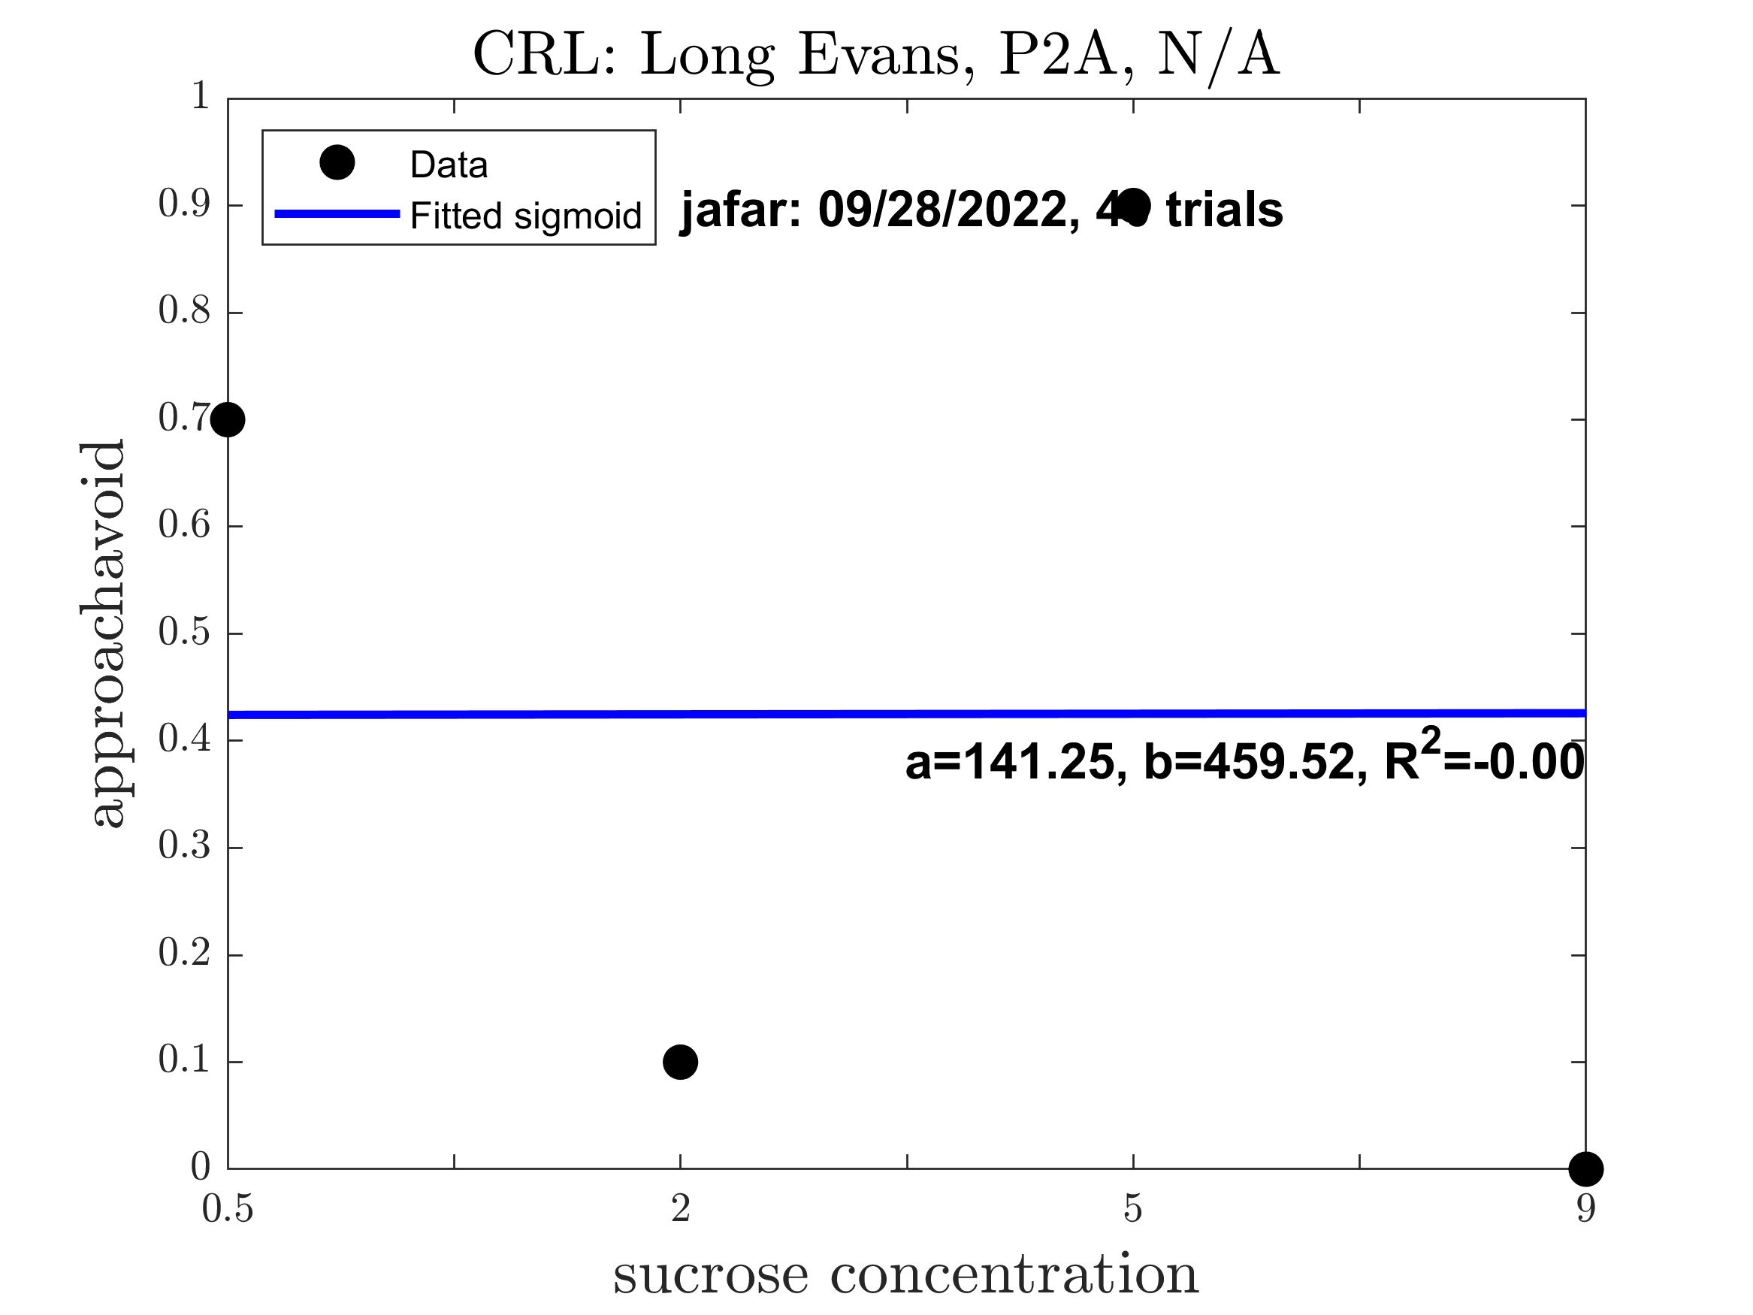
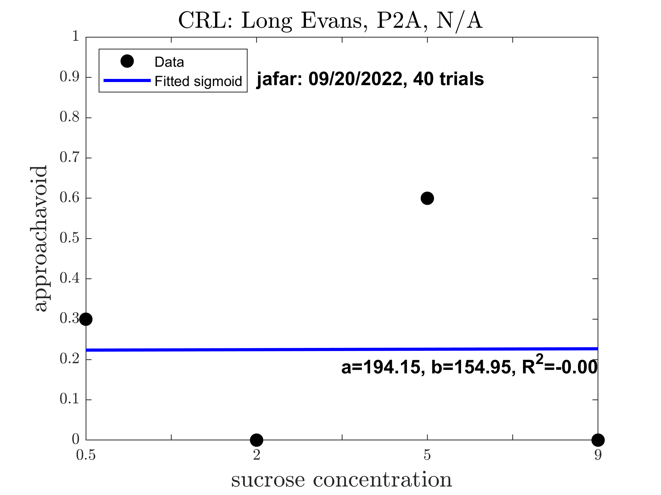





Jafar: Pre alcohol (Good Sigmoid: 0)

Slide 10










Jimi: Pre alcohol (Good Sigmoid: 0.2000)

Slide 11










Scar: Pre alcohol (Good Sigmoid: 0)

Slide 12










Simba: Pre alcohol (Good Sigmoid: 1)

Slide 14
Session Plots for Forced Alcohol
Checks for Vulnerable and Resilient

Slide 15







Fiona: Post alcohol (Good Sigmoid: 0.5714)

Slide 16







Juana: Post alcohol (Good Sigmoid: 1)

Slide 17









Kryssia: Post alcohol (Good Sigmoid: 0.8889)

Slide 18







Neftali: Post alcohol (Good Sigmoid: 0.8571)

Slide 19









Raven: Post alcohol (Good Sigmoid: 1)

Slide 20









Aladdin: Post alcohol (Good Sigmoid: 0.5556)

Slide 21









Jafar: Post alcohol (Good Sigmoid: 0.5556)

Slide 22





Jimi: Post alcohol (Good Sigmoid: 0.8000)

Slide 23








Scar: Post alcohol (Good Sigmoid: 0.7500)

Slide 24








Simba: Post alcohol (Good Sigmoid: 1)

Slide 26
Average Session Plots for Baseline and Forced Alcohol of Individual Animals
Checks for Vulnerable and Resilient

Slide 27





Before alcohol (approachavoid Female)

Slide 28





Before alcohol (approachavoid Male)

Slide 29





Post alcohol (approachavoid Female)

Slide 30





Post alcohol (approachavoid Male)

Slide 32
Session Plots for Boost Animals
Checks for Vulnerable and Resilient

Slide 33










Slide 34









Slide 35









Slide 36










Slide 37









Slide 39





Sex Difference After Alcohol: Last Session Data (approachavoid: baseline, boost, forced and together)
BA: Only lg_etoh animals

Slide 40





Sex Difference After Alcohol: Last Session Data (approach time: baseline, boost, forced and together)
BA: Only lg_etoh animals

Slide 41





Sex Difference After Alcohol: Last Session Data (passing through center: baseline, boost, forced and together)
BA: Only lg_etoh animals

Slide 42





Sex Difference After Alcohol: Last Session Data (Distance Travelled: baseline, boost, forced and together)
BA: Only lg_etoh animals

Slide 43





Sex Difference After Alcohol: Last Session Data (Acceleration Outlier: baseline, boost, forced and together)
BA: Only lg_etoh animals

Slide 44





Sex Difference After Alcohol: Last Session Data (Stopping Points: baseline, boost, forced and together)
BA: Only lg_etoh animals

Slide 45





Sex Difference After Alcohol: Last Session Data (Rotation Points: baseline, boost, forced and together)
BA: Only lg_etoh animals

Slide 47
Group Plot of Features (Failed)
Checks for clusters for health/gender groups

Slide 48








Before and After Alcohol Features: With Same Subjectid and Equal Number of Session

Slide 49







Slide 50





Slide 51





Slide 52





Slide 54





Significant reduction of alcohol approach rate especially for Female

